Slide 1
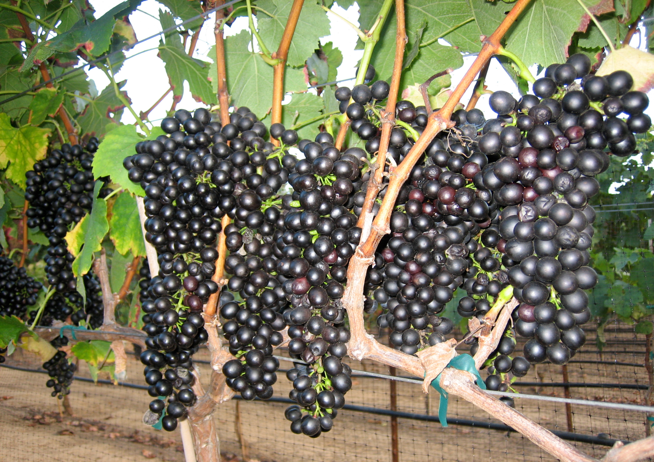
Syrah

Slide 2
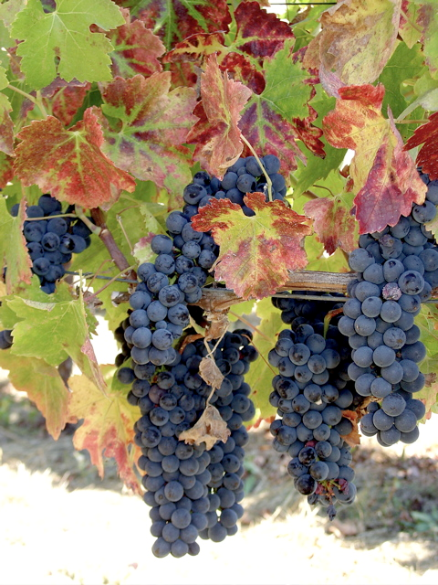
Syrah or Shiraz is a dark-skinned grape grown throughout the world and used primarily to produce powerful red wines. Whether sold as Syrah or Shiraz, these wines enjoy great popularity.

Slide 3
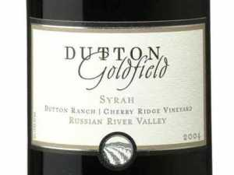
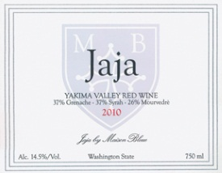
Syrah/Shiraz is used as a varietal and is also blended.

Slide 4
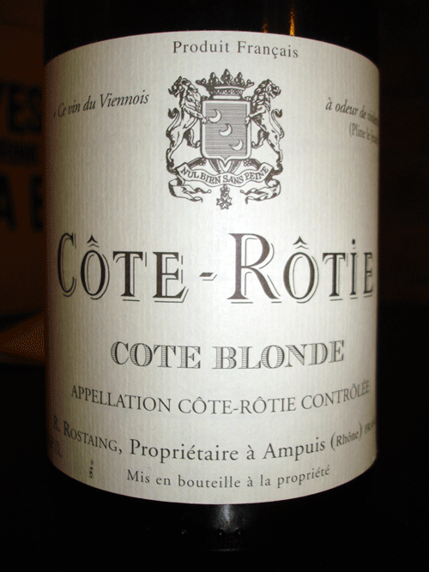
It is called Syrah in its country of origin, France, as well as in the rest of Europe, Argentina, Chile, Uruguay, New Zealand and most of the United States.

Slide 5
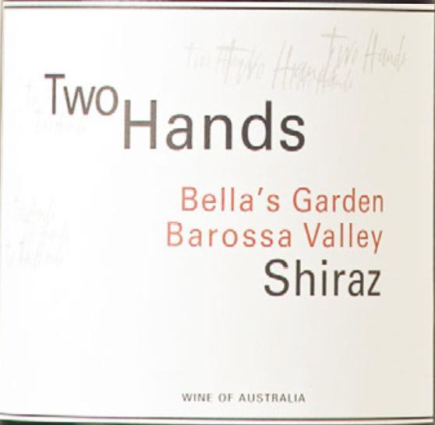
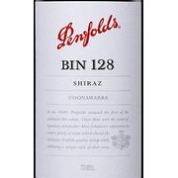
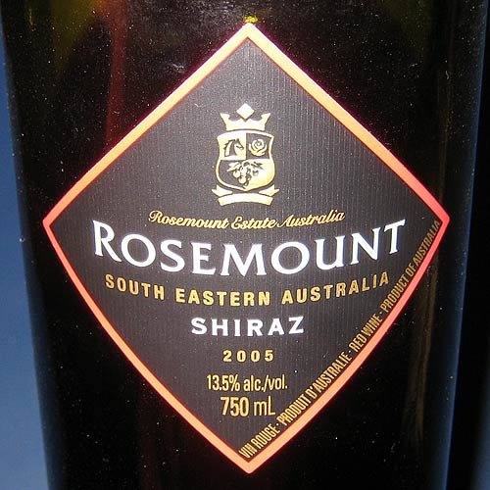
The name Shiraz became popular for this grape variety in Australia, where it has long been established as the most grown dark-skinned variety

Slide 6
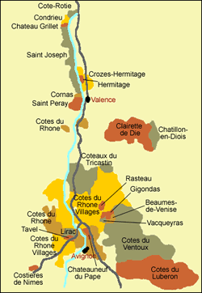
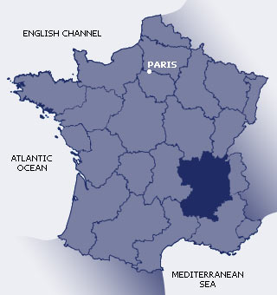
Syrah, as it is known in France, is grown throughout the Rhône valley.

Slide 7
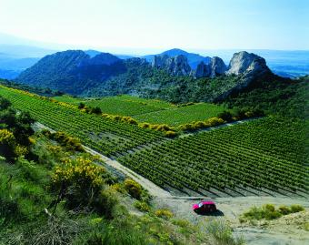
The wines that are made from it vary greatly, even over small changes in the vines locations. The differences in the soil quality as well as the changes in the slope of the terrain tend to produce different styles of wine.

Slide 8
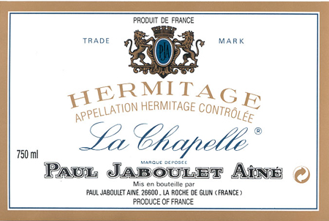
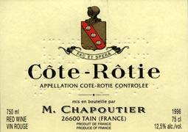
Ranging from the mineral and tannic nature of Hermitage, to fruity and perfumed in the case of Côte- Rôtie

Slide 9
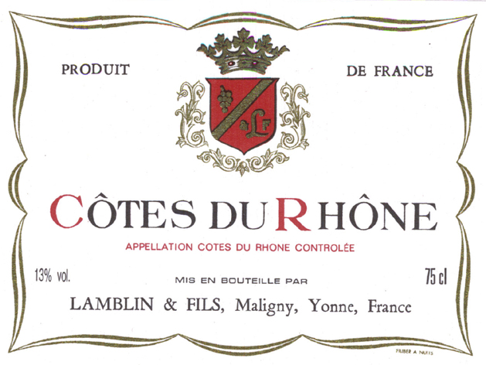
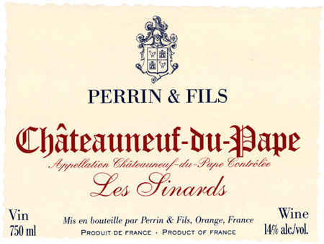
Syrah is also a key component to many blends. It may be used to add structure and color to Grenache in southern Rhône blends, including Côtes-du-Rhône and Châteauneuf-du- Pape.

Slide 10
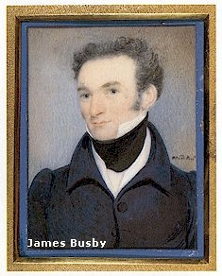
The Syrah grape was introduced into Australia in 1832 by James Busby, an immigrant who brought vine clippings from Europe with him, and it is almost invariably called Shiraz

Slide 11
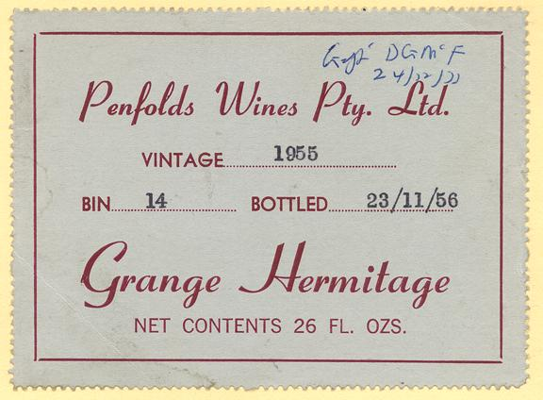
A well-known example of the Shiraz grape in Australian viticulture is the Penfolds "Grange". This wine was created by winemaker Max Schubert in 1951, and has a reputation of aging well.

Slide 12
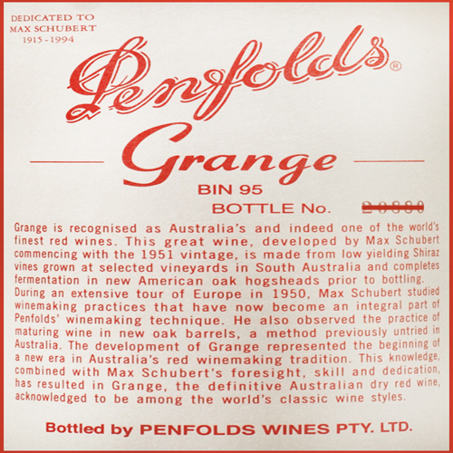
The Penfolds Grange is predominantly Shiraz, but often includes a small quantity of Cabernet Sauvignon. It is usually a multi-regional blend of quality South Australian Shiraz, with the Barossa Valley playing an important role, and matured in new American Oak.

Slide 13
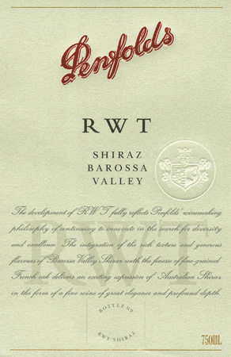
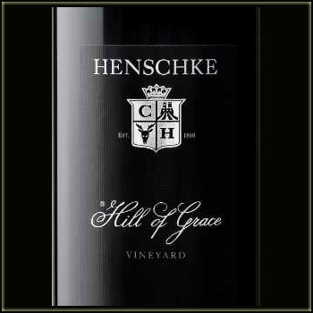
Other well-known Australian Shiraz wines include, the Henschke "Hill of Grace" and the Penfolds "RWT".

Slide 14
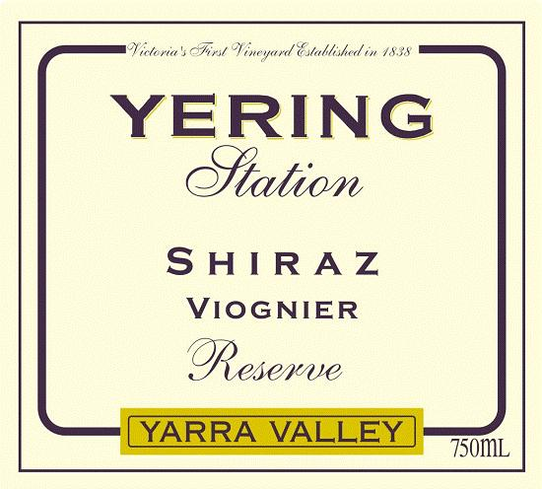
Recently, Australian Shiraz producers have started to add up to 4% Viognier to their Shiraz to add apricot tones to the wine's nose and palate

Slide 15
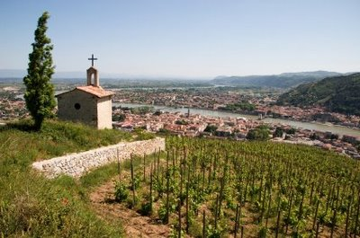
The practice of blending Viognier with Syrah has actually been common for years in the Northern Rhône Valley region of Cote-Rotie

Slide 16
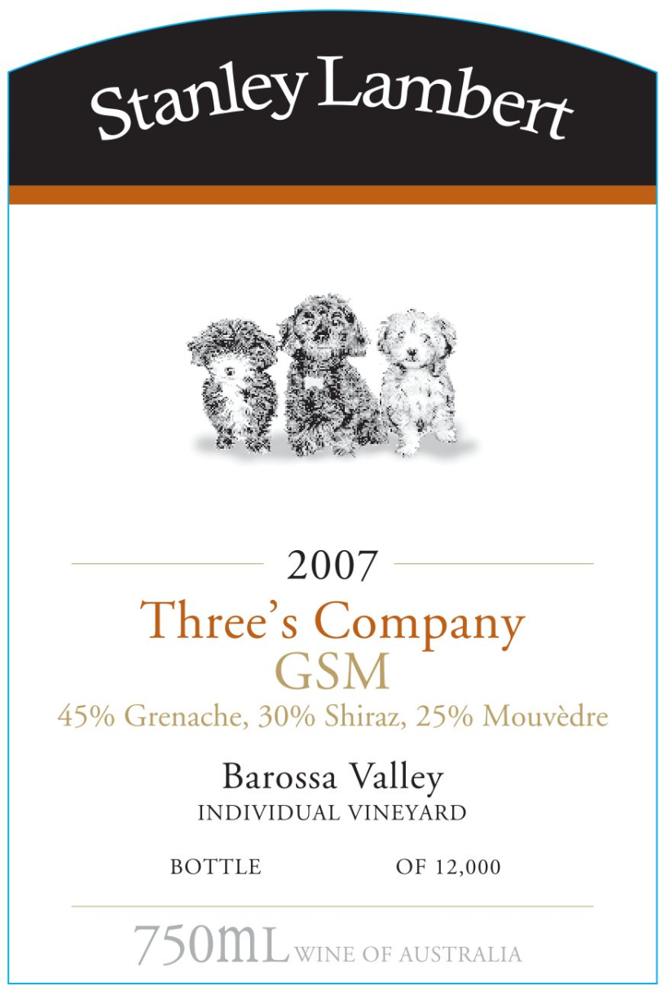
Shiraz is also the "S" in "GSM" (Grenache-Shiraz- Mourvèdre), which is common Australian designation for a Châteneuf-du- Pape -like blend.

Slide 17
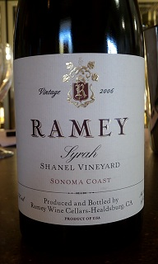
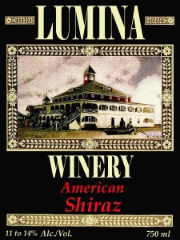
In the United States, wine produced from the grape is normally called by its French name, Syrah.
However, in cases where winemakers choose to follow a New World style, similar to Penfolds Grange, they may choose to label their wines as Shiraz

Slide 18
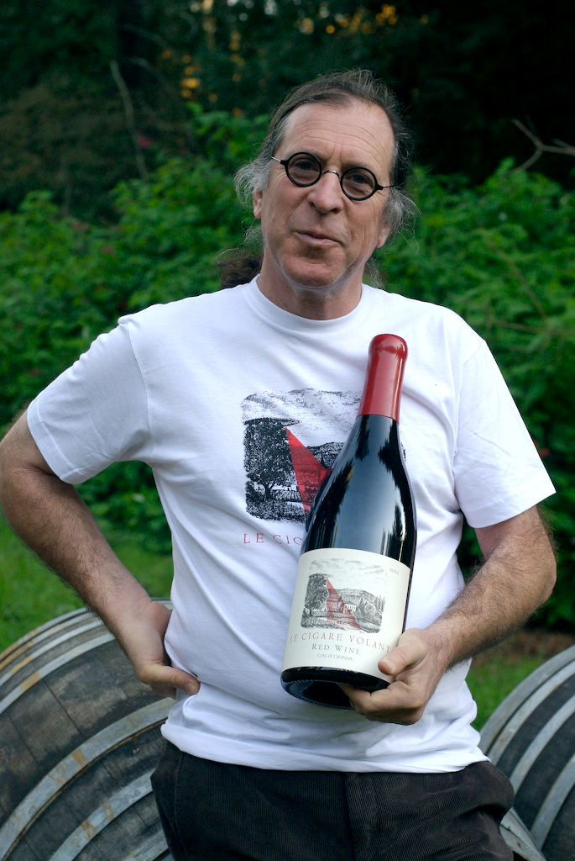
Syrah first appeared as a wine grape in California in the 1970s, where it was planted by a group of viticulturists who called themselves "Rhône rangers”

Slide 19
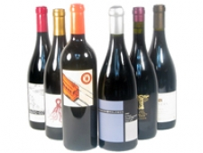
California Syrahs, much like those in France, vary a great deal based on the climate and terroir that they inhabit. In exceptionally warm regions, such as parts of Napa, the wine is often blended with other Rhône varieties

Slide 20
Although most plantings of the grape are in California, there are increasing amounts of it being grown in Washington state. Syrah makes up a significant percentage of wine produced in several Washington AVA's such as the Naches Heights AVA and the Walla Walla AVA.

Slide 21
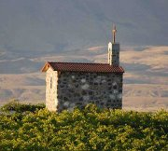
Syrah was introduced into Washington state in 1986 by Red Willow Vineyard through their partnership with Woodinville, Washington based Columbia Winery and Master of Wine David Lake

Slide 22
Swirl and taste: Dark fruit (blackberries, blueberries, and cherries), black olives, and herbs against a backdrop of earthy leather, tobacco, and meaty bacon, laced with black pepper.

Slide 23
Pair with:
• Lamb
• Sausages
• Grilled meats of all kinds
• Roast pork
• Barbecue
• Stews
• Game―venison, squab
• Black olives
• Dishes with lots of black pepper
• Dishes with pungent herbs

