Slide 1
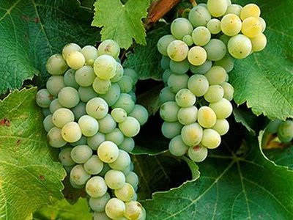
Sauvignon Blanc

Slide 2
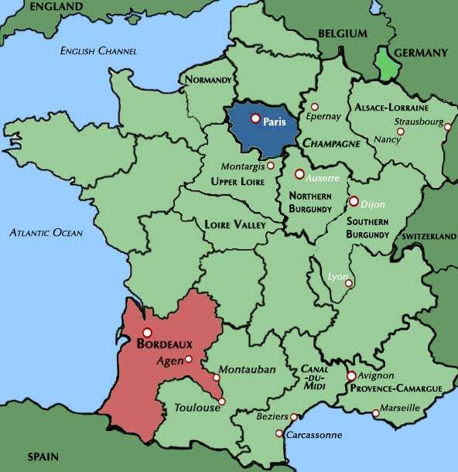
Sauvignon Blanc is a green-skinned grape variety which originates from the Bordeaux region of France. The grape most likely gets its name from the French word sauvage ("wild") and blanc ("white") due to its early origins as an indigenous grape in South West France

Slide 3
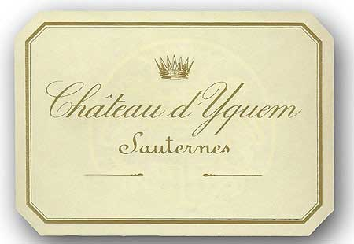
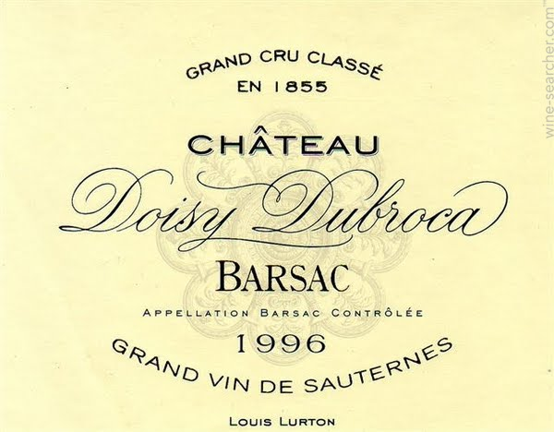
Sauvignon blanc is planted in many of the world's wine regions, producing a crisp, dry, and refreshing white varietal wine. The grape is also a component of the famous dessert wines from Sauternes and Barsac.

Slide 4
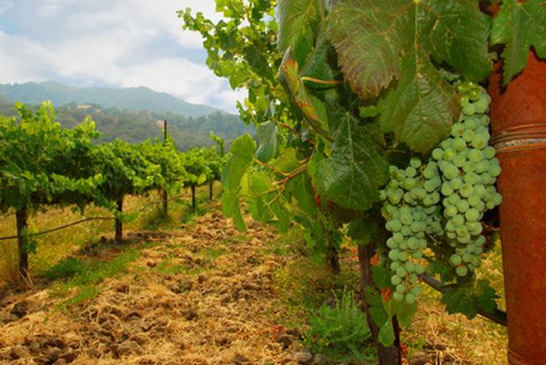
The Sauvignon Blanc vine often buds late but ripens early, which allows it to perform well in sunny climates when not exposed to overwhelming heat. In warm regions such as South Africa, Australia and California, the grape flourishes in cooler climate appellations such as the Alexander Valley area.

Slide 5
In areas where the vine is subjected to high heat, the grape will quickly become over-ripe and produce wines with dull flavors and flat acidity. Global warming has had an effect on the Sauvignon Blanc grape, with the rising global temperatures causing farmers to harvest the grapes earlier than they have in the past.

Slide 6
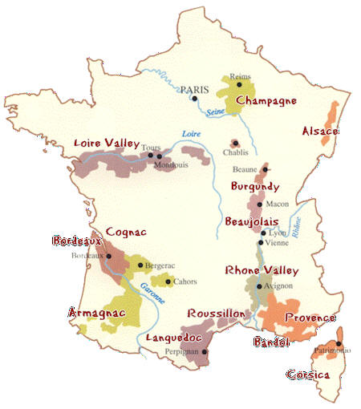
France
In France, Sauvignon Blanc is grown in the maritime climate of Bordeaux (especially in Entre-Deux-Mers, Graves and Pessac-Leognan as a dry wine, and in Sauternes as a sweet wine) as well as the continental climate of the Loire Valley (as Pouilly Fumé, Sancerre, and Sauvignon de Touraine).

Slide 7
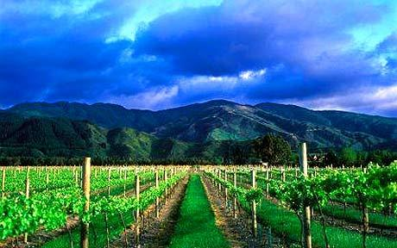
The climates of these areas are particularly favorable in slowing the ripening on the vine, allowing the grape more time to develop a balance between its acidity and sugar levels. This balance is important in the development of the intensity of the wine's aromas.

Slide 8
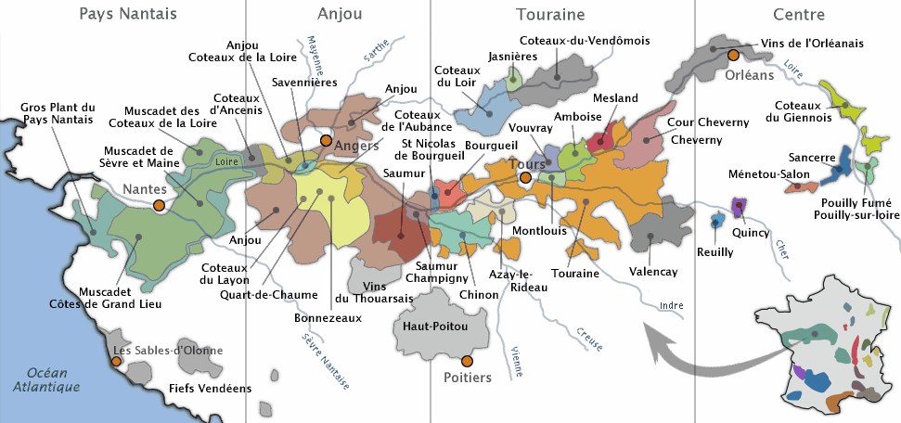
The chalky soil of Sancerre and Pouilly Fume produces wines of richness and complexity

Slide 9
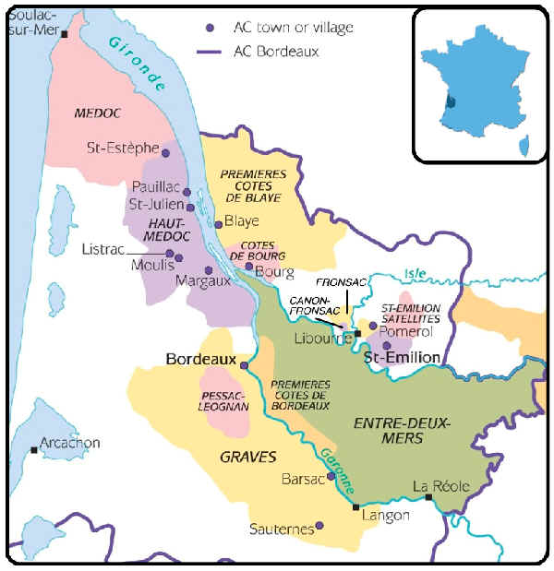
The gravel soil found near the Loire River and its tributaries impart spicy, floral and mineral flavors while in Bordeaux, the wines have a fruitier personality.

Slide 10
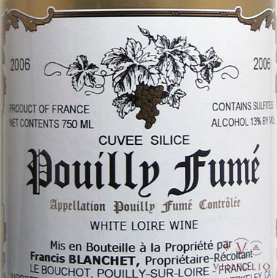
Pouilly Fumé originates from the town of Pouilly-sur-Loire, located directly across the Loire River from the commune of Sancerre. The soil here is very flinty with deposits of limestone which the locals believed imparted a smoky, gun flint flavor to the wine and hence Fumé, the French word for "smoke" was attached to the wine

Slide 11
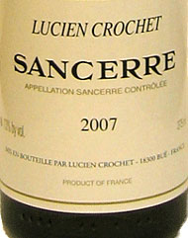
The focus of Sancerre winemakers is usually to express the pure fruit flavors of Sauvignon blanc and the natural terroir of the region with very little adjustments taking place during winemaking. Most Sancerre is produced without malolactic fermentation and little oak influences.

Slide 12
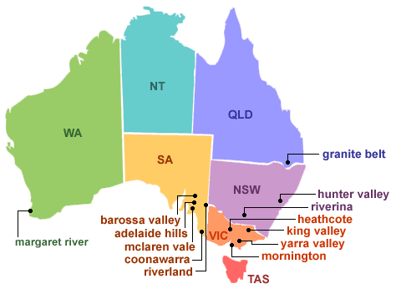
Australia
The Sauvignon Blanc grape from Adelaide Hills has a style distinctive from it’s New Zealand neighbor that tends to be more ripe in flavor with white peach and lime notes and slightly higher acidity.

Slide 13
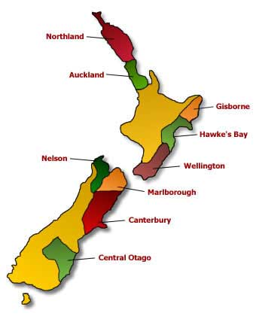
New Zealand
In the 1990s, Sauvignon Blanc wines from the maritime climatic regions of New Zealand, particularly the South Island, became popular on the wine market.

Slide 14
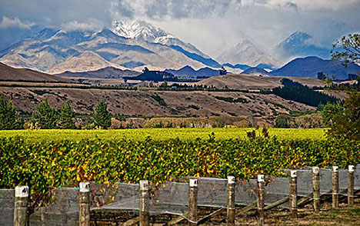
In the Marlborough regions sandy soils over slate has become the most desirable locations for plantings due to the good drainage of the soil and poor fertility that encourages the vine to concentrate its flavors in lower yields.

Slide 15
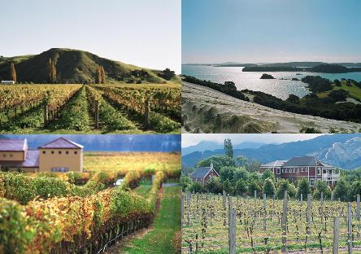
It is this difference in soils, and the types of harvest time decisions that wine producers must make, that add a unique element to New Zealand Sauvignon Blanc.

Slide 16
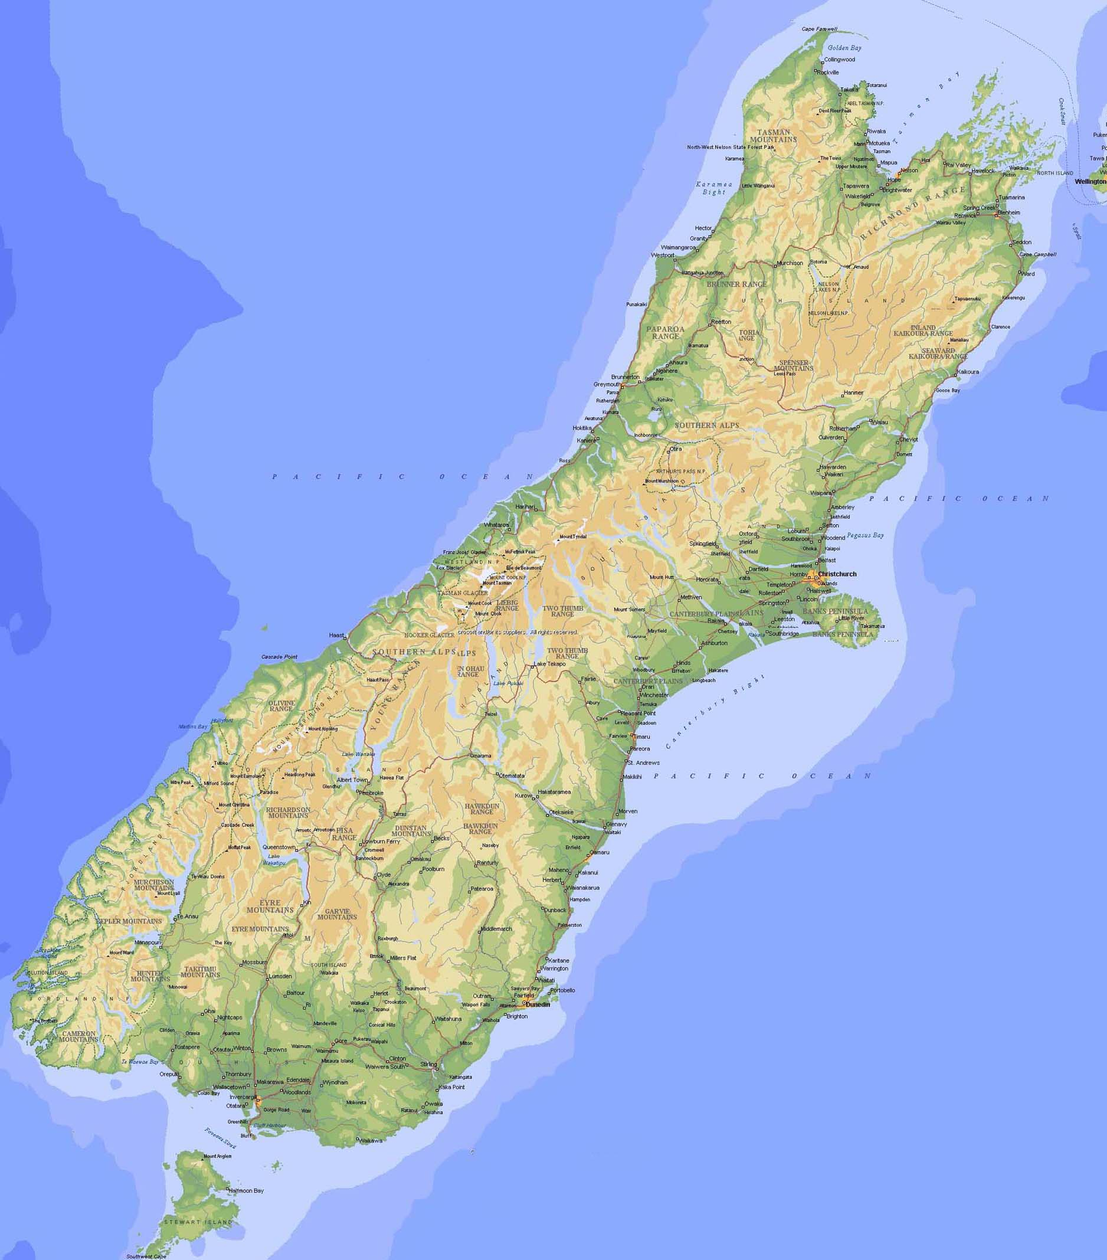
The long narrow geography of the South Island ensures that no vineyard is more than 80 miles from the coast. The cool, maritime climate of the area allows for a long and steady growing season in which the grapes can ripen and develop a natural balance of acids and sugars.

Slide 17
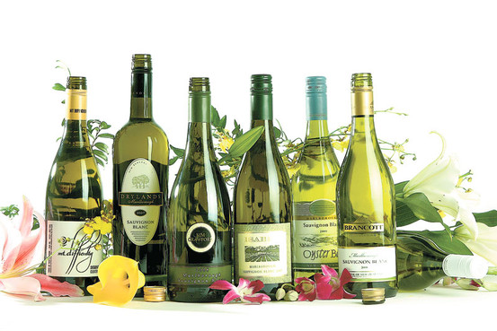
This brings out the flavors and intensity that New Zealand Sauvignon Blancs are noted for

Slide 18
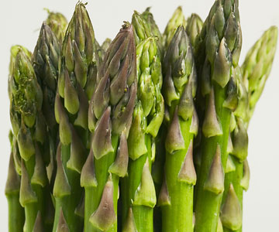
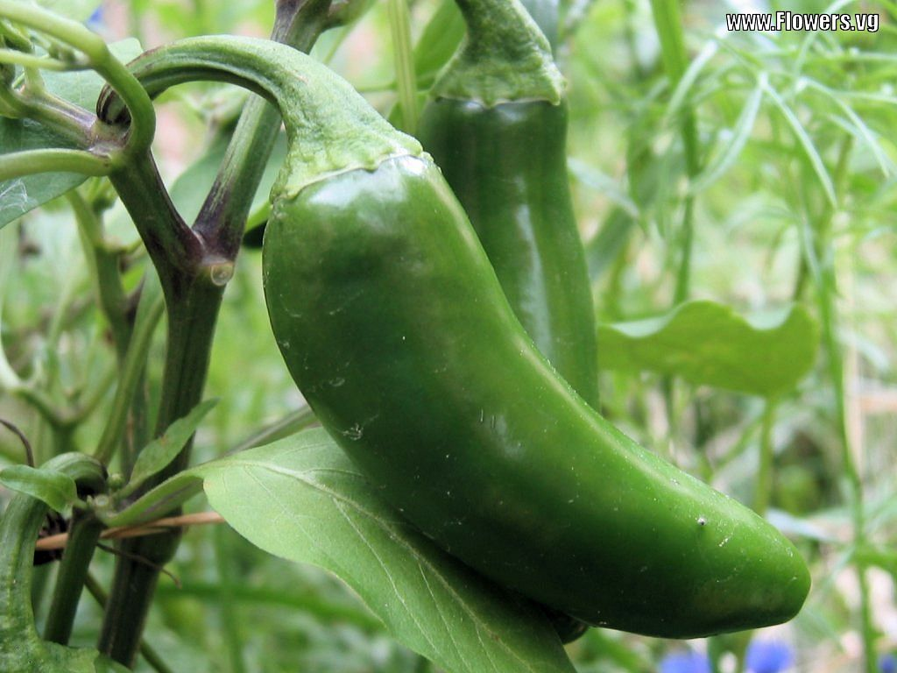
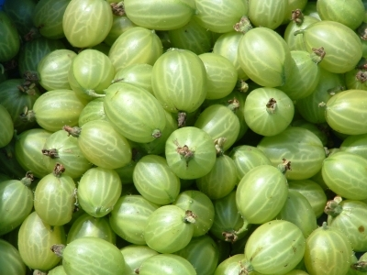
Asparagus, gooseberry, jalapeno and green grass flavor is commonly associated with New Zealand Sauvignon Blanc

Slide 19
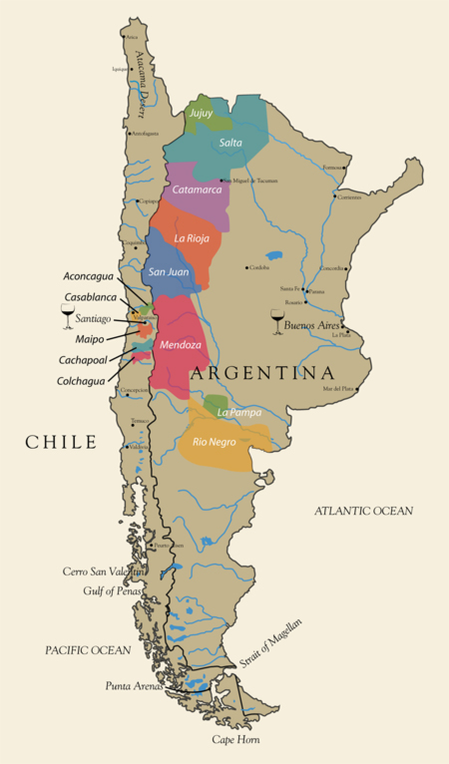
Chile
The character of non-blended Chilean Sauvignon Blancs are noticeably less acidic than the wines of New Zealand and more similar to the French style that is typical of Chilean wines

Slide 20
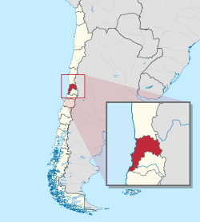
The region of Valparaíso is the most notable area for Sauvignon Blanc in Chile due to its cooler climate which allows the grapes to be picked up to six weeks later than in other parts of Chile.

Slide 21
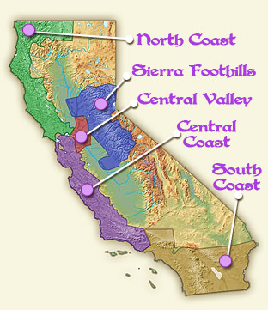
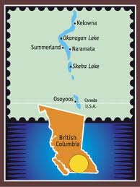
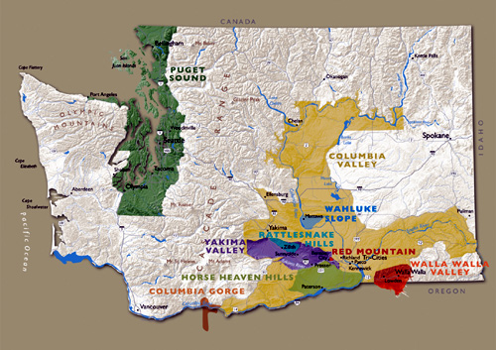
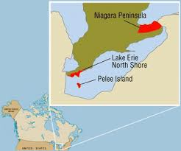
North America
In North America, California is the leading producer of Sauvignon Blanc with plantings also found in Washington State and on the Niagara Peninsula and Okanagan Valley in Canada.

Slide 22
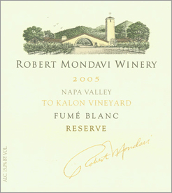
In California wine produced from the Sauvignon Blanc grape is also known as Fumé Blanc. This California wine was first made by Napa Valley's Robert Mondavi Winery in 1968

Slide 23
Mondavi had been offered a crop of particularly good Sauvignon Blanc grapes by a grower. At that time the variety had a poor reputation in California due to its grassy flavor and aggressive aromas. Mondavi decided to try to tame that aggressiveness with barrel aging and released the wine under the name Fumé Blanc as an allusion to the French Pouilly-Fumé

Slide 24
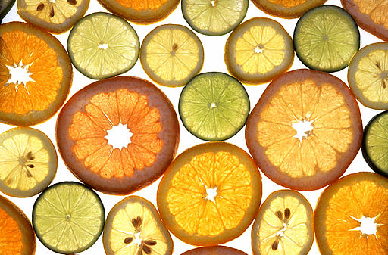
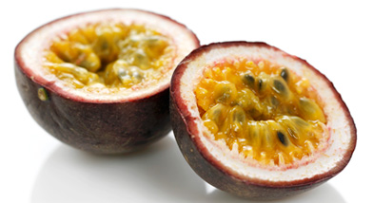
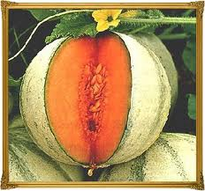
California Sauvignon Blancs tend to fall into two styles. The New Zealand influenced-Sauvignon Blanc have more tropical fruit undertones with citrus and passion fruit notes. The Mondavi influenced Fumé Blanc are more round with melon notes

Slide 25
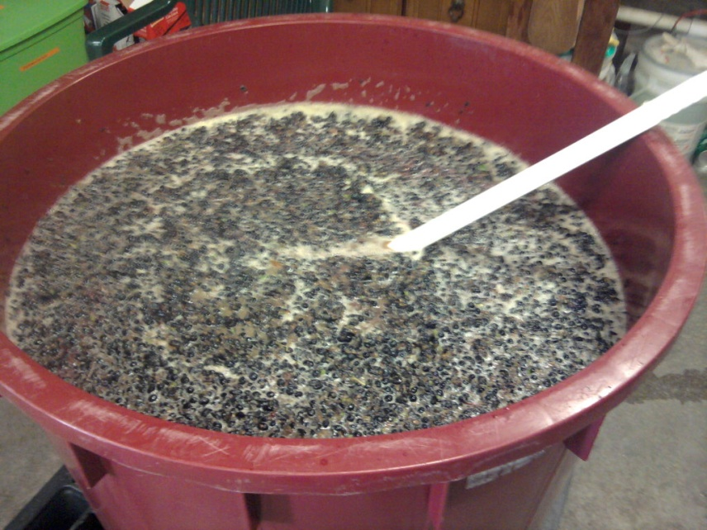
Viticulture
Sauvignon Blanc can be greatly influenced by decisions in the winemaking process. One decision is the amount of contact that the must has with the skins of the grape.

Slide 26
In the early years of the New Zealand wine industry, there were no wineries on the South Island which meant that freshly harvested grapes had to be trucked and then ferried to the North Island, often all the way up to Auckland. This allowed for prolonged exposure of the skins and juice which sharpened the intensity and pungency of the wine.

Slide 27
Some winemakers, like the Loire, intentionally leave a small amount of must to spend some time in contact with the skin for later blending purposes. Other winemakers, like in California, generally avoid any contact with the skin due to the reduced aging ability of the resulting wine.

Slide 28
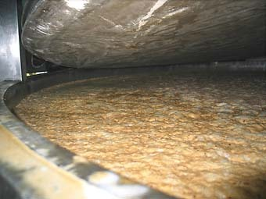
Another important decision is the temperature of fermentation.

Slide 29
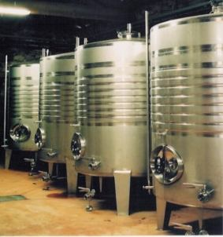
French winemakers prefer warmer fermentations (around 16-18 °C) that bring out the mineral flavors in the wine while New World winemakers prefer slightly colder temperatures to bring out more fruit and tropical flavors.

Slide 30
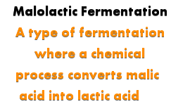
A small minority of Loire winemakers will put the wine through malolactic fermentation, a practice more often associated with New Zealand wines

Slide 31
Oak aging can have a pronounced effect on the wine, with the oak rounding out the flavors and softening the naturally high acidity of the grape. Some winemakers, like those in New Zealand and Sancerre, prefer stainless steel fermentation tanks over barrels with the intention of maintaining the sharp focus and flavor intensity

Slide 32
Sauvignon Blanc is also known under the synonyms Beyaz Sauvignon, Blanc Doux, Blanc Fume, Bordeaux Bianco, Douce Blanche, Feher Sauvignon, Feigentraube, Fie, Fie dans le Neuvillois, Fume, Fume Blanc, Fume Surin,

Slide 33
Genetin, Gennetin, Gentin a Romorantin, Gros Sauvignon, Libournais, Melkii Sotern, Muskat Silvaner, Muskat Sylvaner, Muskatani Silvanec, Muskatni Silvanec, Muskatsilvaner, Painechon, Pellegrina, Petit Sauvignon, Picabon, Piccabon, Pinot Mestny Bely, Pissotta, Puinechou, Punechon, Punechou,

Slide 34
Quinechon, Rouchelin, Sampelgrina, Sarvonien, Sauternes, Sauvignon, Sauvignon Bianco, Sauvignon Bijeli, Sauvignon Blanco, Sauvignon Fume, Sauvignon Gros, Sauvignon Jaune, Sauvignon Jeune, Sauvignon Petit,

Slide 35
Sauvignon Vert, Sauvignon White, Savagnin, Savagnin Blanc, Savagnin Musque, Savagnou, Savignon, Servanien, Servonien, Servoyen, Souternes, Sovinak, Sovinjon, Sovinjon Beli, Sovinon, Spergolina, Surin, Sylvaner Musque, Uva Pelegrina, Weisser Sauvignon, and Zöld Ortlibi

