Slide 1
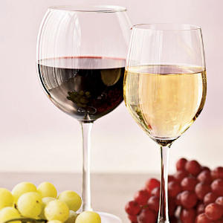
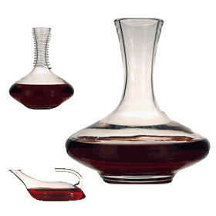
Introduction to Wine CUL 120
Notes:
Assess wine knowledge of class
Who I am
Why wine as part of curriculum?
Provide understanding for the importance of wine as part of
curriculum and culinary career.
Enhance Image
Enhance Food
Profit center
Start with Grape Growing & Winemaking. Knowledge will
provide the foundation for understanding why wines look, smell and taste
the way they do. So when you ask for a barrel fermented Chardonnay
From Ca, you’re going to be pretty sure …describe taste.

Slide 2
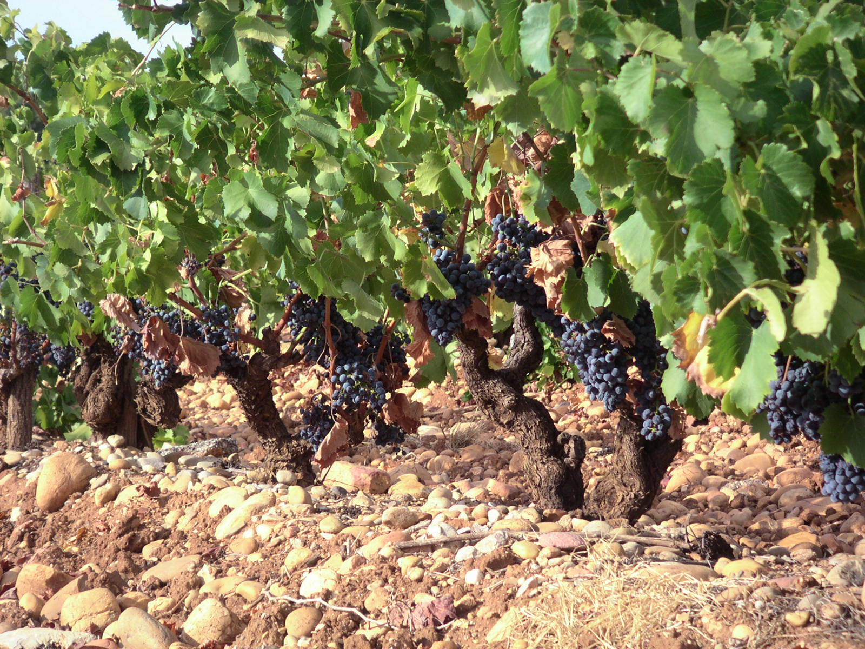
Growing Grapes
Notes:
Sunlight and heat to ripen grapes
Water to feed the vine
Soil to anchor the roots and provide nutrients
Sunlight ripen grapes
Minimum about 1300 hours during the growing season
Wa has about 3000! (17.4 x 200 days)
April to October
Photosythesis— process by which chlorophyl in the leaves uses the
energy of the sun to convert water in plant, w/ atmospheric carbon dioxide
to create sugars/nutrients for the plant
Heat is necessary, too or we’d be growing grapes in Alaska!
Sunlight gives us sugar, and heat helps to develop flavors
Coolest spot that successfully grows grapes is Rheingau w/
1790 hsu
Wa growing region has 3000+ HSU
Water – on avg, vine needs 20+ inches to grow..rain, aquafirs, irrigation
Best in Spring and Winter
Soil – Best are nutrient poor and well drained. Vines hate wet feet and
Must struggle to grow.

Slide 3
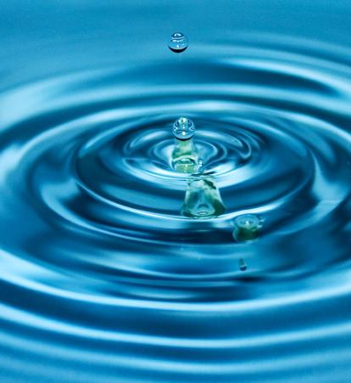
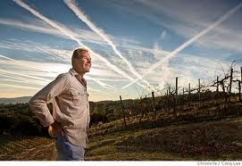
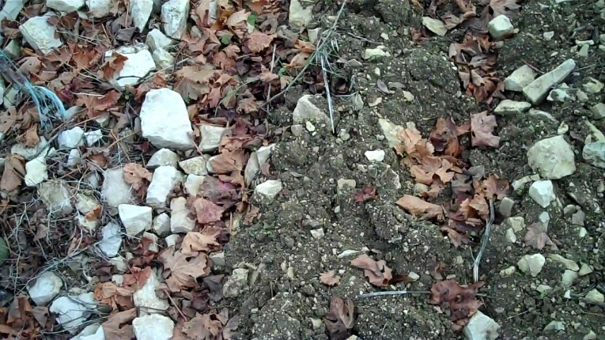
What Grapes Need to Prosper
Sunlight/Heat
Water
Soil
Human Interaction

Slide 4
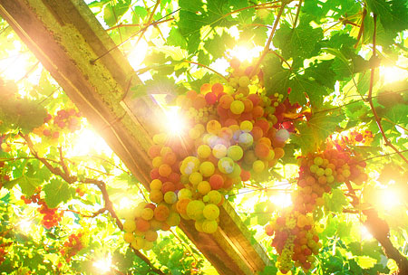
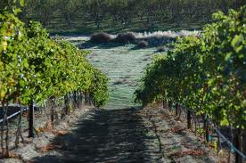
Sunlight & Heat
ripens the grape
Water feeds the vine

Slide 5
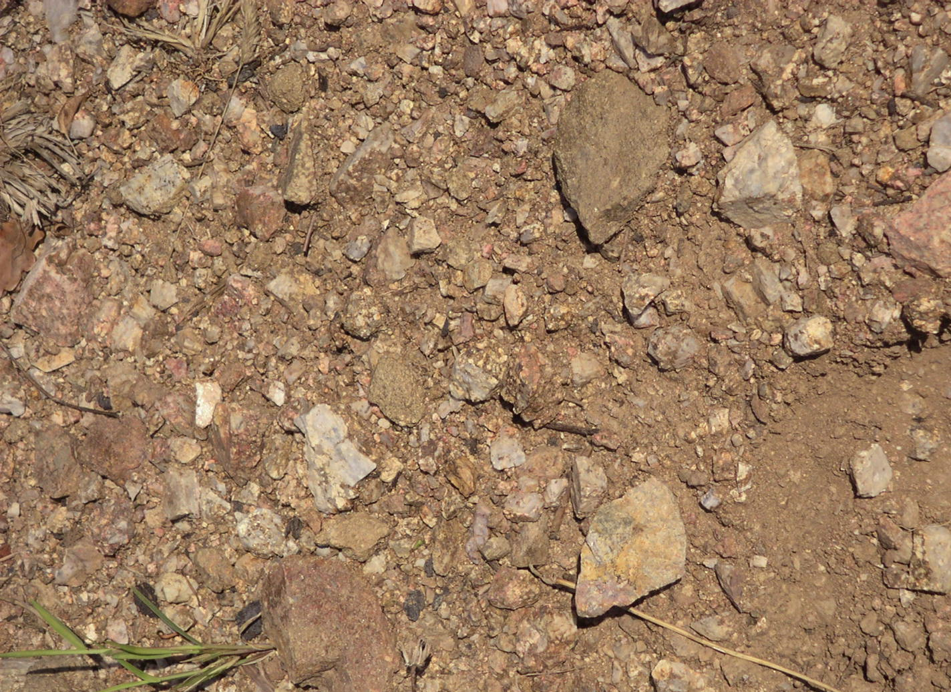
Soil
Notes:
Rocks, gravel, sand, provide great drainage…not clay! In France
They are so serious about soil that they collect samples and put them on
Display in their tasting rooms!

Slide 6
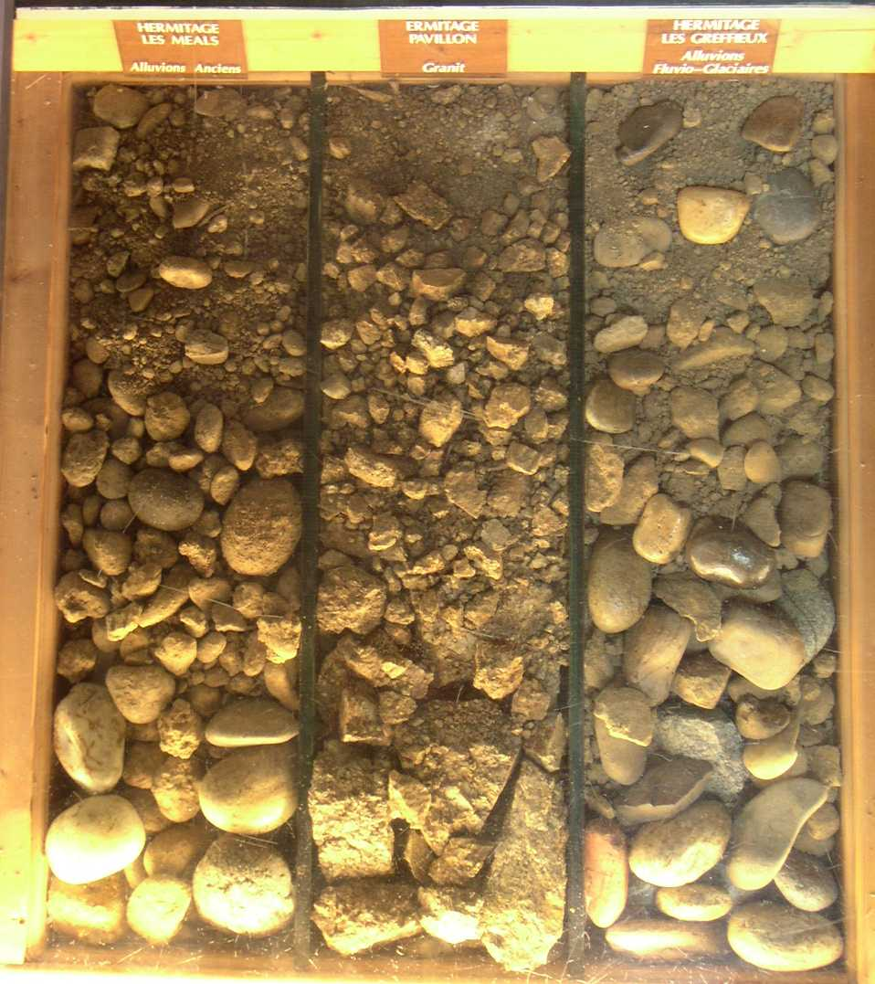
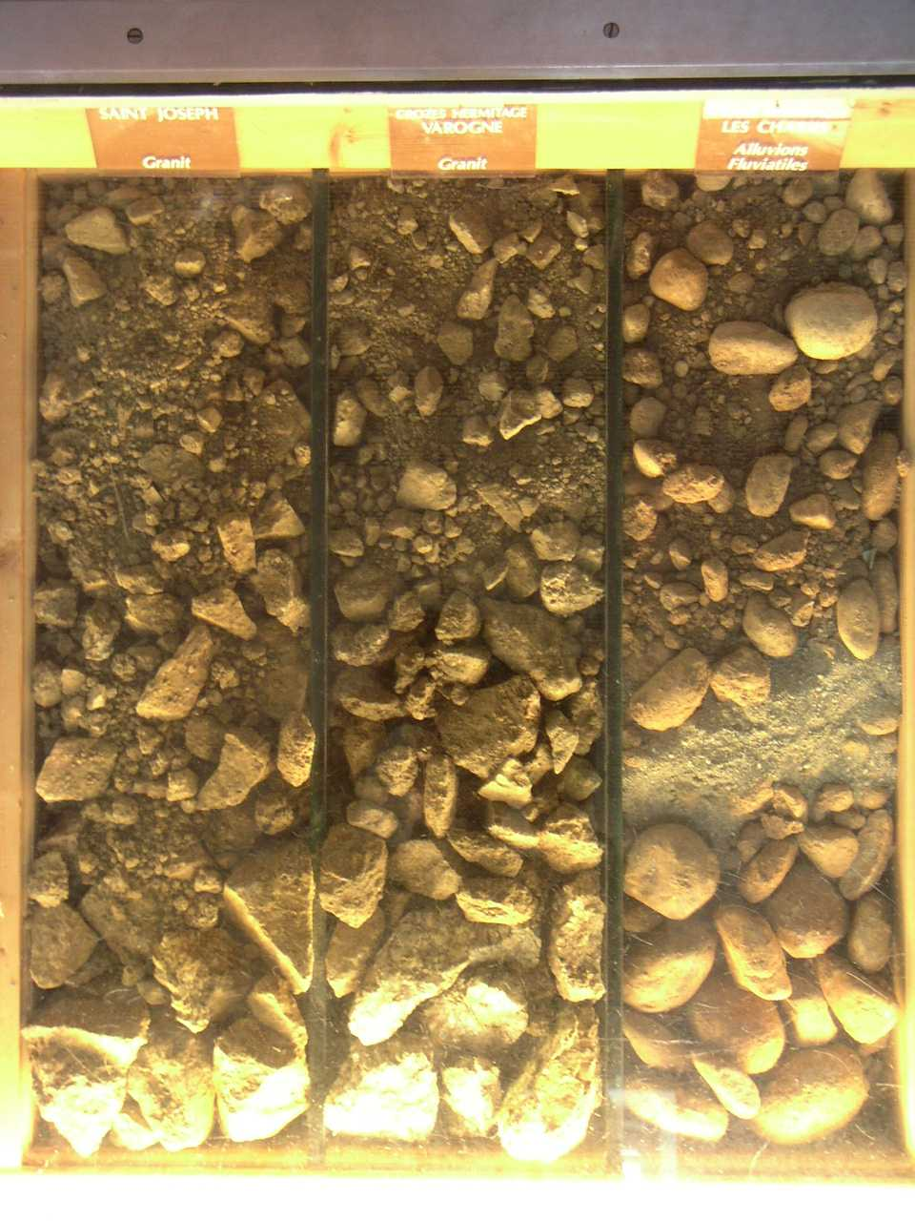
Rocks, gravel, sand, provide great drainage…not clay!
In France they are so serious about soil that they collect samples
and put them on display in their tasting rooms!

Slide 7
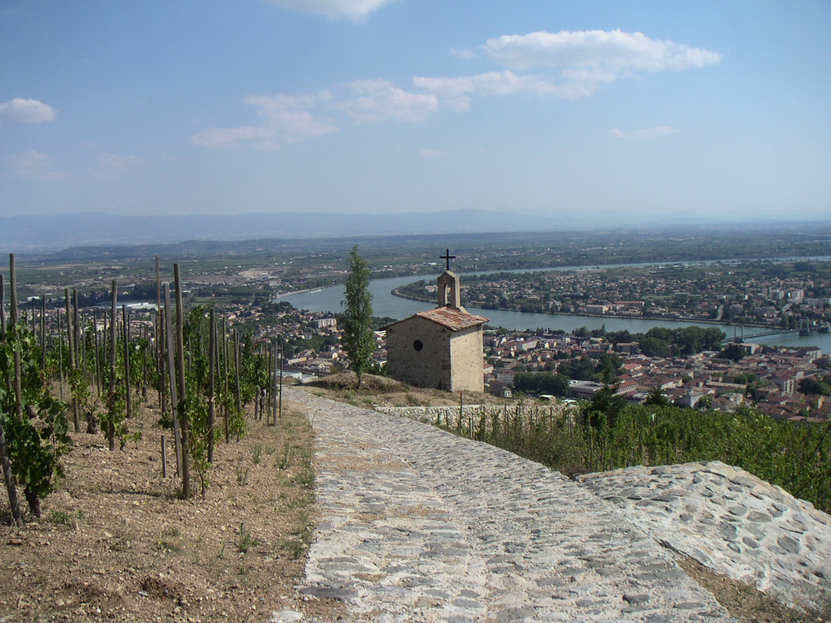
Stages of the vine
Notes:
CHAPEL IS OWNED BY JABOULET, BUT CHAPOUTIER OWNS
THE VINEYARDS THAT SURROUND IT - L’Ermite and LeBessard below
L’Ermite - very old and week granitic soils
Le Meal - weather worn cobbles and clay
Chapoutier believes the granitic soils of Le Meal
give their syrah a smokey quality
Bio -dynamic practices: TAKES THE CYCLES OF NATURE AND
THE COSMIC RHYTMS INTO CONSIDERATION:
COSMIC ENERGY OF THE SOLAR CYCLES &
MAGNETIC ENERGY OF THE SOIL

Slide 8
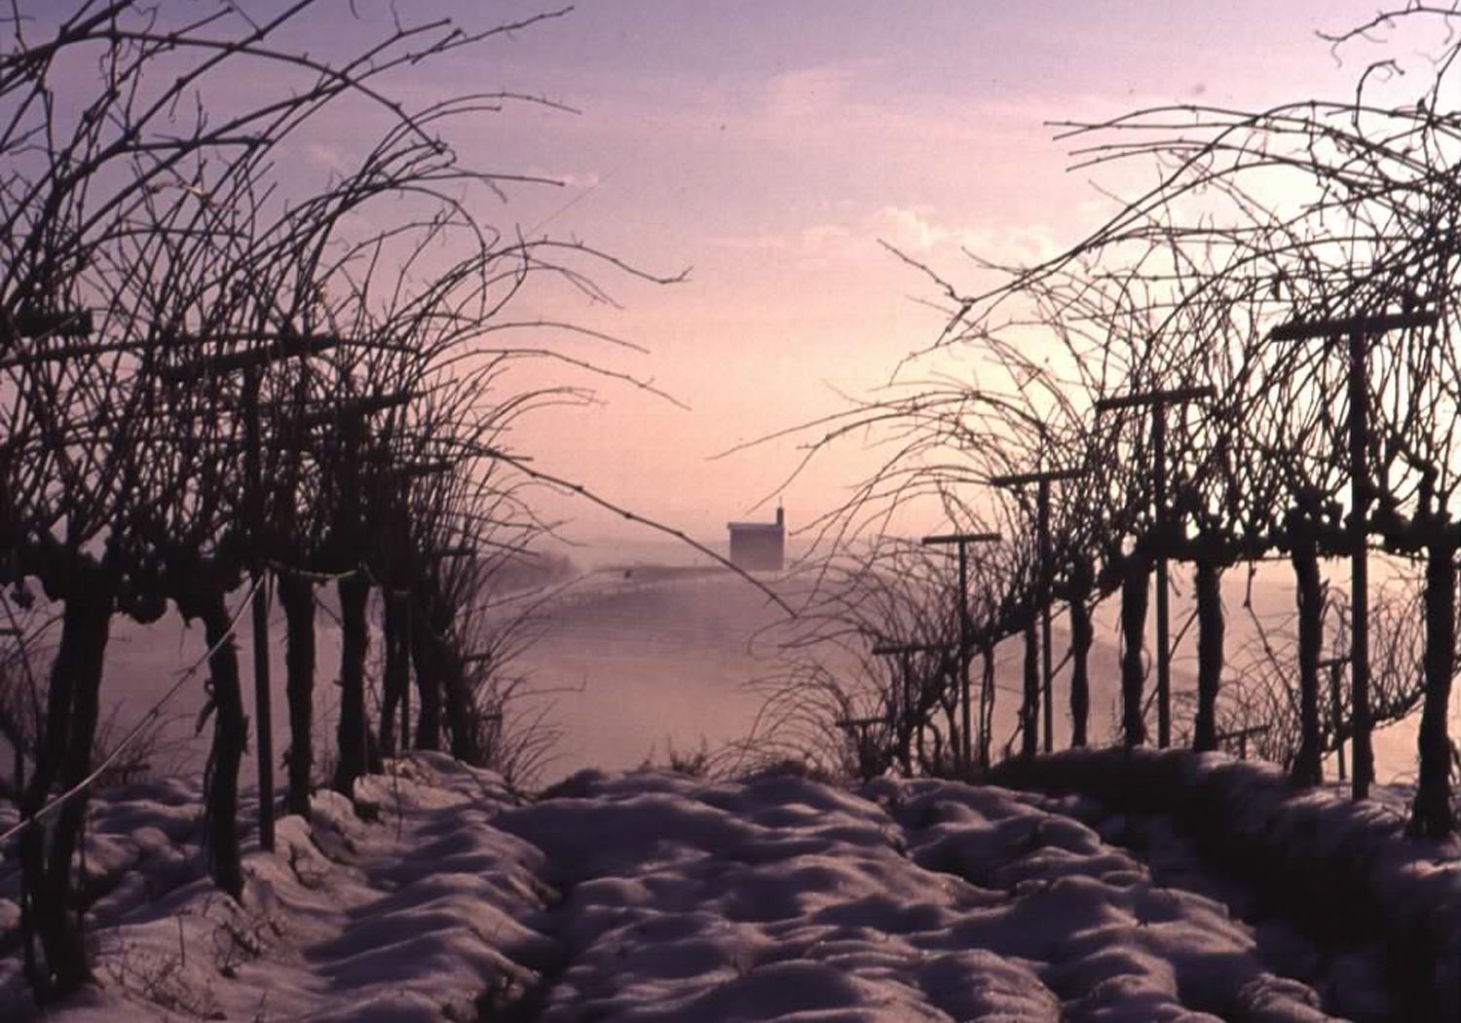
Dormancy
November - February
Notes:
In the Northern hemisphere, this is the schedule that is usually
Followed. (Southern Hemisphere is 6months ahead of us!)
“Dormancy’ (when vine temp falls consistently below 50 degrees)
Prune in Nov vs Feb?

Slide 9
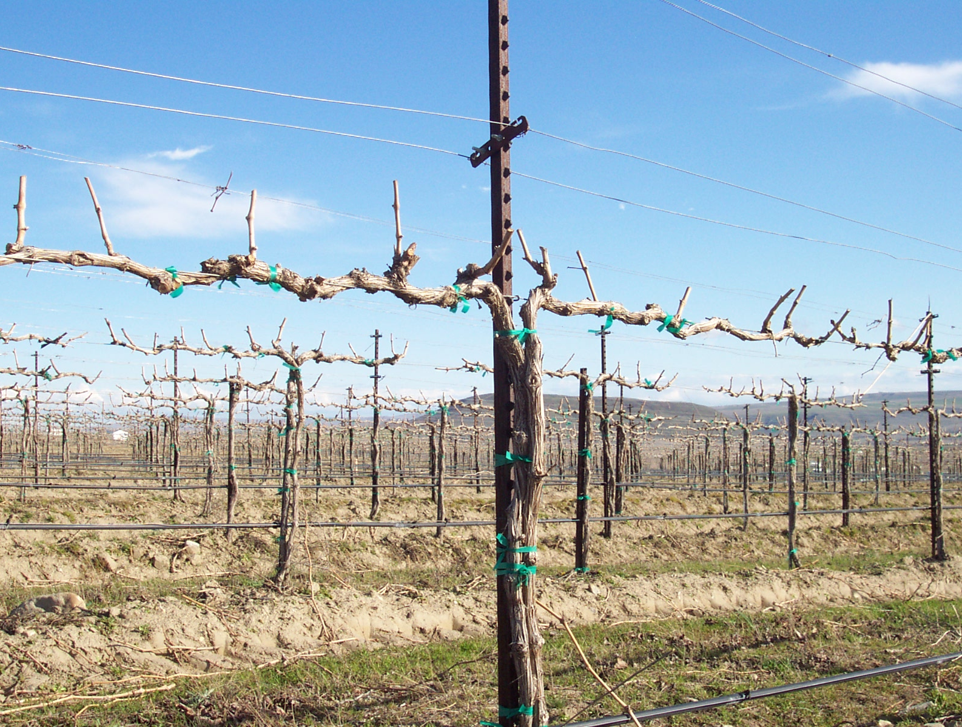
Initial pruning
February

Slide 10
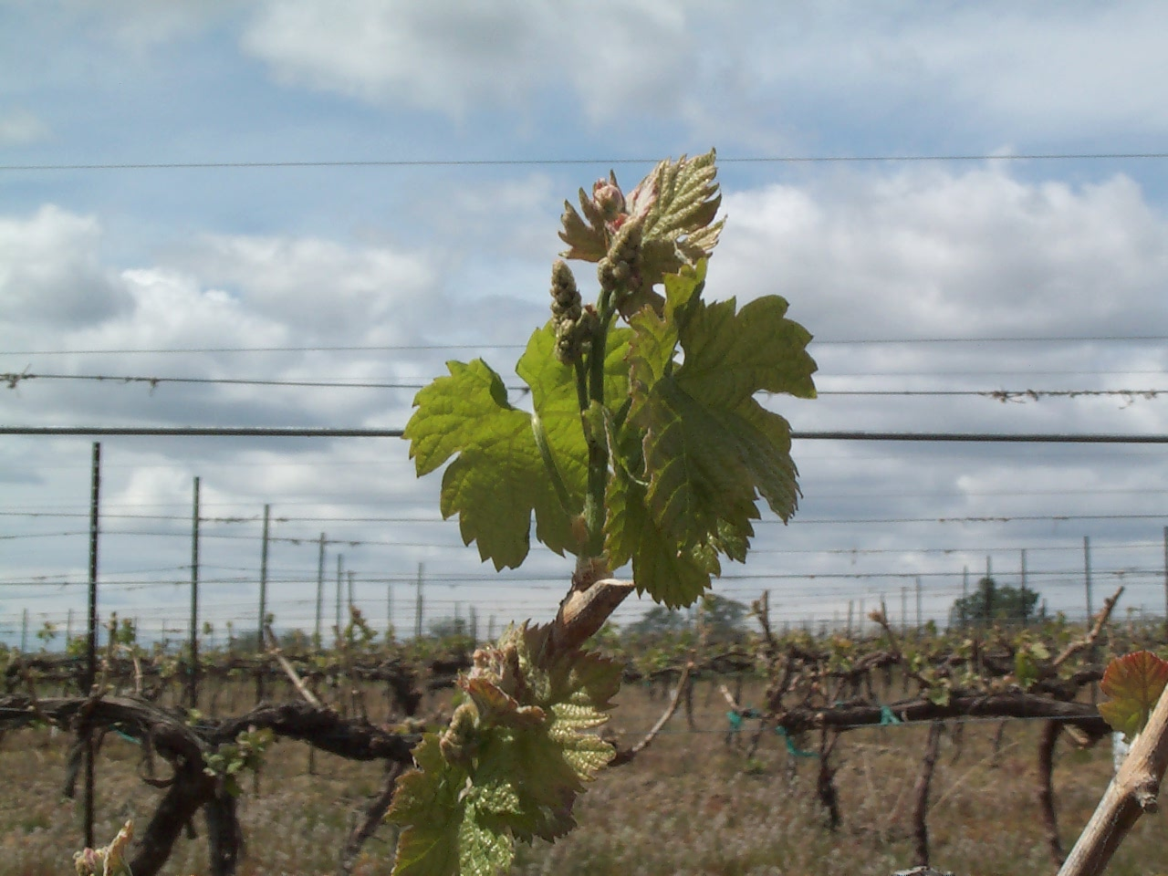
Budbreak & Shoot Elongation
March - April

Slide 11
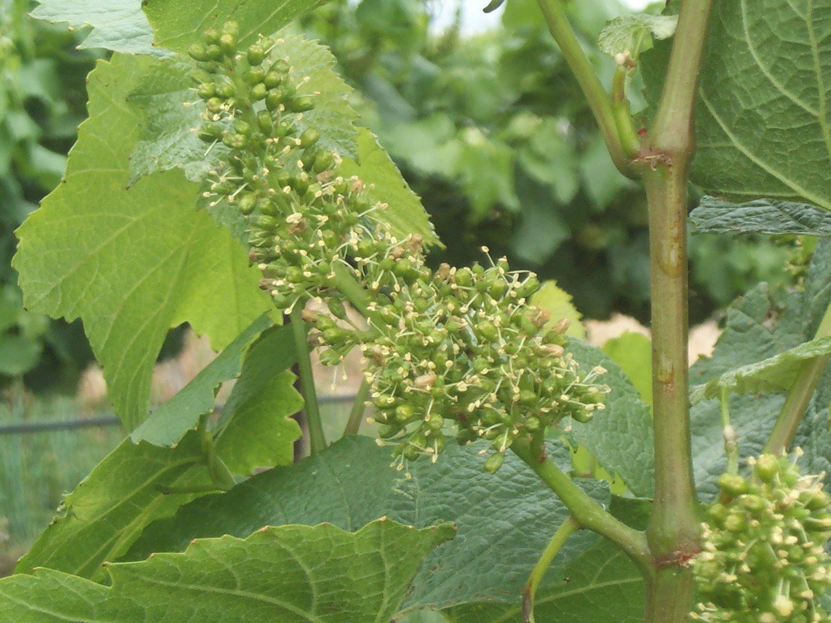
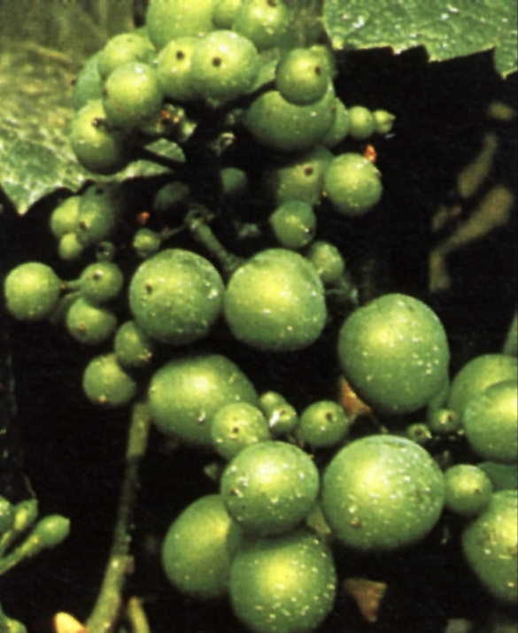
Flowering & Fruit set
May - June
Notes:
Shoot positioning activities

Slide 12
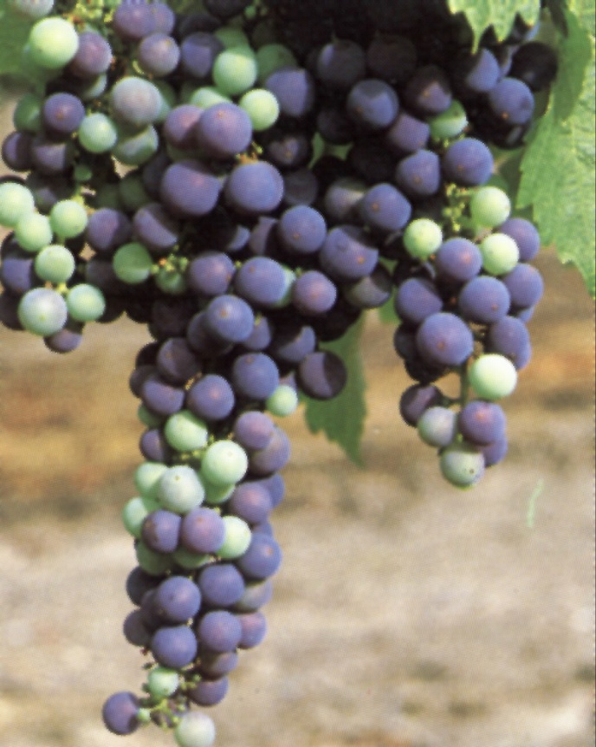
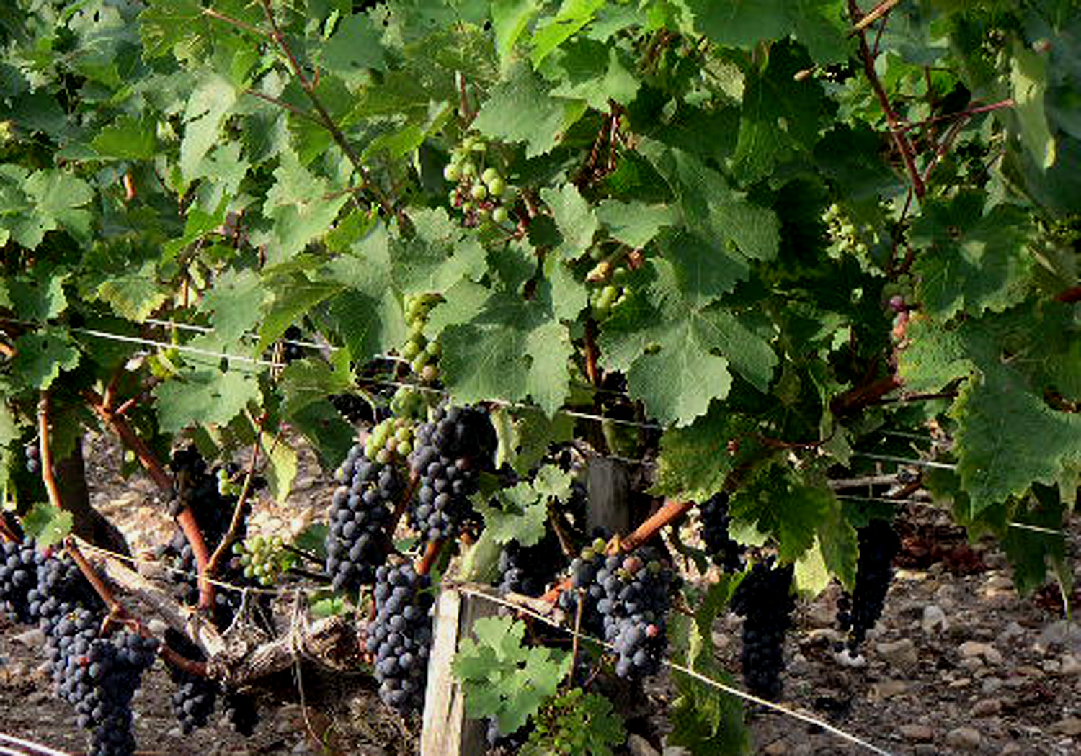
Véraison
Véraison is a viticulture (grape-growing) term meaning "the onset of ripening". It is originally French, but has been adopted into English use. The official definition of Véraison is "change of color of the grape berries." Veraison represents the transition from berry growth to berry ripening, and many changes in berry development occur at Véraison.
July - August
Notes:
Green pruning, leaf pulling

Slide 13
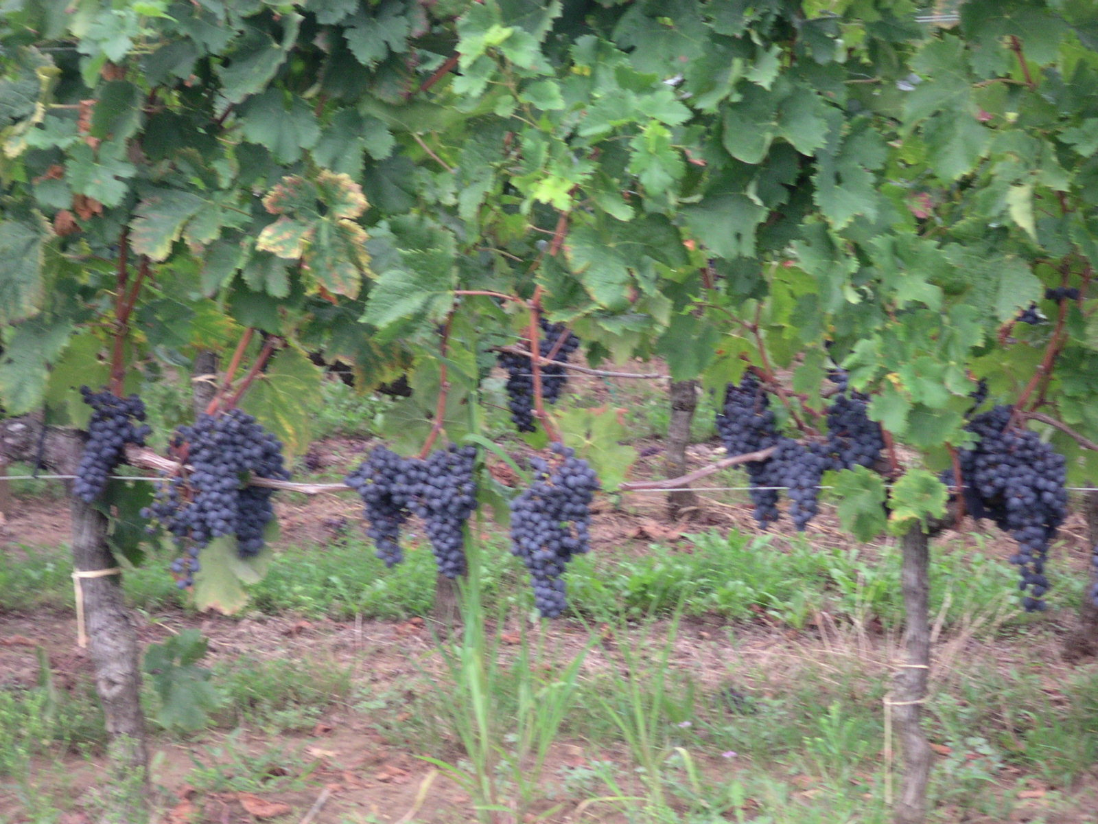
Grape Ripening - Harvest
September - October

Slide 14
Human factor
Notes:
TREMENDOUS INFLUENCES:
Tradition – what did your father do?
What is your goal…produce a wine that is so rich and complex
you can sell it for $40 a bottle, or just a simple wine for $5 a bottle?
What does the climate allow you to successfully grow?
Are you too hot to grow Pinot, but too cold to ripen Cabernet?
What varieties are hot? Don’t want to produce Lemberger
if no one will buy!
When should I prune? Dec, Jan, Feb?
Lets take a look at the growing cycle of the grape vine and you’ll
Get an appreciation for the influence that man can exert to influence
The quality of the grapes he/she produces.

Slide 15
Managing the Vine
Canopy management
Maximizing ripening & flavor development.
Training System
Controlling size and shape through pruning
Trellising
System of posts and wires to guide the vine
Notes:
Human factor comes into play here…

Slide 16
Canopy Management
Optimal positioning and exposure of your grapes to maximize ripening & flavor
Canopy management is an important aspect of viticulture due to its effect on grape yields, quality, vigor, and the prevention of grape diseases. Various viticulture problems, such as uneven grape ripening, sunburn, and frost damage, can be addressed by skillful canopy management. In addition to pruning and leaf trim, the canopy is often trained on trellis systems to guide its growth and assist in access for ongoing management and harvest
Notes:
Ripening and flavor development of your grapes.
CM is all about positioning your grapes so this can be achieved.
Grapes are a vine, would grow any and everywhere!

Slide 17
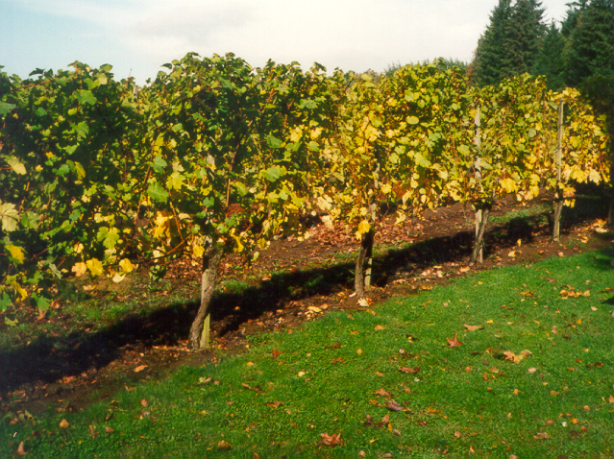
Cordon trained, spur pruned
Notes:
Primarily used in WA – allows for mechanical harvesting

Slide 18
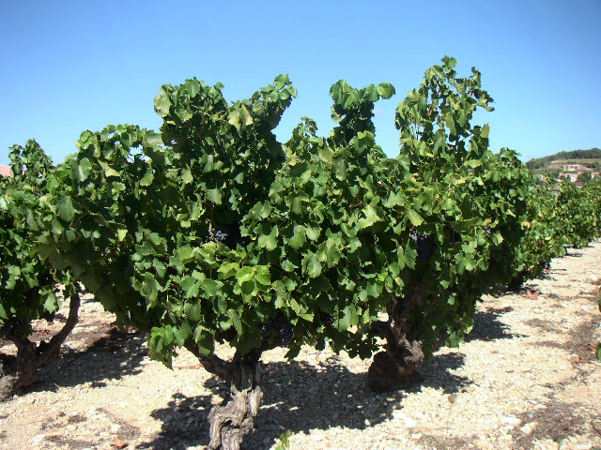
Head trained, spur pruned
Notes:
Old vine Zinfandels in CA and in the Rhone region of France

Slide 19
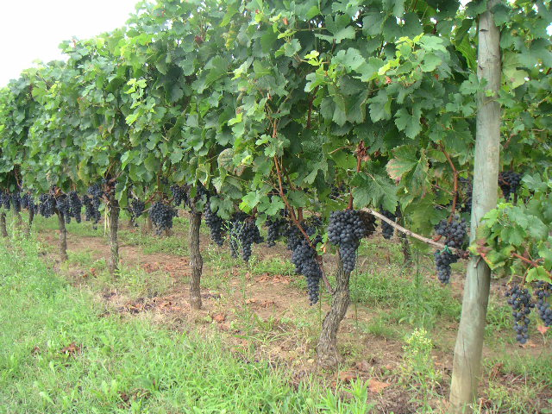
Head trained, cane pruned

Slide 20
Double bi-lateral cordon training
Notes:
Training systems also serve to demote vigor…
Double bi-lateral cordon training also demotes vigor…;here are two root
Sources competing for a finite amount of nutrients in the soil.

Slide 21
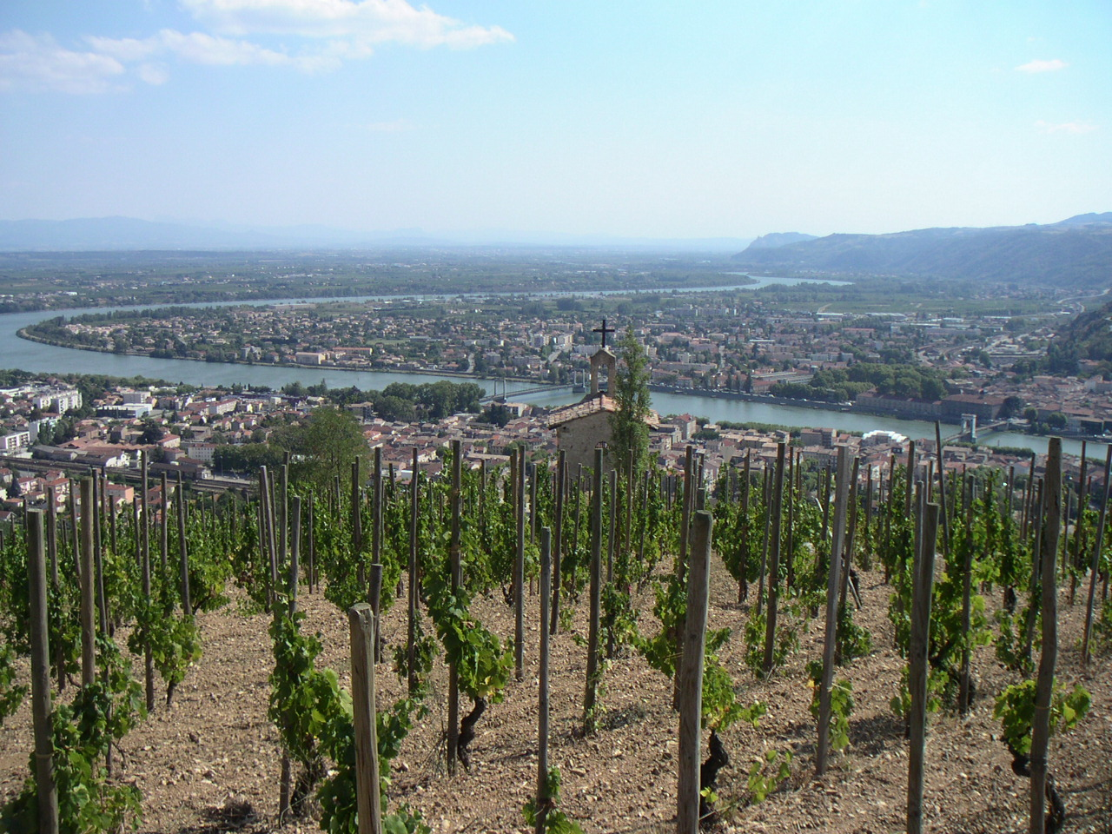
HERMITAGE IS CONSIDERED ONE OF THE GREATEST AREAS IN THE WORLD TO GROW SYRAH.
COMPARE THEIR TRAINING SYSTEM CALLED ‘GOBELET’ (GO-BEE-LAY or GOB- LET)
Notes:
HERMITAGE IS CONSIDERED ONE OF THE GREATEST AREAS
IN THE WORLD TO GROW SYRAH. COMPARE THEIR TRAINING
SYSTEM CALLED ‘GOBELET’ (GO-BEE-LAY or GOB- LET)
GOBELET SINCE ROMAN TIMES
‘LACKS EFFICIENCY”
“NOT IDEAL FOR CLUSTER EXPOSURE”
“TRADITION DETERMINES”
“MOVING TOWARD BI-LATERAL CORDON”
DELAS

Slide 22
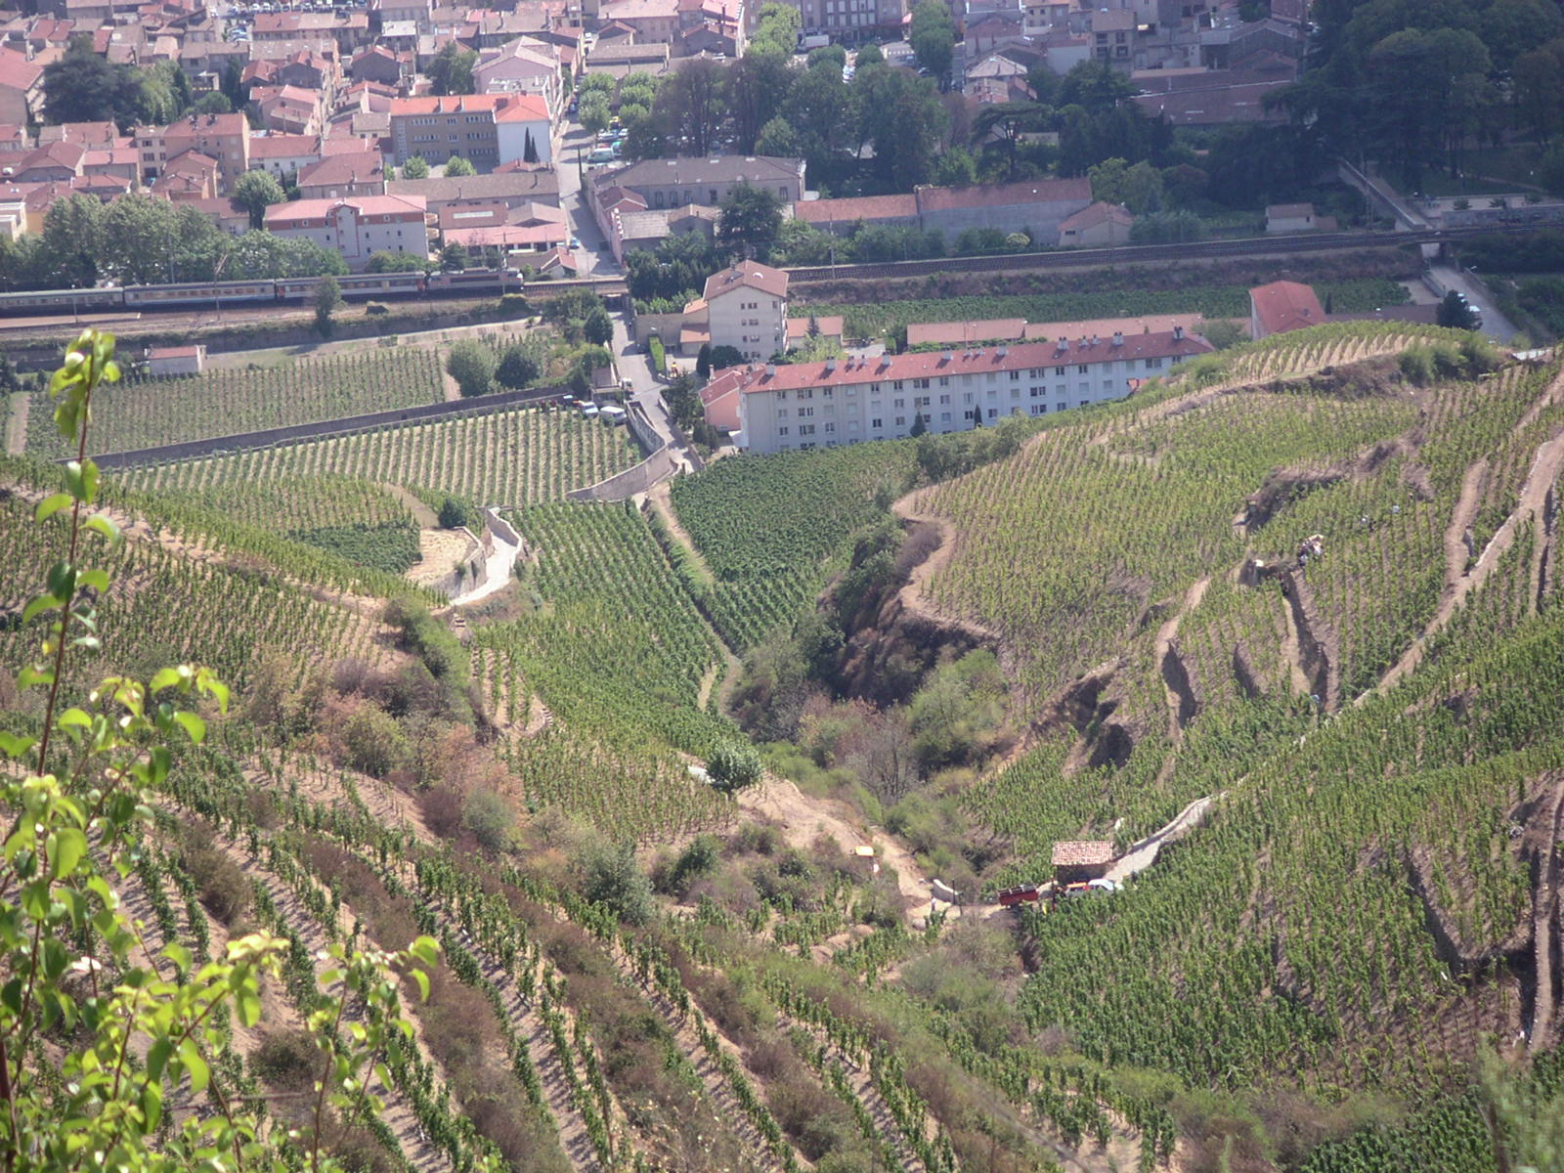
Notes:
CLEARLY SHOWS HOW STEEP HILLSIDES ARE …

Slide 23
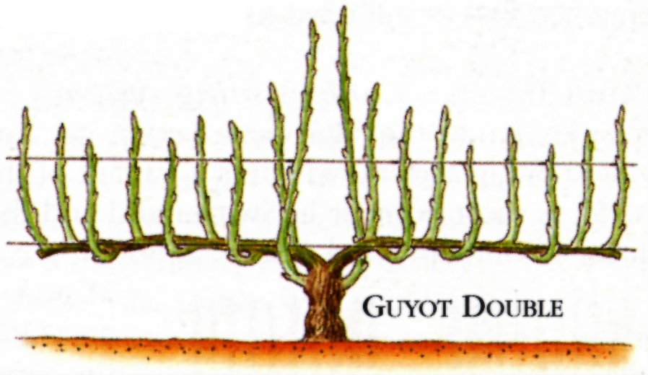
Trellising
Guyot double is a cane training system.
A conservative type of system as it provides an easy method to restrict the number of buds and cane.
This is important in areas like Bordeaux where the AOC demands it.
Notes:
Guyot double is a cane training system. Conservative type as it provides
An easy method to restrict the number of buds and cane and this is
Important in areas like Bordeaux where AOC demands this.
GDC spur training system and promotes high yield!
Also, great for frost protection since high off the ground.

Slide 24
Geneva Double Curtain spur training
system promotes high yield!
Also, great for frost protection since
it’s high off the ground.

Slide 25
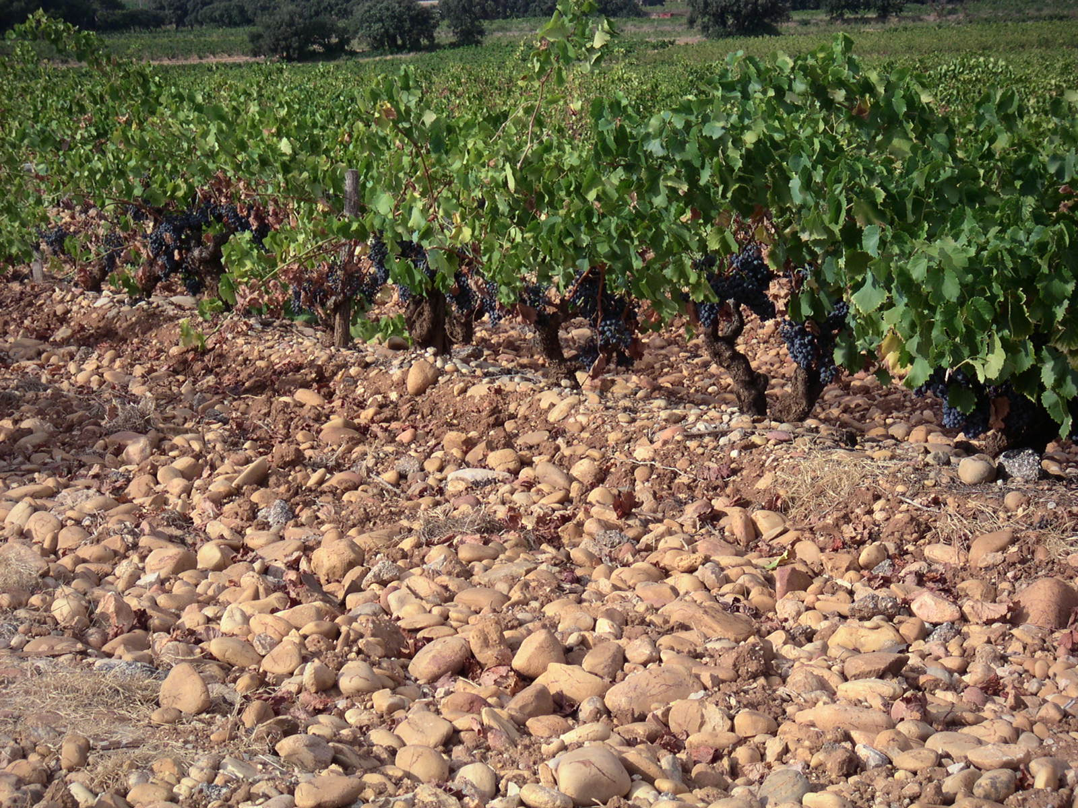
Note low to the ground fruit zone. Why?
No accident!
Maximize heat radiation
Notes:
Note low to the ground fruit zone. Why? No accident! Maximize heat
radiation

Slide 26
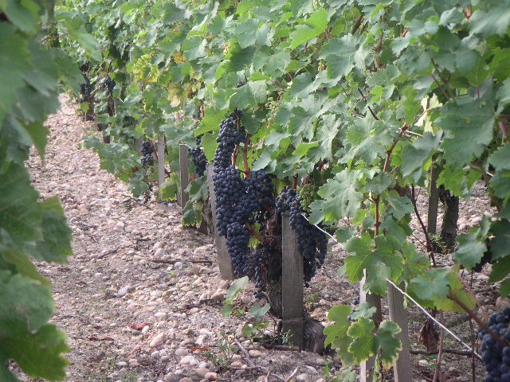
Notes:
Recap:
So, it’s all about sunlight, heat, water and soil and how the human factor
Optimize these key factors thru training and trellising system selection
And by canopy management to produce the best grapes.

Slide 27
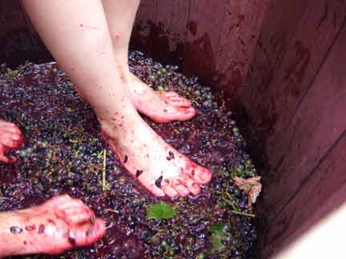
Making Wine
Notes:
3 categories of wine: Table Wines, Sparkling, Fortified
Today we will focus on Table Wine making…white and red
Any questions before we get started?

Slide 28
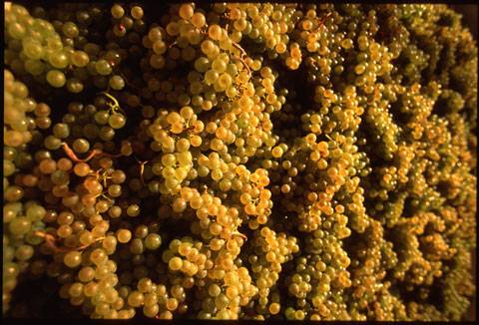
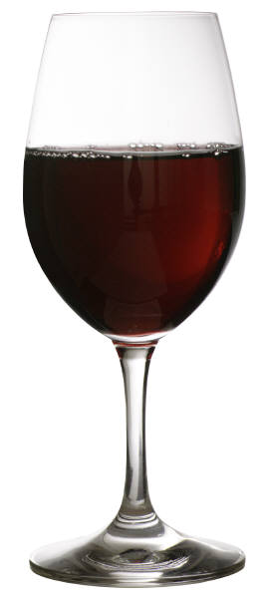
Still Wine
+
Yeast
=
X
CO2
Notes:
It’s really very simple…grapes, plus yeast (naturally present) and alcohol and
CO2 are produced. All happened by accident as long as 6000 years ago, the
first evidence we have of wine.
But wine can only be its best when it is not left to chance, but rather controlled
every step of the way. Lets have a look at these steps

Slide 29
Basic Stages of Wine Making
Harvest
Process
Ferment
Bottle
Age
Clarify & Stabilize
Notes:
Go thru

Slide 30
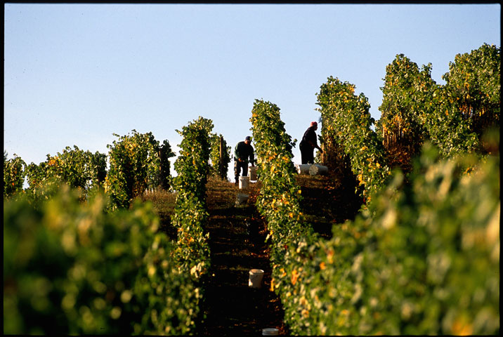
Harvest
Two big questions: How and when…
Notes:
Two big questions: How and when…

Slide 31
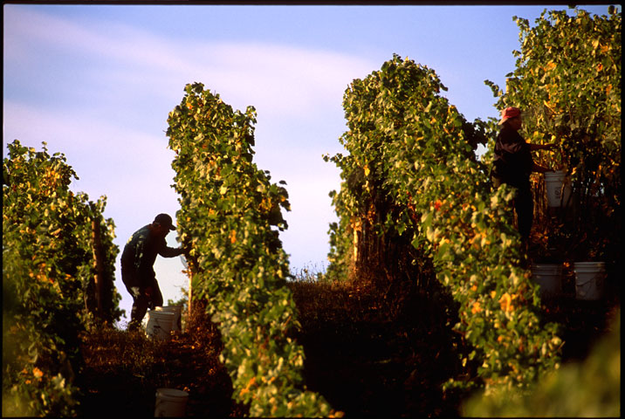
Shall we hand harvest…
Considered much more gentle process with less damage to grapes…
Notes:
Shall we hand harvest…
Considered much more gentle process with less damage to grapes

Slide 32
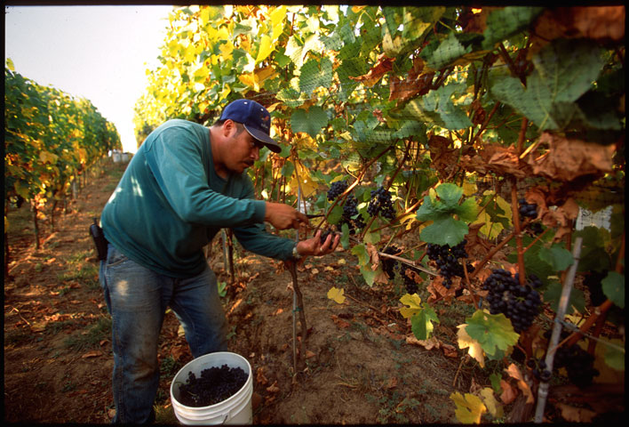
…and allowing for greater selection of just the best clusters
Notes:
Allowing for greater selection of just the best clusters

Slide 33
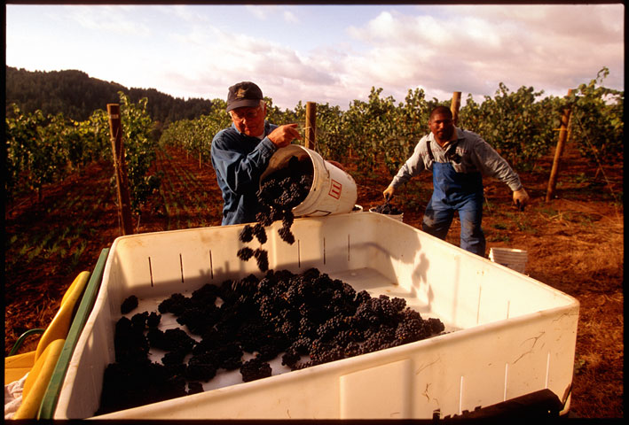
Hand pruning is labor intensive, more expensive and not very fast
which could be of concern if a big rain is threatening.
Notes:
Labor intensive, more expensive and not very fast which could be of
Concern if a big rain is threatening.

Slide 34
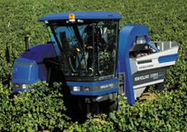
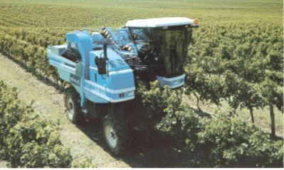
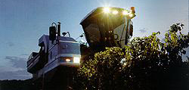
Or shall we mechanically harvest? Not as gentle, but certainly faster and less expensive than hand harvesting.
Notes:
Or shall we mechanically harvest? Not as gentle, but certainly faster and
less expensive than hand harvesting.

Slide 35
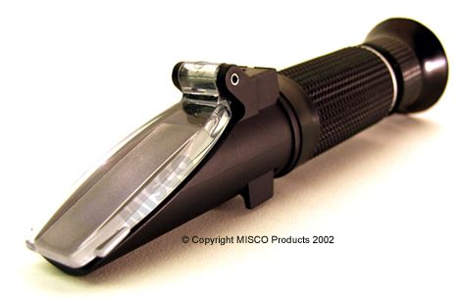
Then there’s the question of when to harvest
A refractometer is used to measure the sugar content in the grapes
Notes:
Then there’s the question of when to harvest. Explain refractometer
And the more important power of tasting

Slide 36
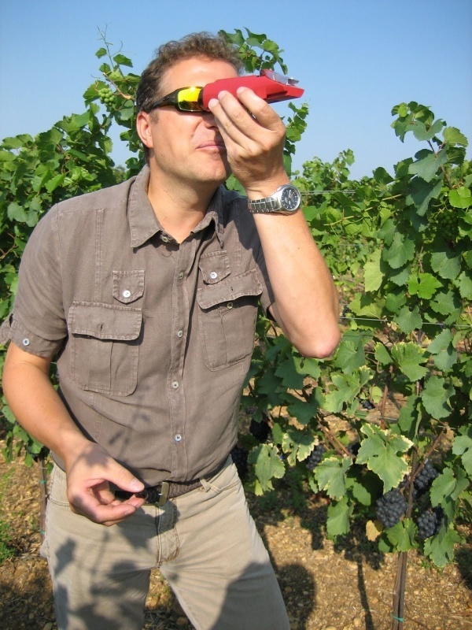
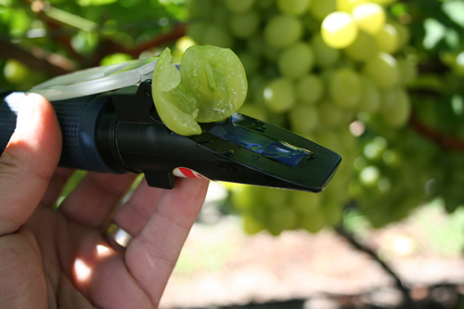
Named for A. F. W. Brix, a nineteenth-century German inventor, the Brix scale is a system used in the United States to measure the sugar content of grapes and wine.

Slide 37
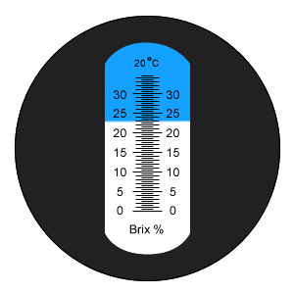
Each degree Brix is equivalent to 1 gram of sugar per 100 grams of grape juice. The grapes for most table wines have a Brix reading of between 20 to 25 at harvest.

Slide 38
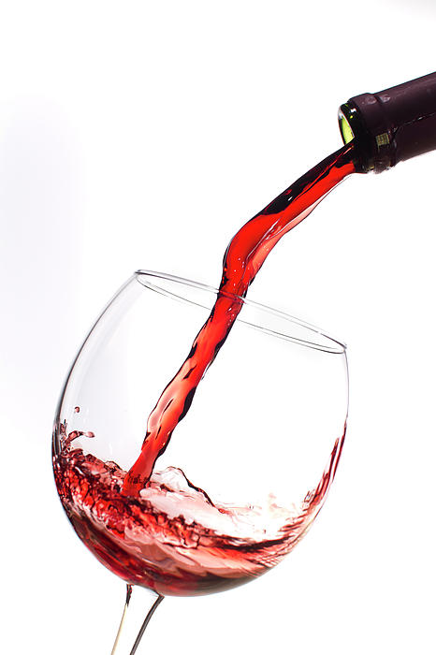
About 55 to 60 percent of the sugar is converted into Alcohol. The estimated alcohol that a wine will produce (called potential alcohol) is estimated by multiplying the Brix reading by 0.55. Therefore, a 20 Brix will make a wine with about 11 percent alcohol.

Slide 39
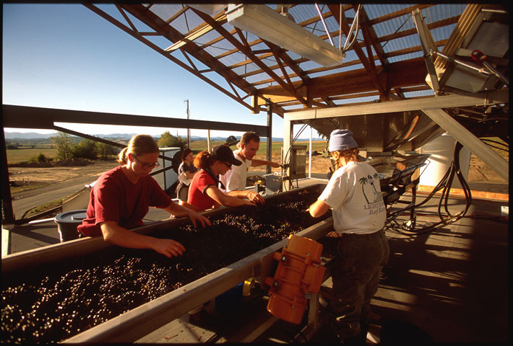
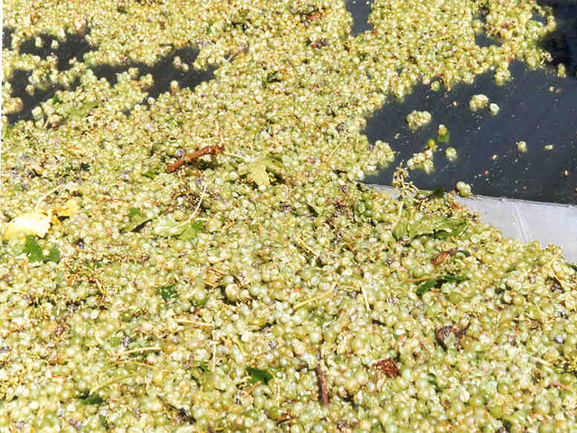
Harvest
Process
Sorting Table
These people are removing stems, rocks, leaves and any questionable grapes to improve the quality potential of their wine.
Notes:
Any Questions about harvest?
So once we’ve picked the grapes, now what do? We must process the grapes. Which
means for the most part, we must find a way to get to the juice of the grapes.
To do this, we use a machine that breaks the skins of the grapes and at the same
Time removes most of the stems. It is called a crusher/destemmer.
Above, is sorting table. Literally, these people are removing MOG and any questionable
Grapes to improve the quality potential of their wine.

Slide 40
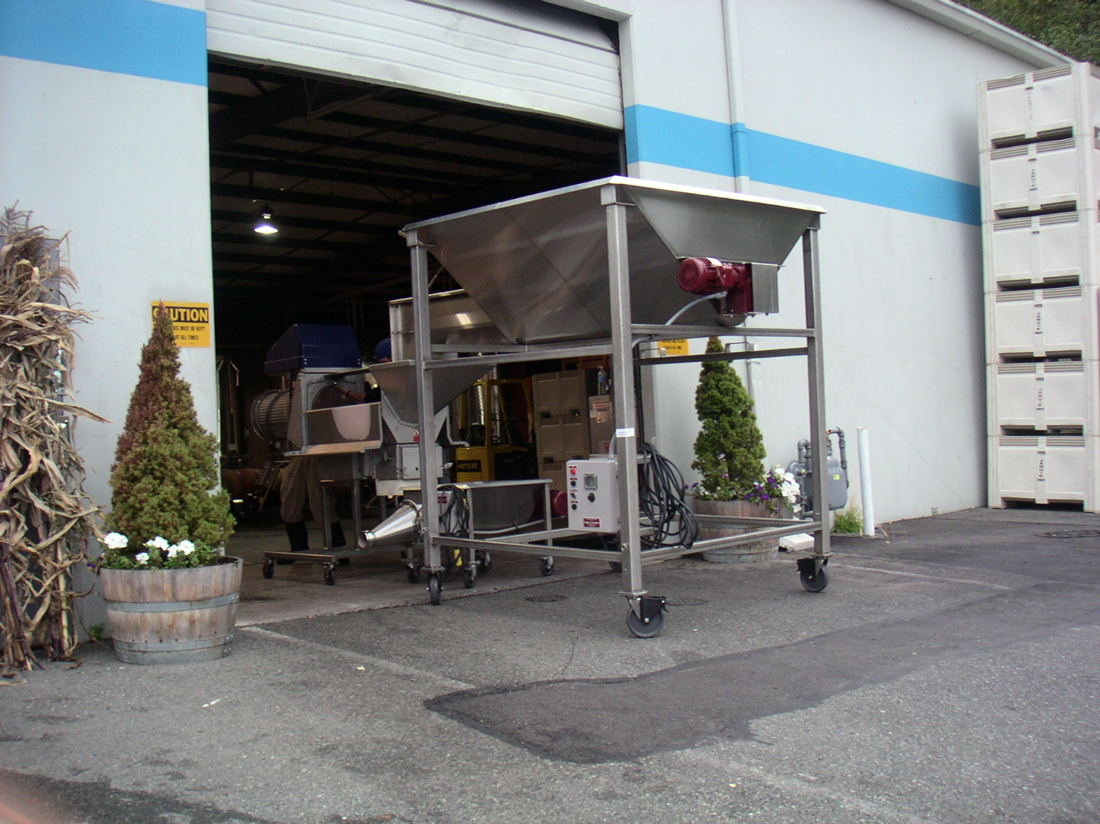
Crusher destemer
Notes:
Crusher destemer

Slide 41
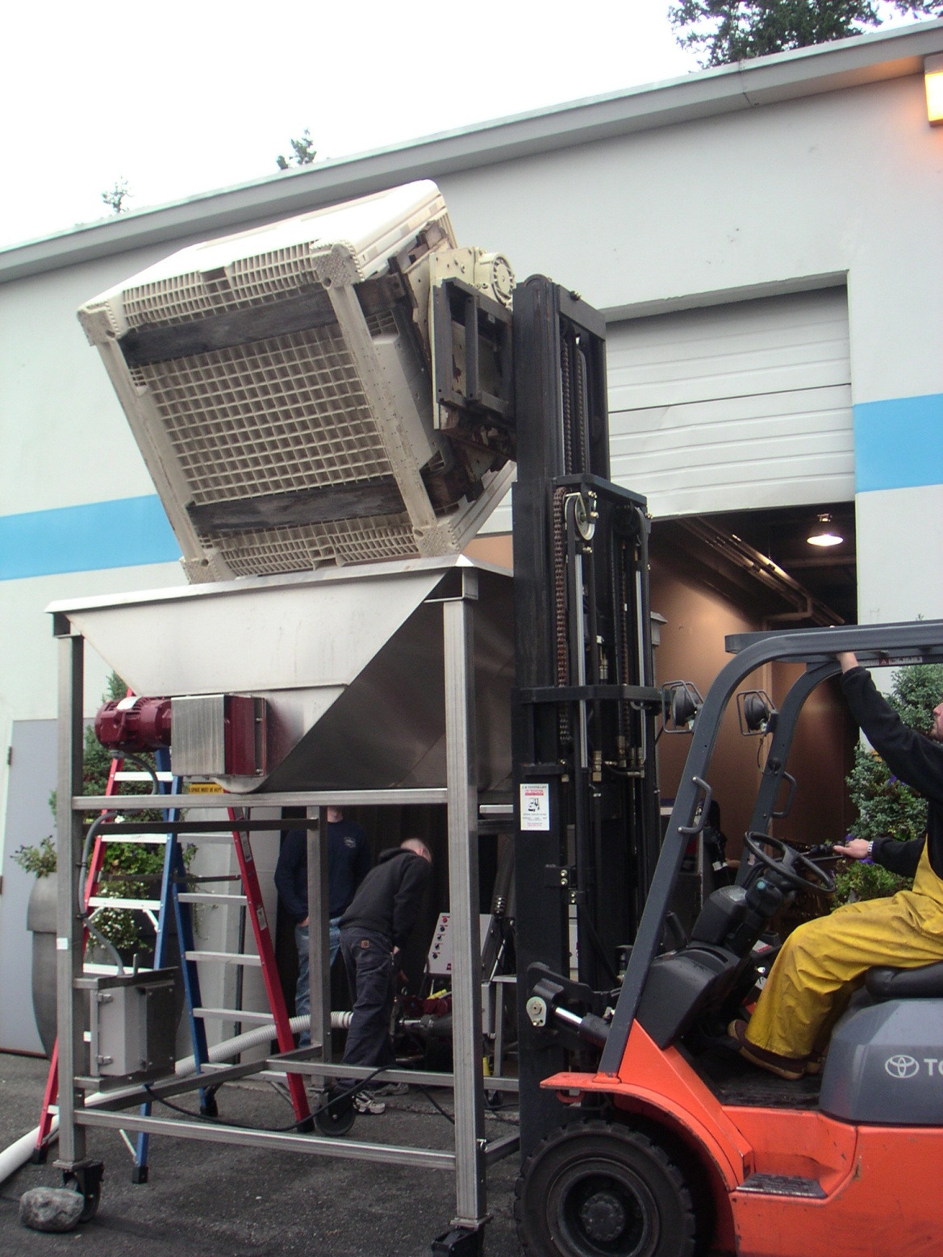
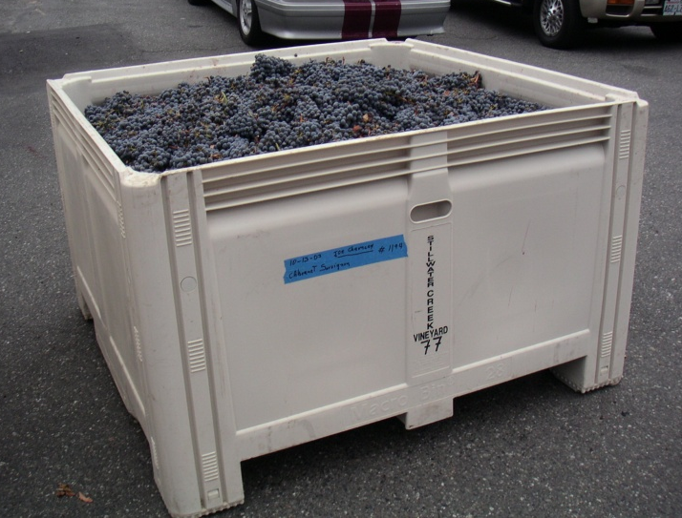
Grapes being loaded into the crusher
Notes:
explain

Slide 42
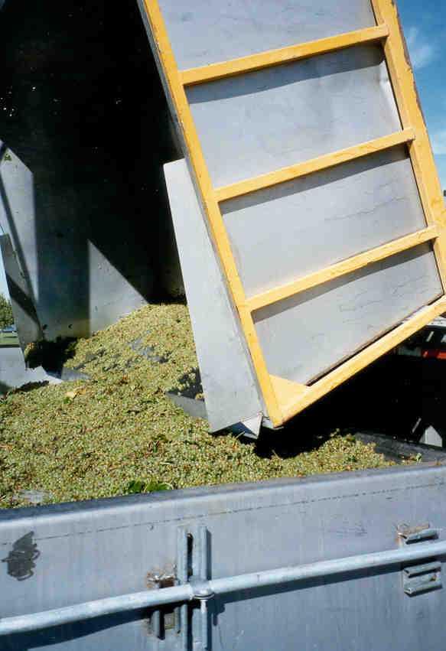
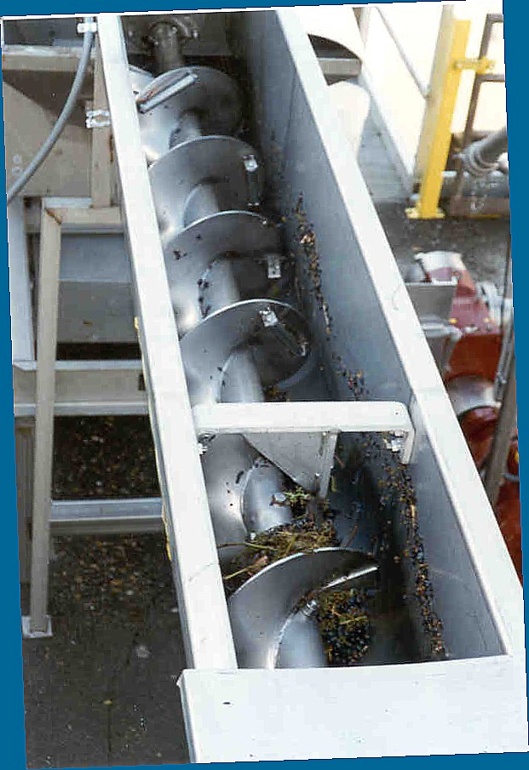
Large production uses an auger to push
grapes to the crusher destemer
Notes:
Large production uses an auger to push grapes to crusher destemer

Slide 43
Juice, with a small percentage whole berries.
Notes:
Juice, with small percentage whole berries. The next step for these
Grapes is fermentation with juice and skins all together. The juice of
all grapes…red and white…is clear. Color is imparted to the juice from
the skins. We want to pull all the color out of those skins during the
Fermentation process.
For whites it is quite different, as the skins provide no color, just
bitterness. We want to remove the skins from the juice
prior to fermentation. So, after the crusher destemmer, the grapes go to
press to remove all the juice from the skins and get that wonderful
bit of flavor that is just beneath the skin. Sometimes, the grapes go
Direct to press and by pass the crusher stemmer phase. It is thought
That this provides a gentler method of getting the juice and minimizes
Some of the harsh extractions by avoiding the crusher-destemmer.
The skins are then discarded and the juice is ready for fermentation.

Slide 44
The juice of all grapes…red and white…is clear.
Color is imparted to red wine from the skins.

Slide 45
The next step for red grapes is fermentation
with juice and skins all together.
We want to pull all the color out of those skins
during the fermentation process.

Slide 46
For whites it is quite different, as the skins provide no color, just bitterness.
We want to remove the skins from the juice prior to fermentation.

Slide 47
Sometimes, the grapes go direct to press and by pass the crusher stemmer phase. It is thought that this provides a gentler method of getting the juice and minimizes some of the harsh extractions by avoiding the crusher destemmer.
The skins are then discarded and the juice is ready for fermentation.

Slide 48
Harvest
Process
Ferment
Tank
Barrel
Tank
Notes:
White wines can be fermented in a stainless steel tank or in oak barrels. Red wines are
almost always fermented in stainless steel tanks then aged in oak barrels. Lets have a
closer look.

Slide 49
White Varieties vitis vinifera
Riesling
Chenin Blanc
Gewurztraminer
Pinot Gris
Pinot Blanc
Muscat Canelli
Tank
Notes:
GOAL OF TANK FERMENTATION OF WHITE GRAPES :
Preserve of natural aromas and prevent oxidation!
Achieved thru cool fermentations and making sure
that processes are accompanied by treatments
that prevent oxygen from contacting juice
EG: nitrogen and CO2 - blanketing, pipe and tank sparging,
antioxidant uses
(Red wines have polyphenols to protect them as they are
natural anti oxidants)

Slide 50
GOAL OF TANK FERMENTATION OF WHITE GRAPES :
Preserve of natural aromas and prevent oxidation!
Red wines have polyphenols to protect them as they are natural anti oxidants

Slide 51
Tank
Yeast added
Fermentation 50-55º 3-6 wk
Fermentation Arrested 30-32º
Notes:
1. Stainless Steel Fermentation takes place in tanks with cooling jacket
which control temp. Starting temp is 50-55 to slow
down the speed at which fermentation occurs and
dropping to 28-29 to arrest the process. Longer and
cooler fermentation more aroma and fresher, fruitier taste.
Stainless is used for the
“fresh & fruity” wines - JR, Gewurtz, Muscat

Slide 52
Stainless Steel Fermentation takes place in tanks with cooling jackets which control temp.
Starting temp is 50-55 to slow down the speed at which fermentation occurs and dropping to 28-29 to arrest the process.
Longer and cooler fermentation gives more aroma and fresher, fruitier taste.
Stainless is used for the “fresh & fruity” wines – Riesling, Chenin Blanc, Gewurztraminer, Pinot Gris, Pinot Blanc, Muscat Canelli

Slide 53
White Varieties vitis vinifera
Chardonnay
Sauvignon Blanc
Semillon
Notes:
Warm fermentation to extract wonderful toasty and nutty flavors from the
Barrel. Explain ML and diacetyl

Slide 54
Barrel
Yeast added
Fermentation 1-2 wk
Malolactic Fermentation
Notes:
Warm fermentation to extract wonderful toasty and nutty flavors from the
Barrel. Explain ML and diacetyl

Slide 55
Malolactic conversion is a process of a change in wine where tart malic acid is converted to softer-tasting lactic acid. It is accomplished by lactic acid bacteria, which consumes the malic acid. This process can give a wine a butterscotch & buttery flavor.

Slide 56
Red Varieties vitis vinifera
Red
Cabernet Sauvignon
Merlot
Syrah
Pinot Noir
Zinfandel
Notes:
On Thursday we will explore these classic varieties further. These
varieties are almost always tank fermented.

Slide 57
Red
Yeast added
Ferment 7-10 days @ 80-85º F
Notes:
explain

Slide 58
Pump-over
During fermentation, the grape skins rise to the top of the tank because of the
gas being produced. It is important that the skins remain in contact with the
juice so that we continue to extract color and flavor from them.
So, we much pump over or punch down 2 times each day during fermentation.
Notes:
During fermentation, the grape skins rise to the top of the tank because
of the gas being produced. It is important that the skins remain in
contact with the juice so that we continue to extract color and flavor from
them. So, we much pump over or punch down 2 times each day
during fermentation.
Above is an example of pump over --explain

Slide 59
Punch-down
Notes:
Pneumatic punch down or hand punch down.

Slide 60
Drain & Press Wine
Ferment 7-10 dy @ 80-85º F
Red
Yeast added
Pump-over / Punch-down
Notes:
When fermentation of red wine is over, we now need to remove the
skins from the wine. What we do is drain off the wine from skins. The
skins have now settled to the bottom of the tank, so it is pretty easy to
just drain the clean wine out of the tank. Once we have done this, it is
now our job to get every last drop of juice out of those skins that remain
at the bottom of the tank. There are a number of ways to do this. My
Husband and I even used a pillow case, but a couple of years ago we
Decided we could afford the basket press you see above. This is one of
The oldest forms of extracting every last drop of juice from the skins.
Which juice is most tannic? Free run or press juice?

Slide 61
Drain & Press Wine
Notes:
Bladder press…explain how works

Slide 62
Red
Yeast added
Ferment 7-10 dy @ 80-85º F
Pump-over / Punch-down
Drain & Press Wine
Malolactic Fermentation
Notes:
Once the red wines are drained and pressed, they are combined and put
Into oak barrels in which they will age. They are then inoculated with a
bacteria that will convert the harsher malic acid to lactic acid. This is
Referred to as a secondary fermentation. The result Is a softening
of the acids of the wine.

Slide 63
Harvest
Process
Ferment
Clarify & Racking
Filtration & Fining
Racking

Slide 64
Filtration
Pad & Frame
Membrane
Diatomaceous Earth
Fining
Bentonite
Egg White
Notes:
Filtration: Basically 2 main categories: Depth and surface:
Depth: particles are caught within the depth of the filter medium. Good for
liquids that are heavily laden with particles:
Used primarily after grapes have come thru press or right after primary
fermentation
common types:
1) earth filtration (kieselguhr = skeletal diatoms tiny sea creatures; they
treated and what remains is silica, inert
Used with rotary fermenters or pad filters
2) sheet or pad filtration (the latter also called plate and frame) Sheets
consist of ordinary cellulose fibers and kieselguhr can be added to
enhance filtration efficiency.
Surface: (also called “absolute or membrane” very small particles,
capable of removing micro-organismes, yielding a microbially stable wine.
Used w/ membrane cartridge. Final membrane
size is .45ums, capable of removing all bacteria
FINING: bentonite – clay that small suspended particles adhere to.
Egg white can attract tannin particles and change the mouth feel softening the wine

Slide 65
Racking
Racking is the process of siphoning the wine
off the lees into a new, clean barrel.
Racking allows clarification and aids in stabilization.
Notes:
Racking is the process of siphoning the wine off the lees into a new, clean
barrel]. Racking allows clarification and aids in stabilization. Wine that
is allowed to age on the lees often develops "off-tastes". A racking hose
or tubing is used and can be attached to a racking cane to make this task
easier. The racking process is repeated several times during
the aging of the wine

Slide 66
Harvest
Process
Ferment
Age
Clarify & Racking
White
Red

Slide 67
Sur Lie
White
Definition: Sur Lie [soor LEE]
The French expression for "on the lees." lees is the coarse sediment, which consists mainly of dead yeast cells and small grape particles that accumulate during fermentation. Winemakers believe that certain wines benefit from being aged sur lie. Chardonnay or Sauvignon Blanc wines are thought to gain complexity if aged in this way for a few months
Notes:
Definition: Sur Lie
[soor LEE] The French expression for "on the lees." lees is the coarse
sediment, which consists mainly of dead yeast cells and small grape
particles that accumulate during fermentation. Winemakers believe that
certain wines benefit from being aged sur lie. Chardonnay or Sauvignon
Blanc wines are thought to gain complexity if aged in this way for a few months
Sur lie aging not only contributes to the wines creamy texture, it also
Incorporates the flavors of the oak barrel with other flavors. Makes for a
richer, more complex wine.

Slide 68
Red
Usually best wines will spend 18 to 22 months in barrel
Notes:
Usually best wines will spend 18 to 22 months in bbl

Slide 69
Harvest
Process
Ferment
Clarify & Racking
Bottle
Age
Notes:
Nitogen sparge

Slide 70
Amount of time in bottle before being sold is up to the owner.
Most wines require at least a month to settle down once bottled
Notes:
Amount of time in bottle before being sold is up to the owner. Most wines
require at least a month to settle down once bottled

Slide 71
Tank Fermentation
Harvest
Winery Transport
Press Grapes
Settle Juice overnight
Juice Stainless Tanks
Remove Settled Particles
Yeast added
Fermentation 50-55º 3-6 wk
Fermentation Arrested 30-32º
Filter to remove yeast
Fine, Filter & Bottle Wine
Racking/ Aging
Notes:
Filtration: Basically 2 main categories: Depth and surface:
Depth: particles are caught within the depth of the filter medium. Good for
liquids that are heavily laden with particles:
Used primarily after grapes have come thru press or right after primary fermentation
common types:
1) earth filtration (kieselguhr = skeletal diatoms tiny sea creatures; they
treated and what remains is silica, inert
Used with rotary fermenters or pad filters
2) sheet or pad filtration (the latter also called plate and frame) Sheets consist of ordinary
cellulose fibers and kieselguhr can be added to enhance filtration efficiency.
Surface: (also called “absolute or membrane” very small particles, capable of removing
micro-organismes, yielding a microbially stable wine. Used w/ membrane cartridge. Final membrane
size is .45ums, capable of removing all bacteria
Cold Stabilization: Purpose: to remove potassium bi-tartrate crystals(wine diamonds)
Grape juice is rich in minerals that are picked up by the roots of the vine
as they delve into the subsoil in search of water. Esp rich in potassium.
After fermentation, alcohol reduces the solubility of the tartrates that they
should fall out of solution. To assist the process, we chill the wine
to about 25 F.
Heat Stabilization: Purpose; to determine if proteins in wine are stable
Process: add Bentonite to remove! To find out if problem: heat wine to 175 F,
then chill to 25F. If haze forms, it can be fined out with Bentonite.
Proteins: complex substances built up from amino acids,
Which are the building block of all organic life. Yeasts feed on.

Slide 72
Barrel Fermentation
Harvest
Winery Transport
Press Grapes
Juice Stainless Tanks
Remove Settled Particles
Settle Juice overnight
Yeast added
Fermentation 58º 2 dy
Barrel Fermentation 1-2 wk
Chard/Sauv Bl Malolactic Fermentation
Sur Lie Aging 6-14 mo
Fine, Filter & Bottle Wine
Notes:
Settling of juice (called debourage): Freshly pressed grapes contain
a considerable quantities of solid matter, like cellular debris from the
skins which can cause off flavors. Tendency to over clarify!
Therefore clarify, but not too quickly:
1) particles nutricious to yeast as minerals and vits have attached them
selves to the particles. Assist in getting fermentation started!
2) Chill down to 45 degrees to slow bacterial action.
If too much solids, ie 2%, then risk of yeast going thru anerobic fermentation.
Producing hydrogen sulfide (H2S)
Ideal is less than .5%.
Transport: 80000 gallons at 45F
ML takes approx 2 to 3months (less at COL)

Slide 73
Red Wine Making Process
Stemmer Crusher
Harvest
Sort Grapes
Cold Soak
Drain & Press Wine
Pumpover 1-2 Times a Day
Stainless Fermenter 7-10 dy @ 80-85º F
Malolactic Fermentation Tanks/Barrel
Racking Barrel to Tank & Tank to Barrel 12-18 mo
Barrels Filled
Bottle Aging Warehouse
Fining, Filtering & Bottling
Blending
Notes:
Cold Soak: get as much of the good stuff out of the grapes as possible
at the front end of the process. Alcohol and heat break down cells, so the
final portion of fermentation can be where some harsh flavors are picked up.
Cold Soak allows enhanced pigmentation and overall shorter
fermentation preventing end of fermentation harsh tannins. harsh tannins.
Mondavi uses dry ice in 5000 gal fermenters`
Tonnelier Taransaud, $26K/tank, 30-50 year life
Punch down generally more gentle process minimizing harsh extractions
How often: 2x’s per day during fermentation
used for smaller wineries where it can be physicallydone.
Pneumatic punchdown $$$$ (Northstar)
White tank fermentation temps: 50 - 55F
White bbl fermentation temps: 58F
ML in bbl why? Better integration of oak
Fining - process of clarification used to prevent haze and remove tannins
to balance wine.
Fining and Filtration are complementary processes:
Filtration removes particles and fining removes suspended
particles that are so small, they cannot be filtered out

