Slide 1
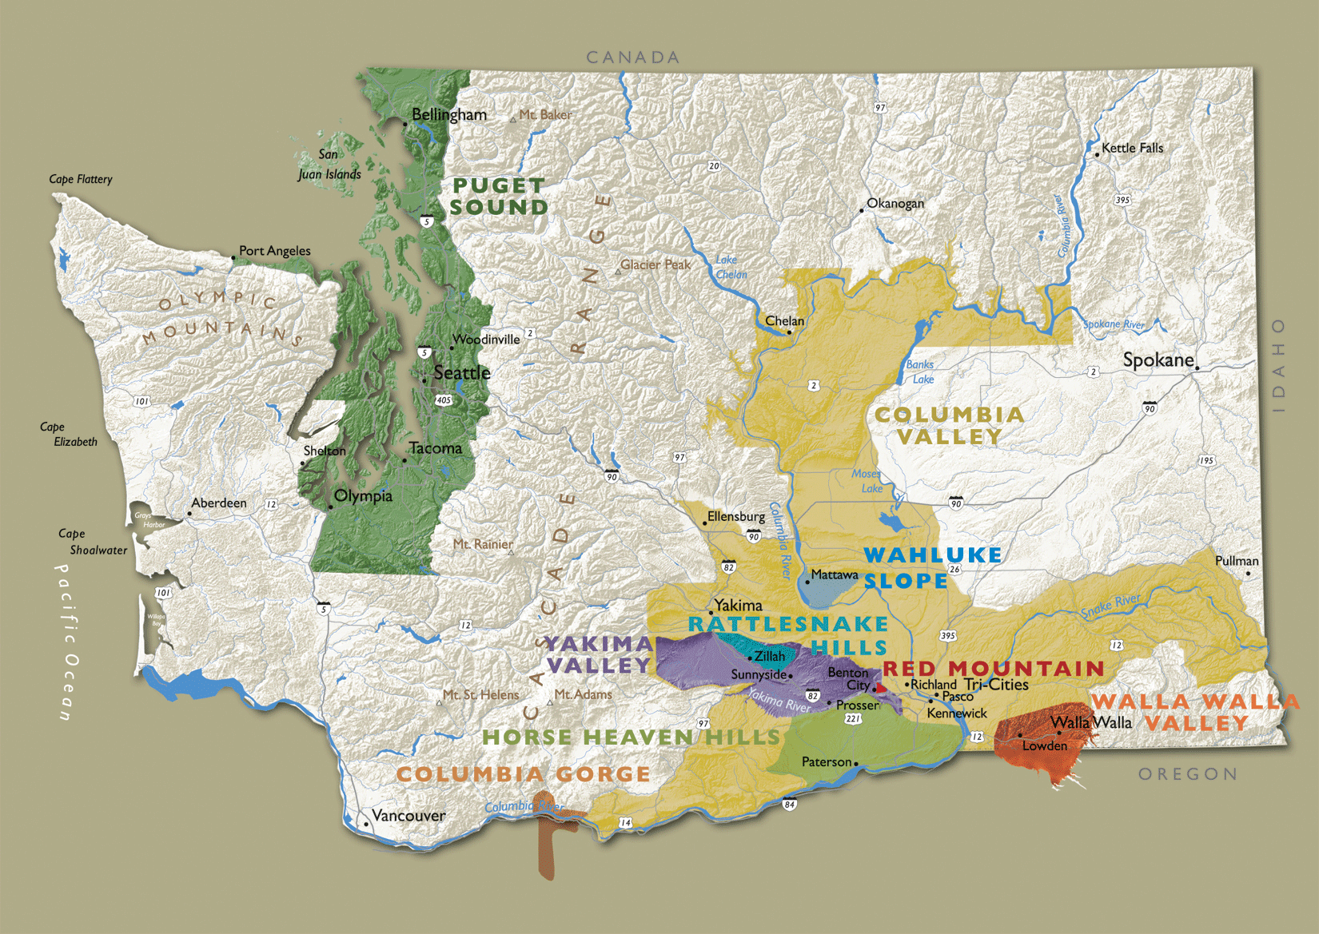
Washington

Slide 2
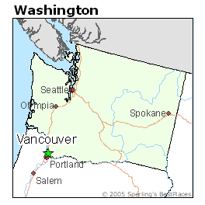
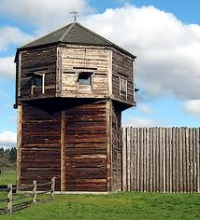
Washington State Wines
Grapes were first planted for personal use in 1825 by early immigrants who acquired vine cuttings at Fort Vancouver to take with them to their new farms.

Slide 3
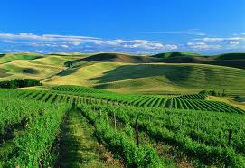
By 1859 grapes make their way
to the Walla Walla Valley.

Slide 4
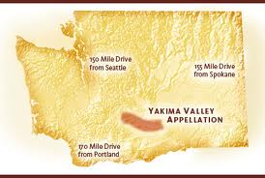
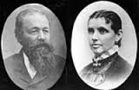
An immigrant named Charles Schanno moves northwest to the Yakima Valley in 1869 and plants grapes and begins making wine.

Slide 5
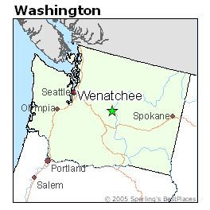
Within a decade grape growing in
the region had expanded north to the town of Wenatchee.

Slide 6
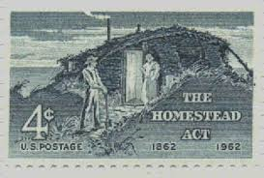
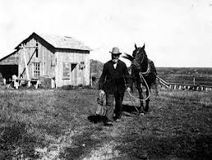
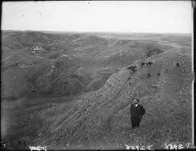
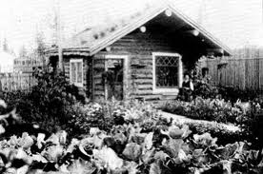
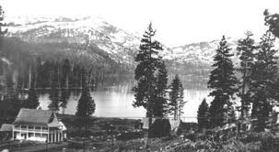
Here John Galler and Phillip Miller each established homesteads.
By 1874 they were producing 1,500 gallons annually.

Slide 7
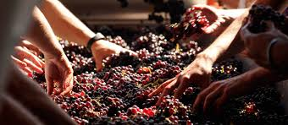
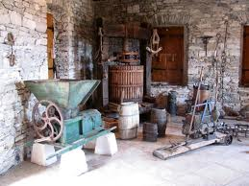
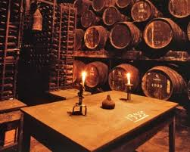
Still at this time the vast majority of wines were made amateurishly and for personal consumption.

Slide 8
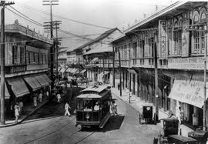
The commercial industry began to develop around the turn of the century.

Slide 9
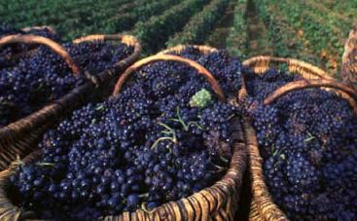
In 1905 a Seattle attorney named Elvert Blaine founded Stone House Winery in the middle of the Yakima Valley.

Slide 10
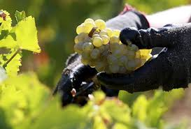
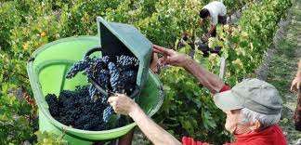
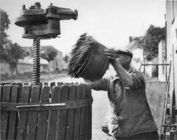
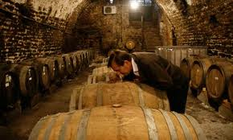
He hired a French Canadian winemaker
began using traditional French
winemaking grapes and techniques

Slide 11
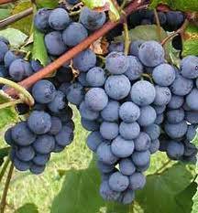
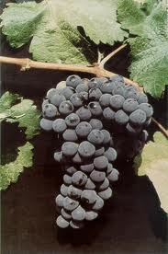
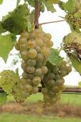
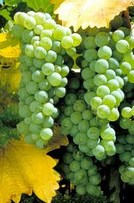
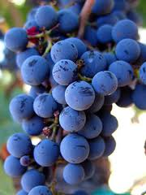
More and more people began growing grapes and experimenting with different varieties.

Slide 12
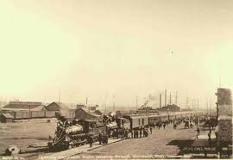
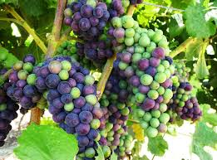
In 1911 the Columbia River Valley Grape Carnival was held in Kennewick, WA.
Over 40 different varieties of grapes entered.

Slide 13
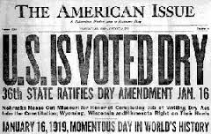
Prohibition
Although wineries were devastated by the prohibition law, vineyards flourished, producing grapes for juice and for home wine making.

Slide 14
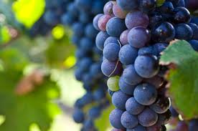
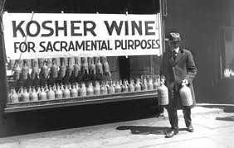
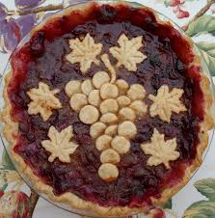
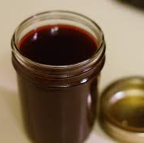
In 1920 there were 1,800 tons of fruit annually and by 1929 the number had grown to 6,200, mostly Concord.

Slide 15
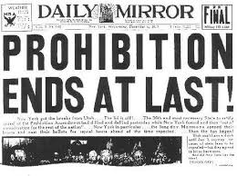
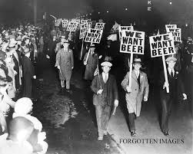
When prohibition was repealed in 1933 the state set up the WA state liquor control board.

Slide 16
Wine and spirits could only be sold from a state controlled store.

Slide 17
Wine and spirits could only be sold from a state controlled store.
They wanted to regulate consumption, but also wanted to encourage the states wine industry.

Slide 18
Wine and spirits could only be sold from a state controlled store.
They wanted to regulate consumption, but also wanted to encourage the states wine industry.
They gave significant tax breaks on wines produced from grapes grown in the state, putting wines from CA and Europe at a large competitive disadvantage.

Slide 19
The first winery after prohibition ended was
St Charles Winery on Stretch Island in the Puget Sound.

Slide 20
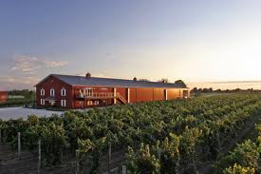
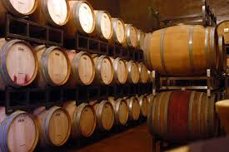
By 1937 there were 42 wineries
operating in the state.

Slide 21
By 1942, with the outbreak of war the number had reduced to 26.
During the war years mostly concord grapes were grown and quality levels were average.

Slide 22
Protectionist laws were still in effect so there was little reason to change the quality of the wines.
Even though the number of wineries had diminished, the market share in the state was as high as 65.7%.

Slide 23
This trend continued until the 1960’s.

Slide 24
In the Early ’60s WSU began doing studies on winemaking and the growing of premium grapes in eastern WA.

Slide 25
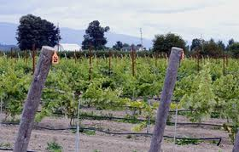
Dr. Charles Nagle set up test vineyards and produced wines that showed the states potential to produce fine wines.

Slide 26
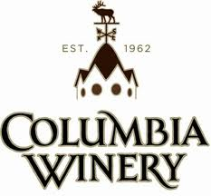
In 1962 a group of amateur winemakers incorporated and formed the Associated Vintners and began producing premium wines.
Associated became Columbia Winery in 1983.

Slide 27
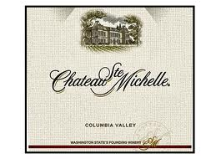
In 1967 AWG, one of the states biggest wineries, hired renowned California winemaker Andre Tchelistcheff as a consultant and renamed their brand Ste. Michelle.

Slide 28
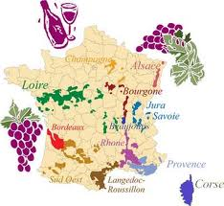
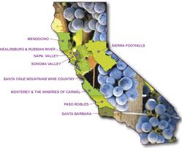
In 1969 the WA state legislature removed the tax on wine imported from out of the state.
This increased competition and forced wineries to improve quality.

Slide 29
In the 1980’s two trade organizations were formed to help promote the WA state wine industry.

Slide 30
In the 1980’s two trade organizations were formed to help promote the WA state wine industry.
1981-The WA State Wine Institute

Slide 31
In the 1980’s two trade organizations were formed to help promote the WA state wine industry.
1981-The WA State Wine Institute
1983- The WA State Wine Commission

Slide 32
In the 1980’s two trade organizations were formed to help promote the WA state wine industry.
1981-The WA State Wine Institute
1983- The WA State Wine Commission
Both were created to promote marketing of WA wine and the business interests of wineries.

Slide 33
8.6 Billion Dollar Industry
Number of Licensed Washington Wineries, 2013: 750+
Number of Vineyards: 350+
Vineyard Acreage: 43,849
Grape Crop Size (Tons): 188,000
Value of Grape Crop/Vineyard
Revenue: $1 billion
Full-time Equivalent Jobs 27,455
Wages Paid $1,174,010,066
Cases of Washington Wine Produced, 2010 (9L equivalents): 11.2 million
Retail Value of Washington Wine: $1.47 billion
Winery Revenue: $1,007,854,109
Wine Related Tourism Expenditures $1,059,217,000.00
Number of Wine Related Visits:
2.4 million
Taxes Paid:
State and Local: $237,724,633
Federal: $304,891,053
All States & Local:$634,732,581
Federal:$716,951,240
Charitable Contributions² $5.5 million $5.8 million

Slide 34
Washington Wine Regions
99% of wines in WA State are grown east of the Cascades.
The east has a dry climate with an average rainfall of 8 inches per year, one fifth the amount as the west coast.
The eastern area also has adequate water for irrigation with an ideal climate during the growing season.

Slide 35
American Viticultural Area
WA State has 13 Appellations or AVAs.
1.Yakima Valley - 1983
2.Walla Walla Valley - 1984
3.Columbia Valley - 1984
4.Puget Sound - 1995
5.Red Mountain - 2001
6.Columbia Gorge - 2004
7.Horse Heaven Hills - 2005
8.Wahluke Slope - 2006
9.Rattlesnake Hills - 2006
10.Snipes Mountain - 2009
11.Lake Chelan - 2009
12.Naches Heights - 2011
13.Ancient Lakes of Columbia Valley - 2012.

Slide 36
American Viticultural Area
Each region is a designated growing area as determined by the BATF, Bureau of Alcohol Tobacco & Firearms.
85% of the grapes used to make the wine must be grown in the area in order to use the name of the AVA on the wines label.

Slide 37
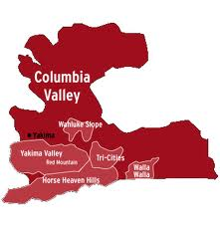
The Columbia Valley
Established in 1987, it is one of the largest AVAs in the country with over 11 million acres with over 18,000 planted to grapes.
The climate is overall uniform, but there are a variety of soils and microclimates that give different terroir.
60% of the states grapes are grown here: Cabernet Sauvignon, Merlot, Chardonnay, White Riesling & Syrah being the most popular.

Slide 38
Yakima Valley
Established in 1983 and being the first WA AVA, the Yakima Valley runs for 60 miles from the southern edge of the town of Yakima to where the Yakima joins the Columbia river.
The valley has gentle rolling hills and gravely soil that drains well.
Grapes: Chardonnay, Merlot, Cabernet Sauvignon & White Riesling

Slide 39
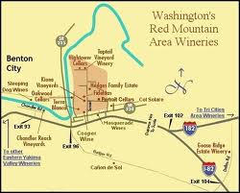
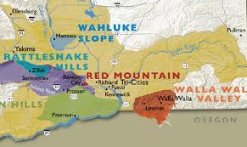
Red Mountain
Established in 2001 & located about 20 miles east of the town of Prosser, Red Mountain is the smallest AVAs with a reputation for producing some of the state’s best wines.
The appellation covers 4,000 acres and is best known for it’s red wines.
Grapes: Cabernet Sauvignon, Merlot, Syrah & Sangiovese

Slide 40
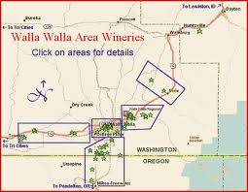
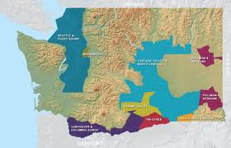
The Walla Walla Valley
Lying at the southeastern edge of the Columbia Valley and extends over the border with Oregon.
Translates as “many waters”, it has many tributaries that flow from the blue mountains into the Walla Walla river.
Averages 19 inches of rainfall a year allowing some vineyards to be dry farmed without irrigation.
Grapes: Chardonnay, Merlot & Cabernet

Slide 41
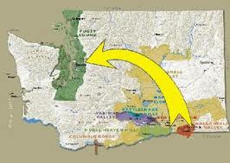
The Puget Sound Region
Located in the Western part of the state with maritime climate, increased rain and freezing temperatures makes it hard to grow grapes.
There are only about 100 acres planted but over 30 wineries.
Most wineries source their grapes from the east to make their wines.
North of Seattle, the town of Woodinville has become a major destination with a number of small and large wineries.
Chateau Ste Michelle and Columbia are located across the street from one another.

Slide 42
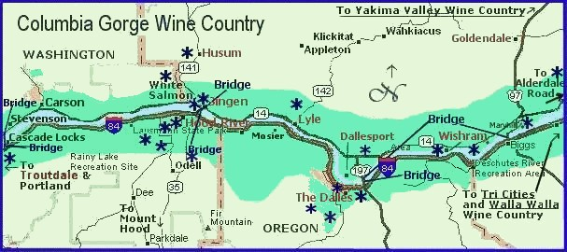
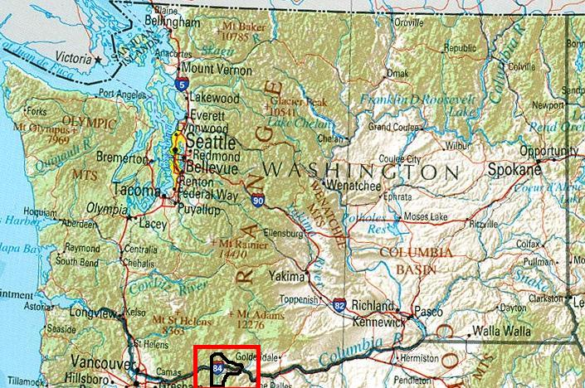
The Columbia Gorge
Established in 2004, its boundaries extend roughly 8 miles on either side of the Columbia River into Oregon and WA.
The climate is different on each side of the Cascade Mountains.
The west is cool and wet and the east is warm and dry.
A wide variety of grapes are grown on each side on a total of over 300 acres.

