Slide 1
Really Very Simple Process
Notes:
It’s really very simple
Wine tasting process

Slide 2
It’s very simple
Do you not like it?
Do you like it?
Like all kinds of art, what we end up appreciating are those
things that we become educated in or develop a taste for
Notes:
Do you like it or don’t you?
Like all kinds of art, what we end up appreciating are those things that we become educated in or develop a taste for

Slide 3
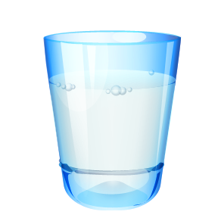
Ground Rules
Odor Free
White Backdrop
Proper temperature
Crackers
Concentration
Water
Spit Cup
Notes:
Ground rules:
Odor free
Proper wine temperature
White back drop
Water, crackers, spit cup
Spitting, concentration

Slide 4
Color
  Concentration
  Variety
  Age

Slide 5
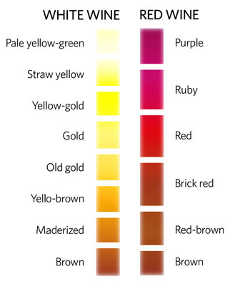
Wine Color Chart
Notes:
Whites: Water white → amber
Water white→straw→pale yellow→yellow→gold→amber
Reds: Purple → brick orange
Purple→ ruby→crimson→ red→garnet→brick orange

Slide 6
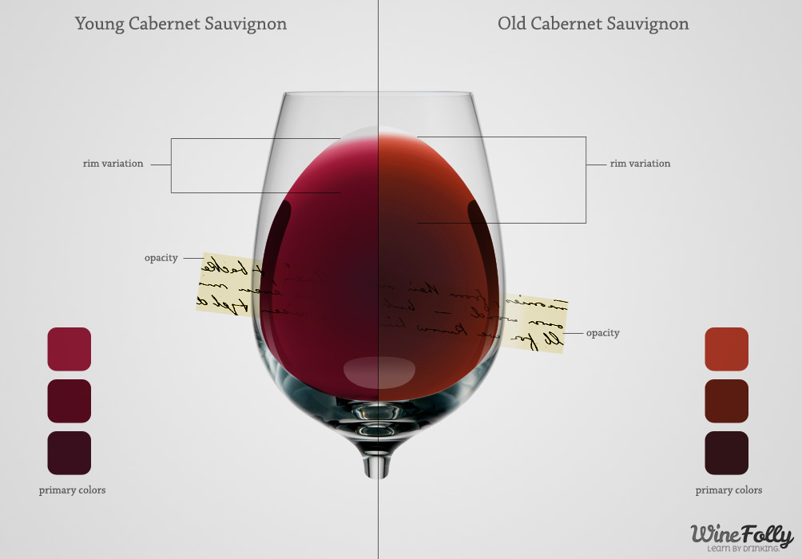

Slide 7
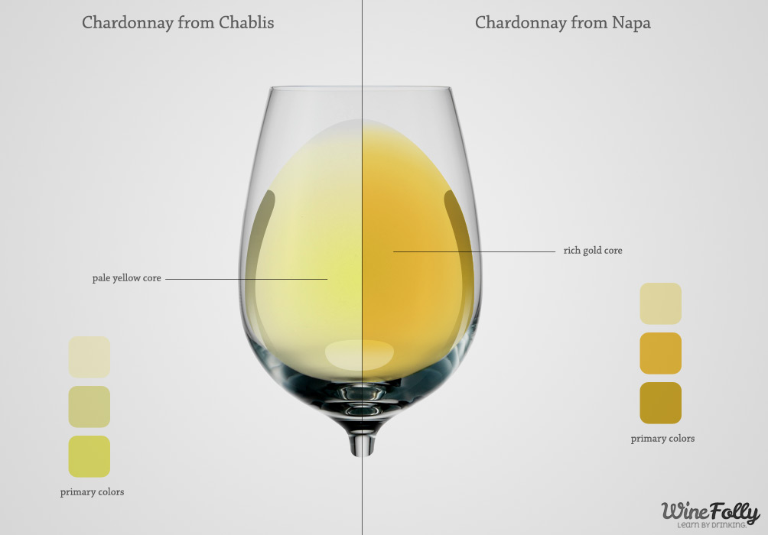

Slide 8
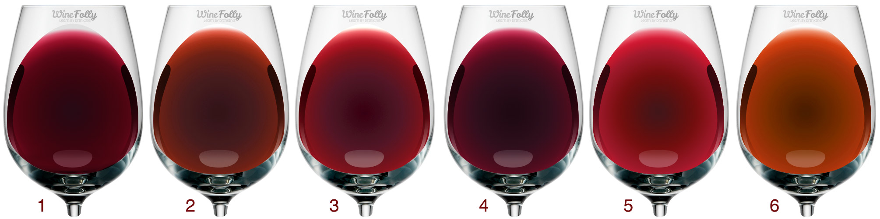
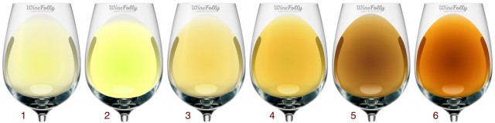
1. young cabernet, 2. old cabernet/merlot, 3. young merlot, 4. young syrah, 5. young pinot noir, 6. old pinot noir
1. Vinho Verde / Pinot Gris, 2. Sauvignon Blanc, 3. Marsanne / Chenin Blanc / Viognier, 4. Chardonnay, 5. Old White Wine, 6. Sherry

Slide 9
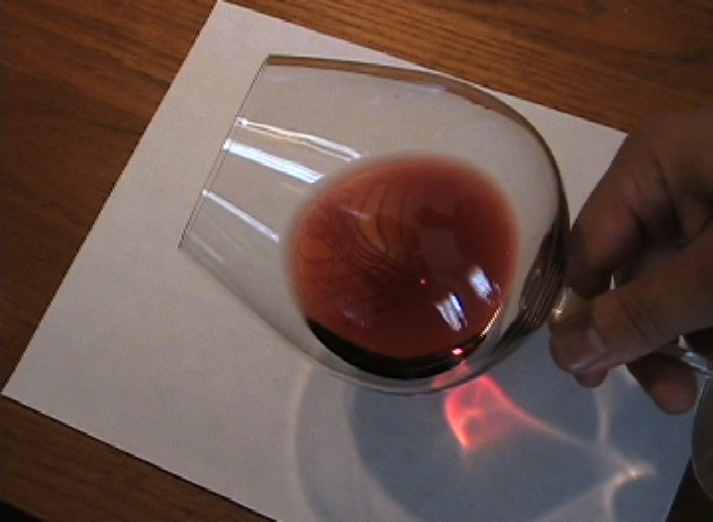

Slide 10
Clarity
  Brilliant →Clear→Dull→Cloudy
  Severely Cloudy
      Heat unstable – proteins in wine when heated break their bonds and make the wine look cloudy
      Cold unstable – tartrate crystals
      Microbial – yeast, bacteria
Note-Many of the best wines are unfiltered to avoid stripping the wine of its precious aromas and flavors. In this case a very slight haze can be normal or even a good thing.
Notes:
Clarity
Brilliant →Clear→Dull→Cloudy
Cloudy
Flaws
Heat unstable – proteins in wine when heated break their bonds and make the wine look cloudy
Use bentonite to attract particles
Cold unstable – tartrate crystals
Chill wine to 26
Microbial – yeast, bacteria
Sterile filter

Slide 11
Aroma
  The sense of smell and detecting the aromas in wine is the primary means through which wine is tasted and evaluated.
Notes:
Clarity
Brilliant →Clear→Dull→Cloudy
Cloudy
Flaws
Heat unstable – proteins in wine when heated break their bonds and make the wine look cloudy
Use bentonite to attract particles
Cold unstable – tartrate crystals
Chill wine to 26
Microbial – yeast, bacteria
Sterile filter

Slide 12
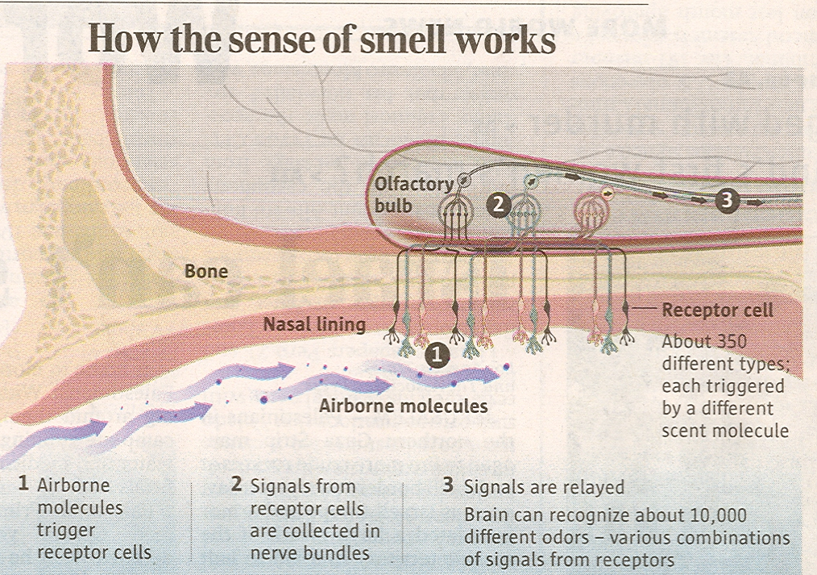
Notes:
Work of Dr Linda Buck, Nobel prize winner for her research on the sense of smell:
Humans can detect anywhere from 10k to 100k odors.
Humans have 350 receptors and mice have 1000.
never want to compete with a mouse for cheese!
Aroma pathway: receptors in the nose to olfactory bulb olfactory cortex in your brain.
With the ability to smell being 1000 times more acute than that of taste, it is amazing how much people miss by not developing this sense and lexicon.
Key word is develop. You can train yourself. It is a matter of concentration, definition and memory.
Fatigue: ie..going into aromatic kitchen and all of a sudden you can’t smell it anymore. Part of sensory adaptation. Allows you to adjust to a constant smell and prepare to be sensitive to change in smell. This occurs with sight, too. Think of your eyes adjusting in a movie theatre. Sound, etc.

Slide 13
Variety
Origin
Winemaking
Age
Flaws
Notes:
Chemical make up of wine includes a bunch of smells or trace elements that all come together to make up what we’re smelling in one wine. Some of these elements are found in things like, food, spices, fruit, flowers, etc that are already familiar to us, So, it is not unusual for us to say this wine smells like these things that we are already familiar with. It’s just a metaphor, there is no cherry juice in that Pinot Noir.
Aroma Wheel

Slide 14
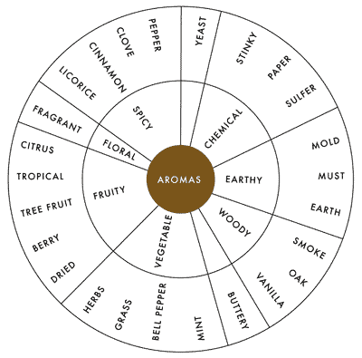

Slide 15
Acid
Sweet
TASTE
Umami
Salt
Bitter
Notes:
We are able to taste 5 things (just do 4 if you feel uncomfortable explaining Umami)
Umami - not a new thing. This ‘fifth’ taste was actually discovered in 1908 by a Japanese researcher at Tokyo Imperial University. It is an amino acid called L-glutamate found in high protein sources. Usually very high personality foods.
Palate fatigue takes place after about 40 seconds. Therefore, keep wine moving in your mouth. Proof is that we think our own saliva doesn’t have any taste. But when you kiss someone, you find out the indeed, it does!

Slide 16
BITTER
UMAMI
SOUR
SALTY
SOUR
SWEET
2003 info: old info based upon misinterpreted research done in 19th century!
Notes:
2003 info: old info based upon misinterpreted research done in 19th century! The Scientific American, Mar 2001, as reported by David Smith and Robert Margolskee. No evidence that any type of spatial segregation of sensitivities exists!
9000 taste buds on the average tongue.
Taste sensitivity varies from one person to another
Bitter from alkaloids such as those contained in quinine and coffee.
Salt (sodium chloride – table salt),or sodium nitrite in smoked meats
Acids – citric in fruit, malic in apples, pears, etc
Sugars – primarily sucrose (table sugar) fructose, glucose,

Slide 17
Sweetness
Acidity
Tannin
Body/Weight
Flavor
Notes:
Sweetness
Dry→Off dry→Semi-sweet→Sweet→Very sweet
Acidity
Tart →flat→flabby
Tannin
Smooth, soft →bitter→mouth puckering pain!
Body/Weight (alcohol and dissolved solids)
Light (thin)
Medium
Full (rich, round, heavy, creamy)
REMEMBER, alcohol can make seem hot on your tongue

Slide 18
Aroma
Taste
FLAVOR
Psychological
Touch
Notes:
The components that all come together to compose FLAVOR are…Aroma, Taste, Touch, and Psychological.
(Touch: hot vs cold; heat from pepper; crispness…
Psycho: experience that makes you feel one way or another about a food)

Slide 19
Sweetness
Acidity
Tannin
Body/Weight
Flavor
Quality
Notes:
Quality
Complexity
Balance
Alcohol & Sweetness - softness, smoothness
Tannin & Acid - 'firmness'
Length in finish
Depth
Typicity

Slide 20
Quality
‘The quality of a wine
is the totality of its properties...which render it
acceptable or desirable.
In effect, it is the totally subjective pleasure provided by drinking the wine
which conditions judgement.”
  Emile Peynaud

Slide 21
Balance
“…so that no single one of them is obtrusive on the palate.” Emile Peynaud
Notes:
BALANCE, explain
Emile Peynaud was a Bordeaux enologist whose work had a profound influence on winemaking and wine appreciation in the last half of the 20th century. Things we take for granted today:
1) Good wine starts in the vineyard
2) Complete control of ML
Basically ...Two reasons to blend:
1) to create a wine that is better than any one of the components it is made of
2) to create a blend that provides uniform experience from year to year
EXAMPLE: nv brut…house Champagne or Vintage Character Port

Slide 22
Sensory Evaluation
Components of Wine
  Residual Sugar
  Acidity
  Tannin
  Alcohol
  Balance

Slide 23
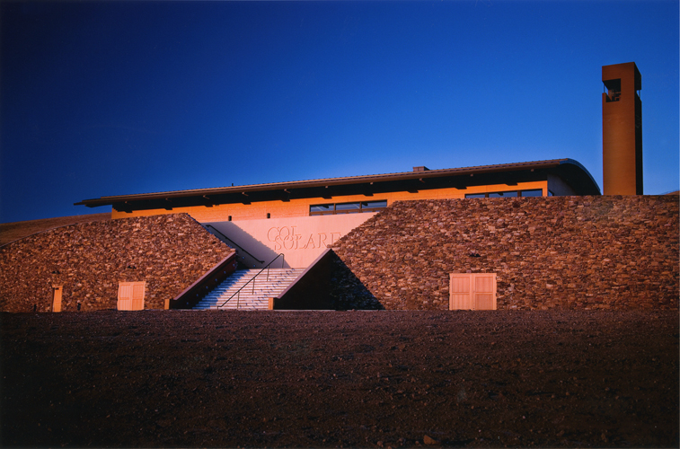

Slide 24
Sensory Evaluation
Control
Residual Sugar
Acidity
Tannin
Alcohol
TCA – cork taint

Slide 25
Sensory Evaluation
Control
Residual Sugar
Acidity
Tannin
Alcohol
TCA – cork taint

Slide 26
Sensory Evaluation
Control
Residual Sugar
Acidity
Tannin
Alcohol
TCA – cork taint

Slide 27
Sensory Evaluation
Control
Residual Sugar
Acidity
Tannin
Alcohol
TCA – cork taint

Slide 28
Sensory Evaluation
Control
Residual Sugar
Acidity
Tannin
Alcohol
TCA – cork taint

