Slide 1
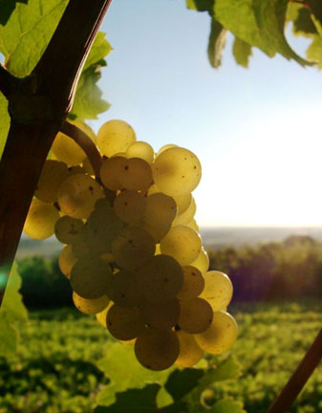
Riesling

Slide 2
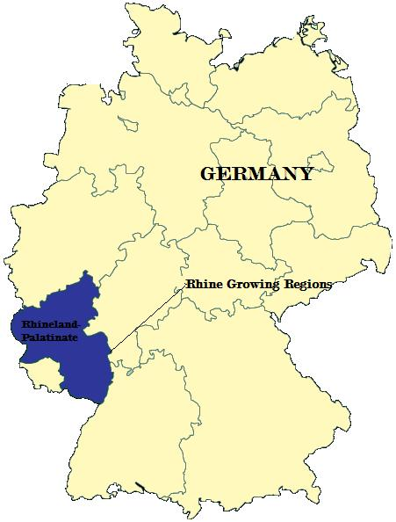
Riesling is a white grape variety which originated in the Rhine region of Germany. Riesling is an aromatic grape variety displaying flowery, almost perfumed, aromas as well as high acidity. It is used to make dry, semi-sweet, sweet and sparkling white wines.

Slide 3
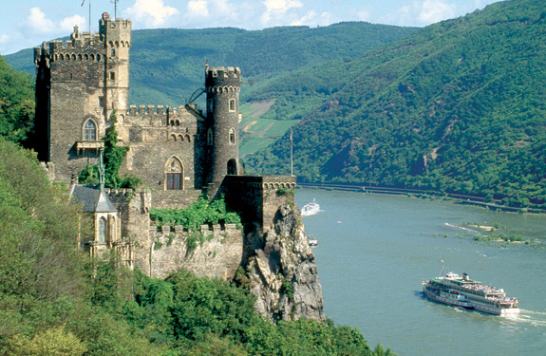
Riesling is a variety which is highly "terroir-expressive", meaning that the character of Riesling wines is clearly influenced by the wine's place of origin.

Slide 4
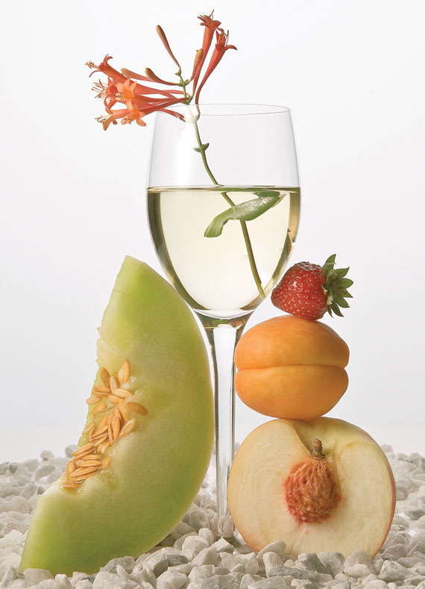
Riesling wines are often consumed when young, when they make a fruity and aromatic wine which may have aromas of green or other apples, grapefruit, peach, gooseberry, honey, rose blossom or cut green grass, and usually a crisp taste due to the high acidity

Slide 5
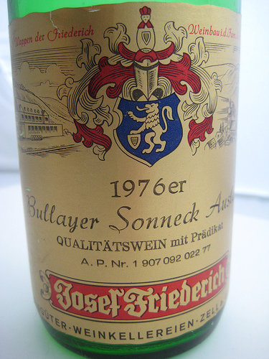
Riesling's naturally high acidity and range of flavours make it suitable for extended aging, some hundreds of years old.

Slide 6
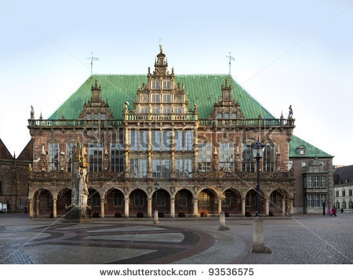
The town hall of Bremen, Germany, stores various German wines, including Riesling based wines, in barrel back to the 1653 vintage

Slide 7
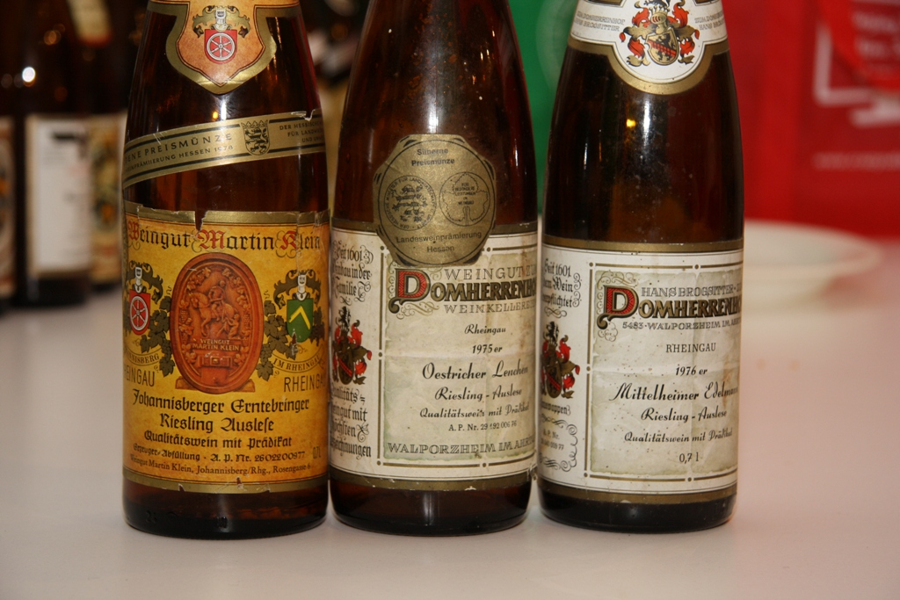
More common aging periods for Riesling wines would be 5–15 years for dry, 10–20 years for semi-sweet and 10-30+ for sweet versions.

Slide 8
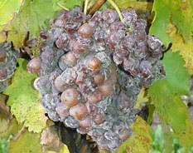
The most expensive wines made from Riesling are late harvest dessert wines, produced by letting the grapes hang on the vines well past normal picking time. Through evaporation caused by the fungus Botrytis cinerea ("noble rot") or by freezing, as in the case of ice wine (in German, Eiswein), water is removed and the resulting wine offers richer layers on the palate.

Slide 9
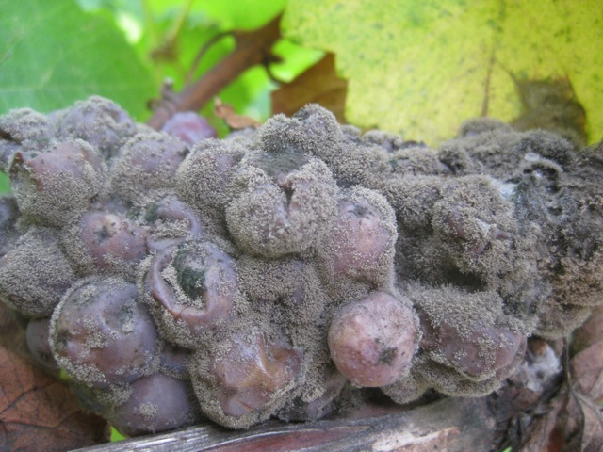
The beneficial use of "noble rot" in Riesling grapes was discovered in the late 18th century at Schloss Johannisberg. Permission from the Abbey of Fulda (which owned the vineyard) to start picking Riesling grapes arrived too late and the grapes had begun to rot; yet it turned out that the wine made from them was still of excellent quality

Slide 10
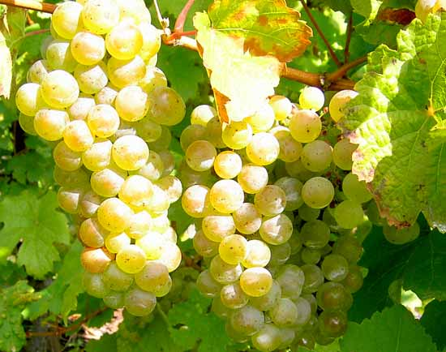
Germany
Riesling is Germany’s leading grape variety, known for its characteristic “transparency” in flavor and presentation of terroir, and its balance between fruit and mineral flavours.

Slide 11
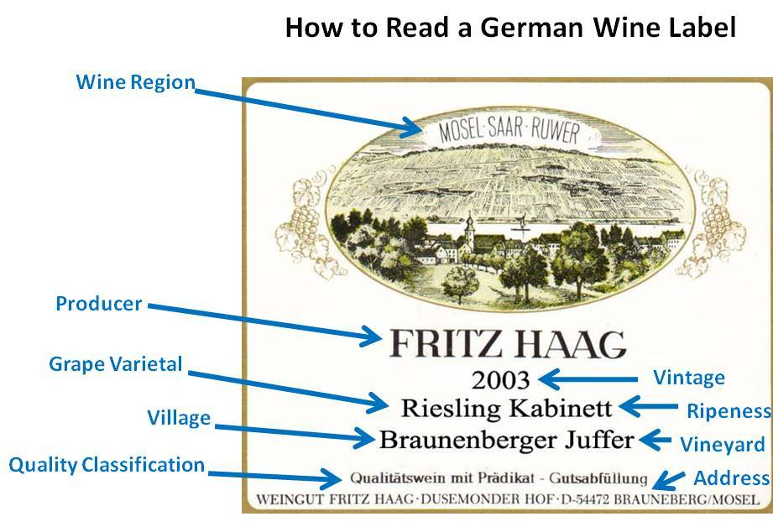
In Germany, Riesling normally ripens between late September and late November, and late harvest Riesling can be picked as late as January.

Slide 12
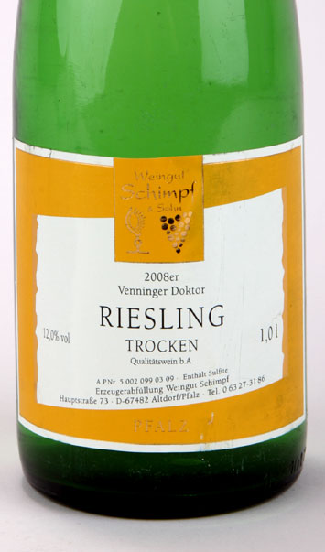
STYLES
Trocken - “Dry” – For a German Riesling to be classified in the “trocken” style, there can be a maximum amount 0.4% residual sugar for wines with lower acidity and up to 0.9% residual sugar for wines with higher acidity.

Slide 13
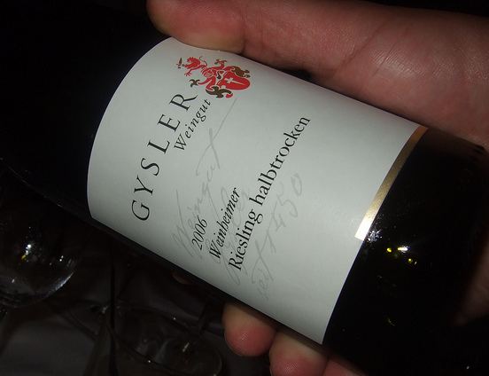
Halbtrocken - “Half-Dry” – To be classified in the “halbtrocken” style, there can be a maximum amount of 1.2% residual sugar for wines with lower acidity and up to 1.8% residual sugar for wines with higher acidity.

Slide 14
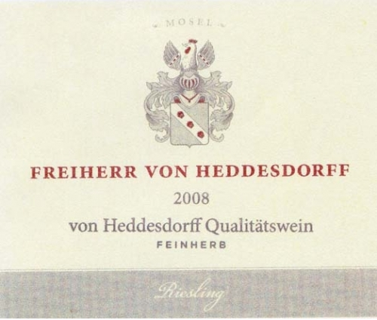
Feinherb - “Off-Dry” – This style is slightly sweeter than halbtrocken, with an unregulated designation.

Slide 15
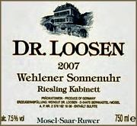
RIPENESS CLASSIFICATION
Kabinett - Essentially the first level of reserve grape selection, which have achieved minimum defined potential alcohol levels. Kabinett style Riesling is lower in alcohol (8%-10%) and are made in the drier style. This style of Riesling is a fantastic option for pairing with a wide variety of foods.

Slide 16
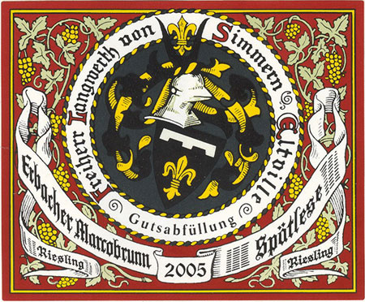
Spätlese – Translated as “late picking” and refers to Riesling grapes picked late during the harvest season. This style is usually medium in body and can be made either in the dry or sweet style. This Riesling style holds up well with foods with a bit of spice.

Slide 17
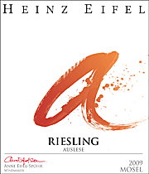
Auslese - Translated as “out picked” or select harvest, and refers to ripe grapes picked out from a specific cluster of berries. This style can be crafted into either a dry or sweet style, and is the first Riesling range that may exhibit true dessert wine status.

Slide 18
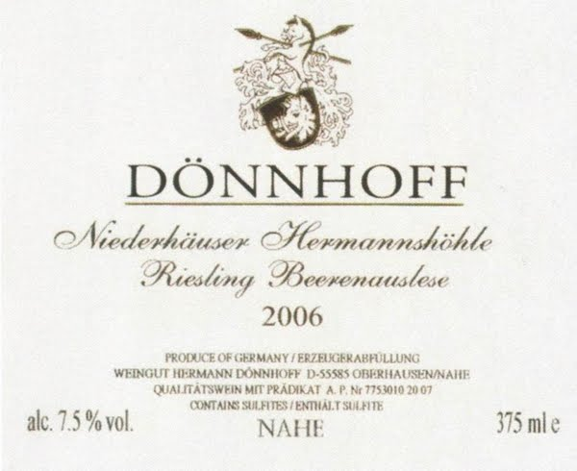
Beerenauslese – Translated as “selected harvest of berries” and refers to grapes that have been affected by Botrytis, or noble rot, and hand selected. This style is a luxurious dessert wine and pairs nicely with a myriad of desserts, more specifically peach-based desserts and caramel delights.

Slide 19
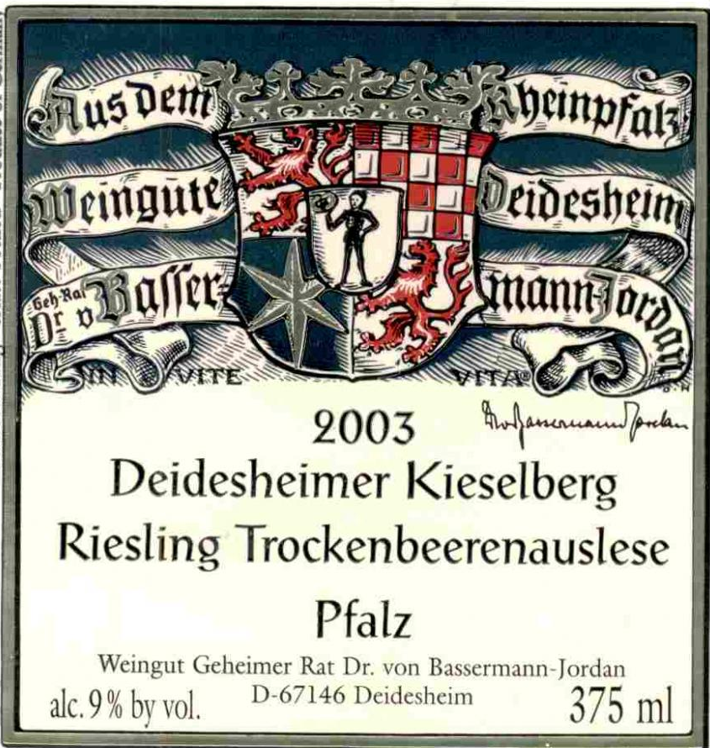
Trockenbeerenauslese - Translated as “dry berry select picking” and refers to a late harvest, Botrytis (noble rot) picking, where the berries have started to shrivel on the vine, thus concentrating the sugars and creating ultra concentrated, nectar like dessert wines

Slide 20
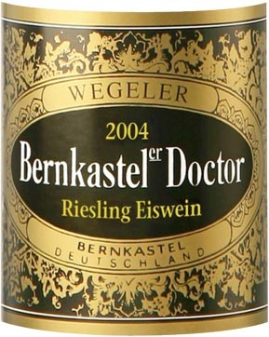
Eiswein - Translated as “ice wine” and refers to grapes that have been frozen on the vine. Unlike trockenbeerenauslese styles, the grapes for Eiswein should not be affected by Botrytis. Eiswein is created from pressing frozen grapes, and produces a low-yield, high flavor, rich dessert wine.

Slide 21
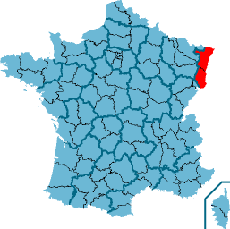
Alsace (France)
Riesling is on record as being planted in the Alsace region by 1477. Today over a fifth of Alsace's vineyards are covered with Riesling vines, mostly in the Haut-Rhin district, with the varietal Riesling d'Alsace being very different from neighboring German Riesling

Slide 22
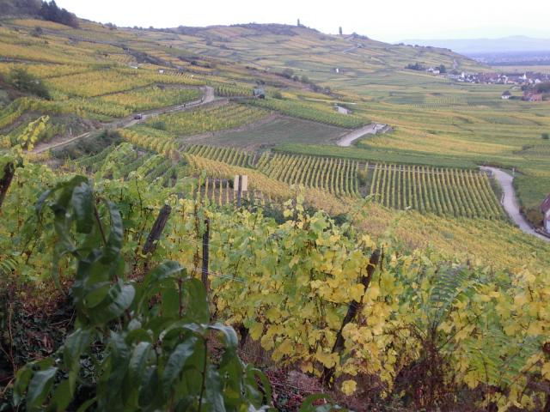
This is partly from difference in the soil with the clay Alsatian soil being more dominantly calcareous than the slate composition of Rheingau. The other differences come in wine making styles,

Slide 23
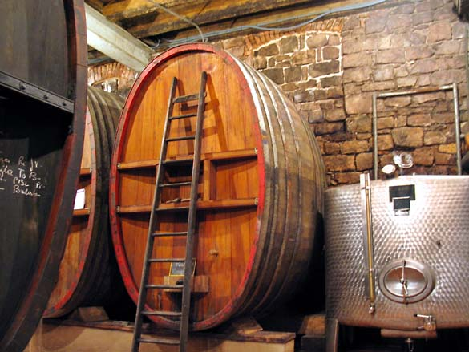
the Alsatian preferring more French-oriented methods that produce wines of higher alcohol content (normally around 12%) and more roundness due to longer time spent in neutral oak barrels or steel tanks.

Slide 24
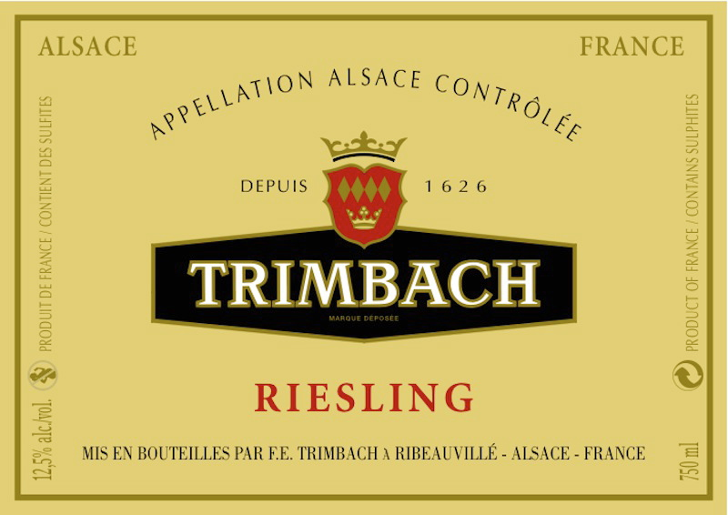
Rieslings d'Alsace tend to be mostly very dry with a cleansing acidity. They are thick-bodied wines that coat the palate. These wines age exceptionally well with a quality vintage aging up to 20 years.

Slide 25
This is beneficial since the flavors in an Alsace wine will often open up after three years, developing softer and fruitier flavours

Slide 26
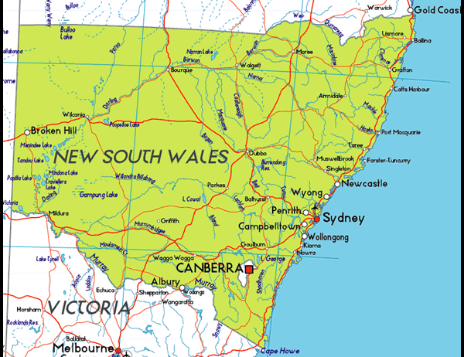
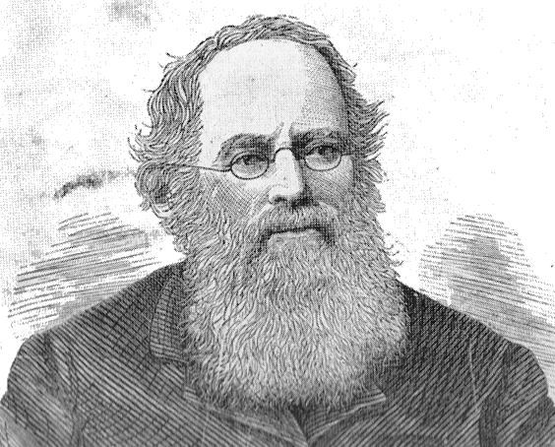
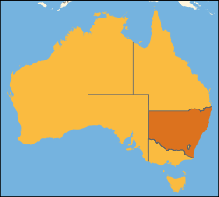
Australia and New Zealand
In 1838 William Macarthur planted Riesling vines near Penrith in New South Wales. Riesling was the most planted white grape in Australia until the early 1990s when Chardonnay greatly increased in popularity

Slide 27
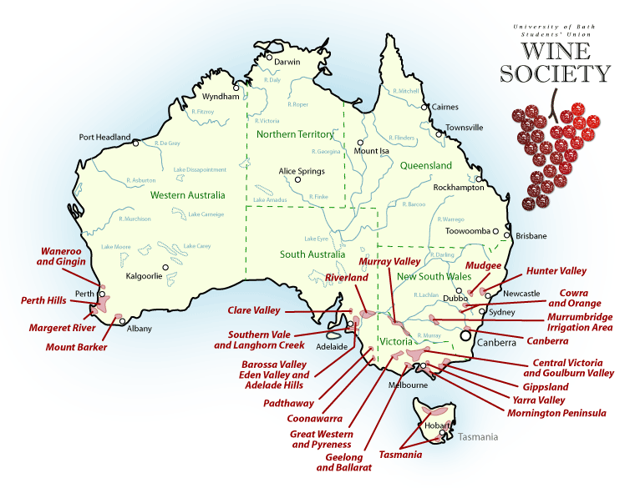
Riesling still flourishes in the Clare Valley, in particular the areas of Watervale and around the Polish Hill River, and the cooler Eden Valley and High Eden regions. Riesling is also being grown with increasing popularity in the Western Australian regions Albany, Frankland River and Porongorup.

Slide 28
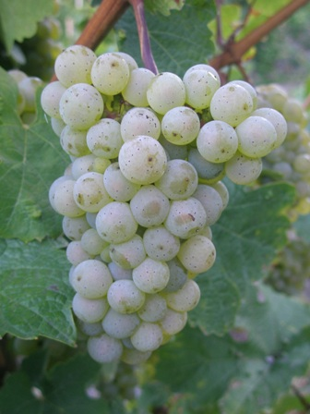
The warmer Australian climate produces thicker skinned grapes, sometimes seven times the thickness of German grown grape. The grapes ripening in free drain soil composed of red soil over limestone and shale, producing a lean wine that as it matures produces toasty, honeycomb and lime aromas and flavors.

Slide 29
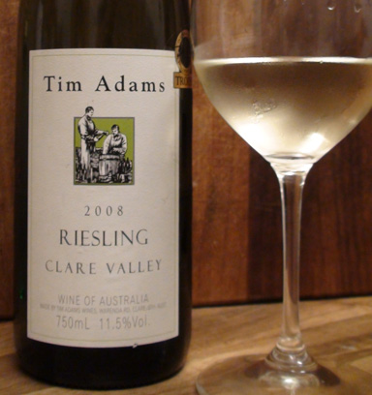
Australian Rieslings are noted for their oily texture and citrus fruit flavors in their youth and a smooth balance of freshness and acid as they age

Slide 30
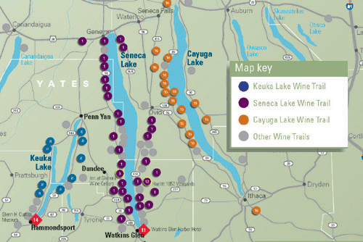
United States
New York, particularly in the Finger Lakes region, was one of the earliest U.S. producers of Riesling. Plantings started to appear in California by 1857 and followed in Washington State in 1871

Slide 31
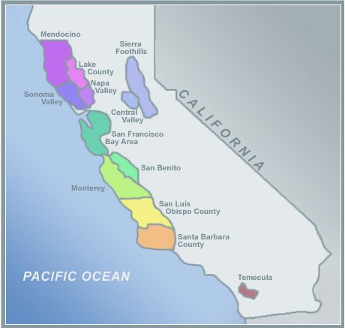
In California, Riesling lags far behind Chardonnay in popularity and is not as commonly planted. A notable exception is the growing development of high quality Late Harvest dessert wines.

Slide 32
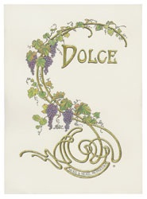
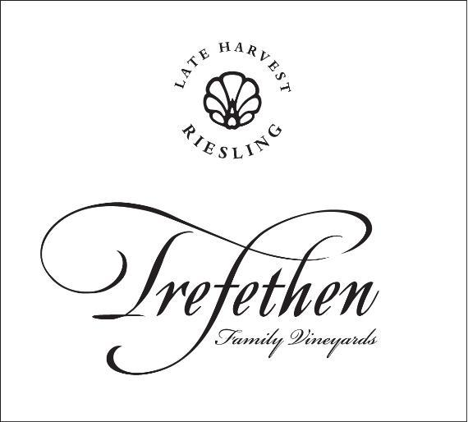
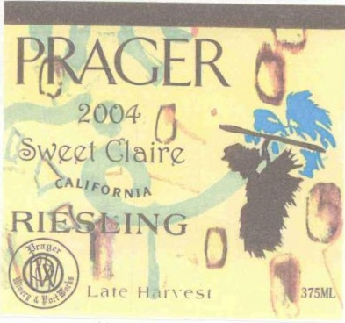
So far, the Late Harvest wines most successfully produced are in the Anderson and Alexander Valleys where the weather is more likely to encourage the needed botrytis to develop.

Slide 33
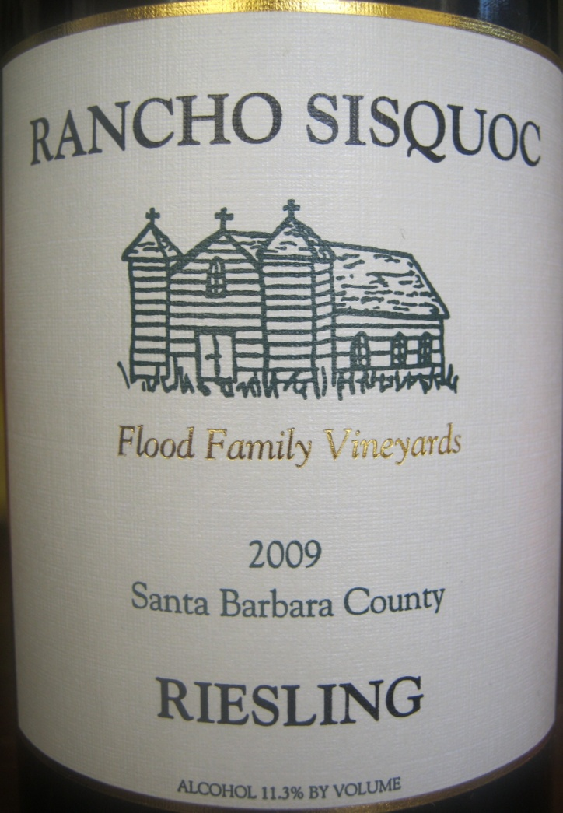
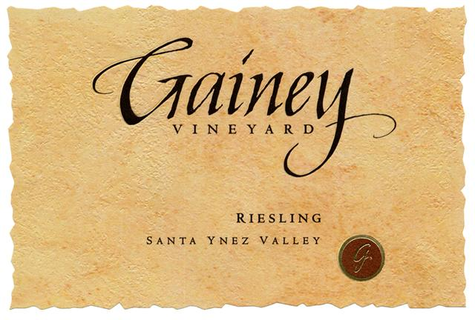
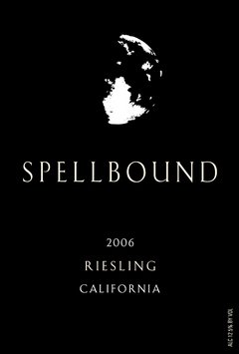
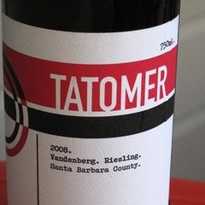
The Riesling that does come out of California tends to be softer, fuller, and having more diverse flavours than a "typical" German Riesling.

Slide 34
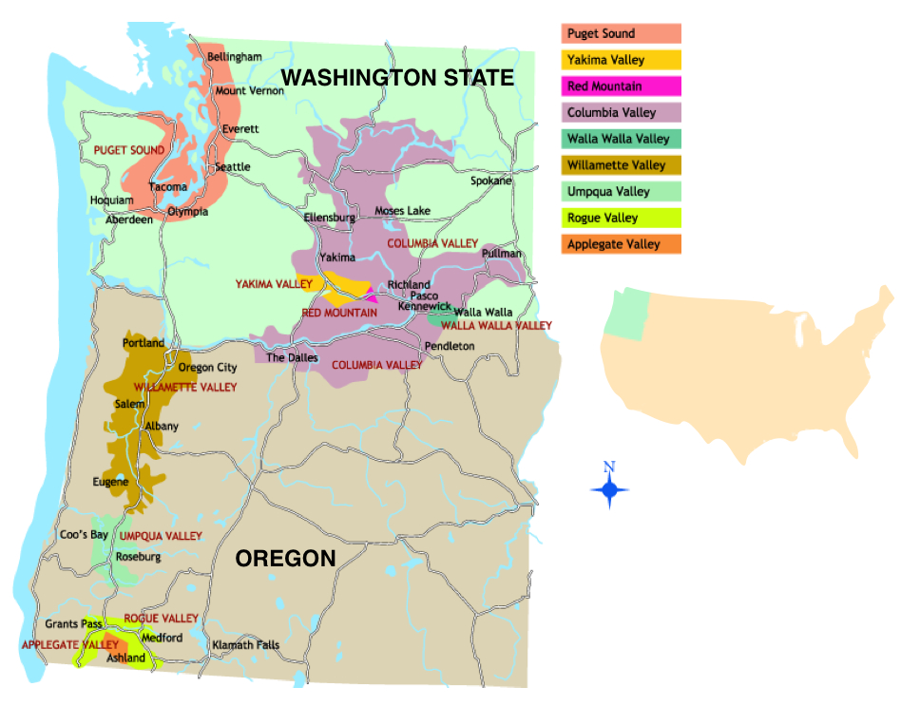
In the Pacific Northwest there is a stark contrast in Riesling production. The grape is currently on the rise in Washington State but on the decline in neighboring Oregon.

Slide 35
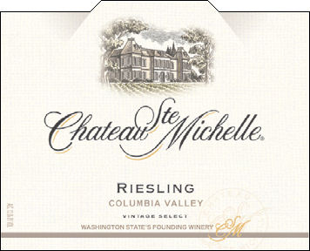
Riesling from this area ranges from dry to sweet, and has a crisp lightness that bodes well for easy drinking.

Slide 36
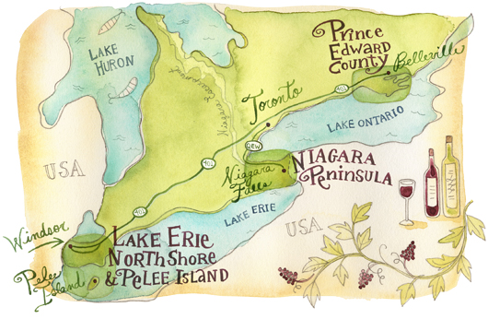
Canada
In Ontario, Riesling is commonly used for Icewine, where the wine is noted for its breadth and complexity. Niagara is a major producer of ice wine in general, putting it neck-and-neck with Germany.

Slide 37
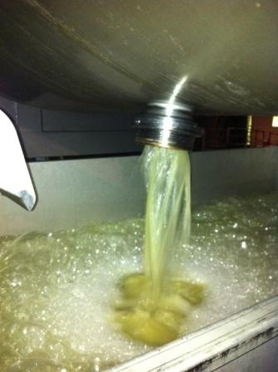
Production
In wine making, the delicate nature of the Riesling grape requires special handling during harvesting to avoid crushing or bruising the skin. Without this care, the broken skins could leak tannin into the juice, giving a markedly coarse taste and throwing off balance the Riesling’s range of flavours and aromas.

Slide 38
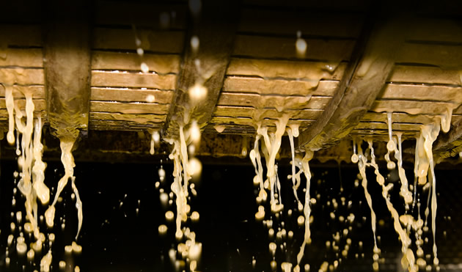
A wine that is best at its “freshest” states, the grapes and juice may be chilled often throughout the vinification process.

Slide 39
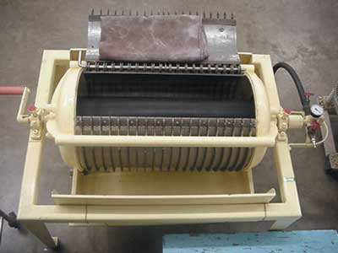
Once, right after picking to preserve the grapes' more delicate flavours. Second, after it has been processed through a bladder press and right before fermentation.

Slide 40
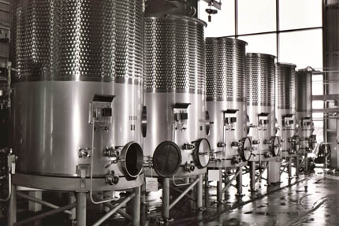
During fermentation, the wine is cooled in temperature controlled stainless steel fermentation tanks kept between 10 and 18 °C (50 and 64 °F).

Slide 41
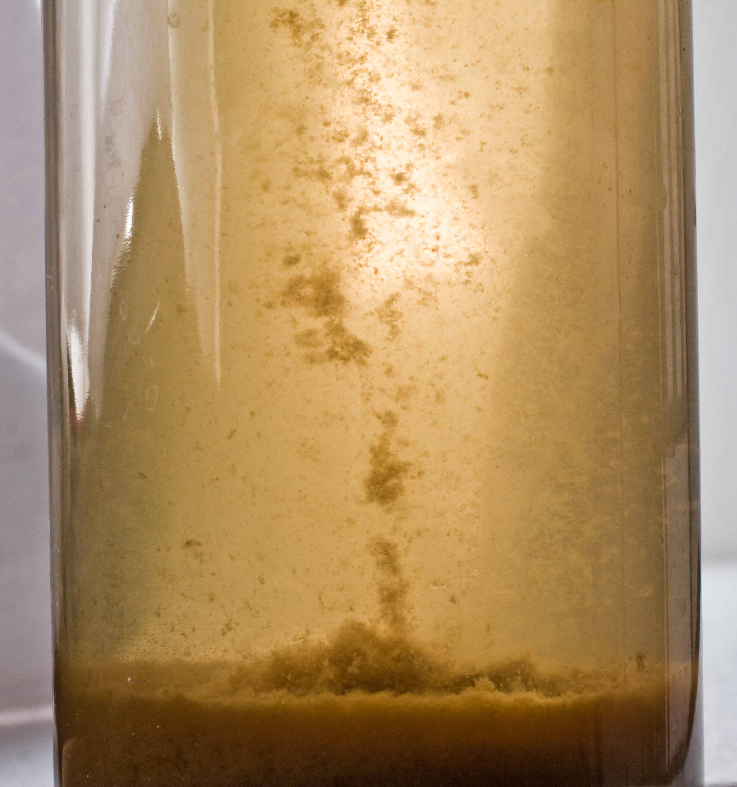
Unlike Chardonnay, most Riesling do not undergo malolactic fermentation. This helps preserve the tart, acidic characteristic of the wine that gives Riesling its “thirst-quenching” quality.

Slide 42
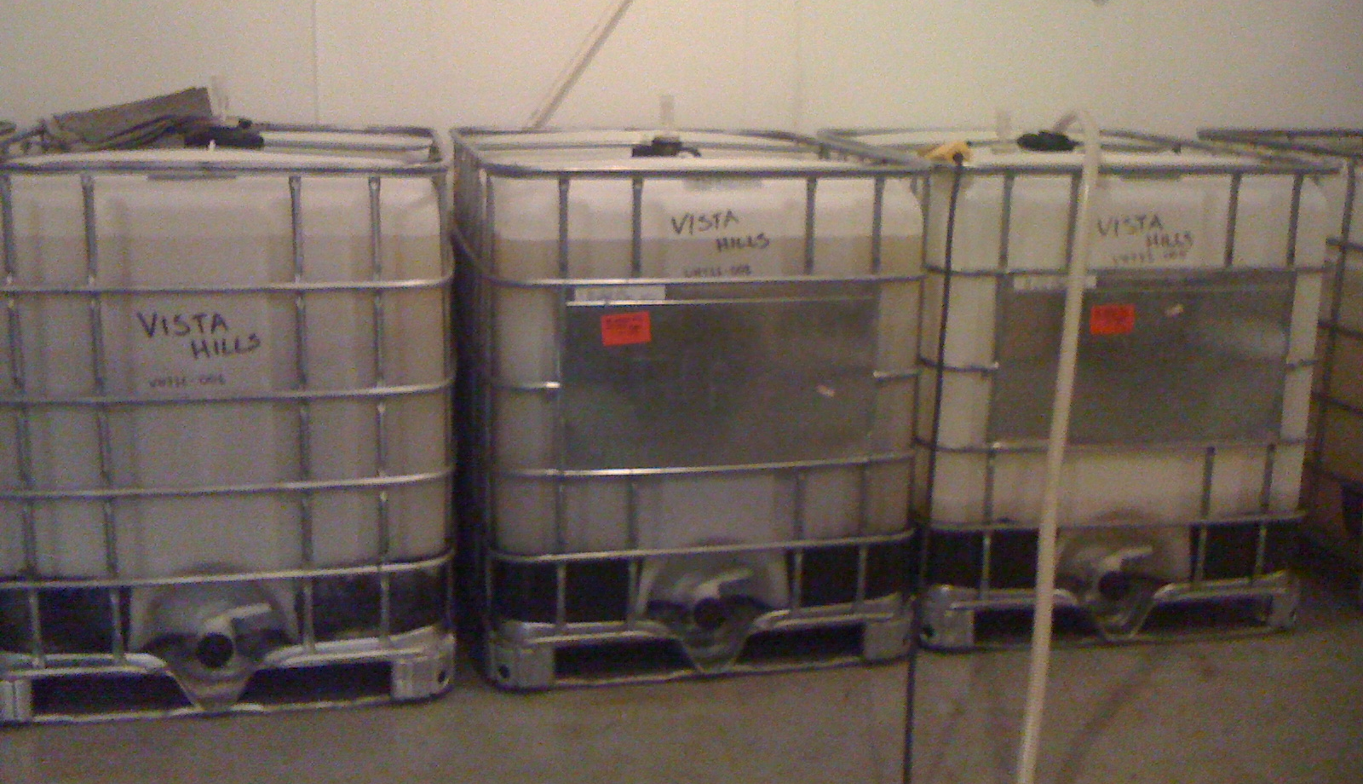
Riesling is often put through a process of cold stabilization, where the wine is stored just above its freezing point. The wine is kept at this temperature until much of the tartaric acid has crystallized and precipitated out of the wine

Slide 43
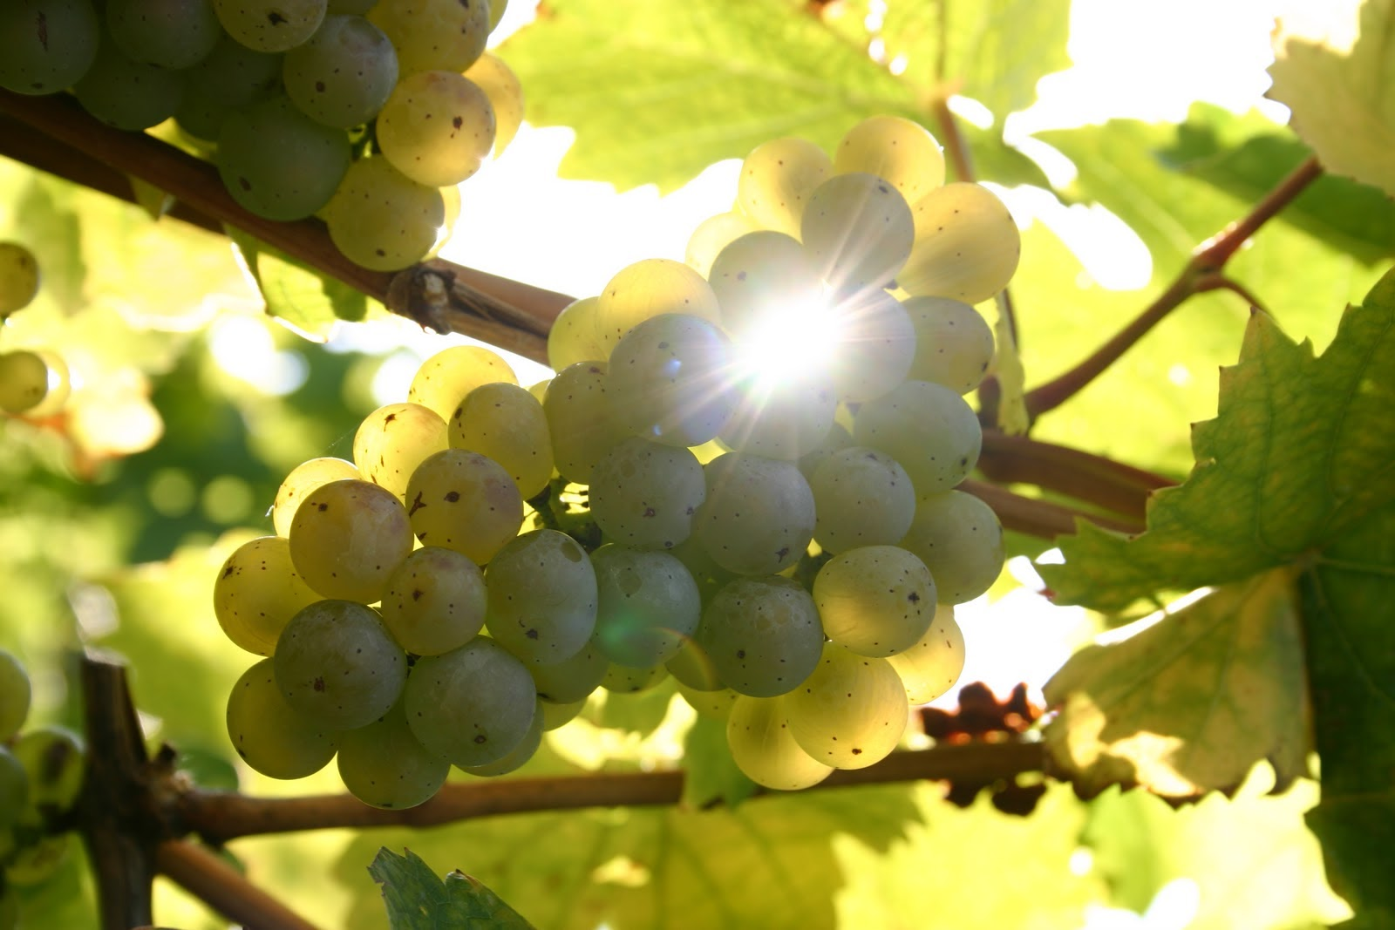
In viticulture, the two main components in growing Riesling grapes are to keep it "Long & Low" meaning that the ideal situation for Riesling is a climate that allows for a long, slow ripening and proper pruning to keep the yield low and the flavor concentrated

Slide 44
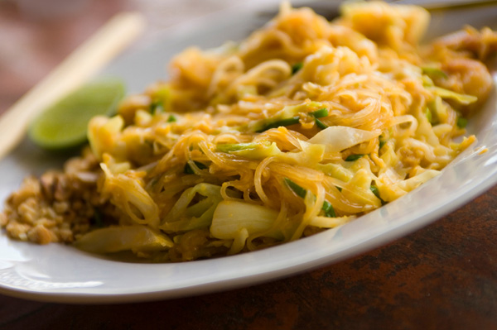
With food
Riesling is a versatile wine for pairing with food, because of its balance of sugar and acidity. It can be paired with white fish or pork, and is one of the few wines that can stand up to the stronger flavours and spices of Thai and Chinese cuisine.

Slide 45
Riesling tends to be lighter weight and therefore suitable to a wider range of foods. The sharp acidity/sweetness in Rieslings can serve as a good balance to foods that have a high salt content. In Germany, cabbage is sometimes cooked with Riesling to reduce the vegetable's smell.

