Slide 1
"God made Cabernet Sauvignon whereas the devil made Pinot noir”-André Tchelistcheff

Slide 2
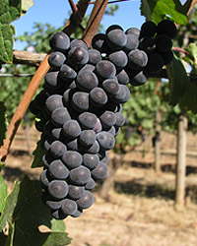
Pinot Noir
Pinot noir is a black wine grape variety.
The name is derived from the French words for "pine" and "black" alluding to the grape variety's tightly clustered dark purple pine-cone shaped bunches of fruit.

Slide 3
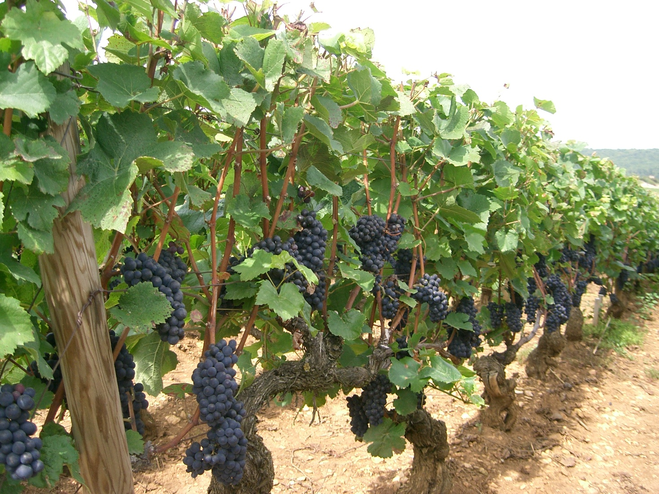
Pinot Noir is widely considered to produce some of the finest wines in the world, but is a difficult variety to cultivate and transform into wine.

Slide 4
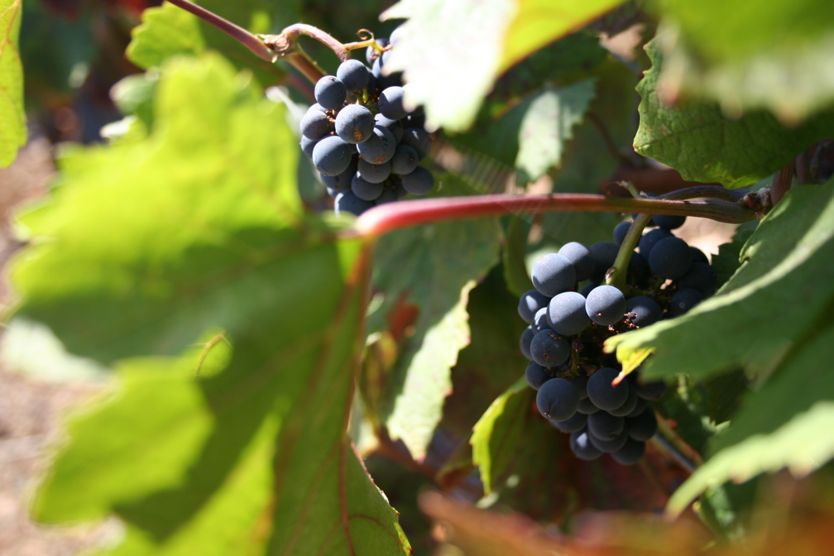
The leaves of Pinot noir are generally smaller than those of Cabernet Sauvignon or Syrah and the vine is typically less vigorous than either of these varieties.

Slide 5
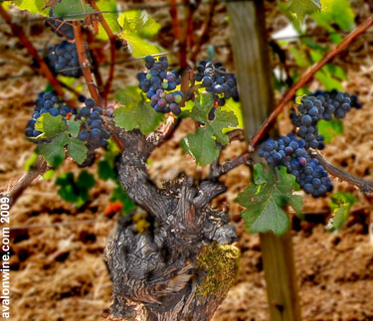
In the vineyard Pinot noir is sensitive to wind and frost, cropping levels (it must be low yielding for production of quality wines), soil types and pruning techniques

Slide 6
In the winery it is sensitive to fermentation methods, yeast strains and is highly reflective of its terroir with different regions producing sometimes very different wines

Slide 7
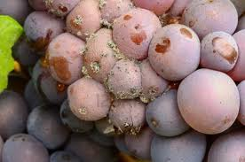
Its thin skin makes it susceptible to bunch rot and similar fungal diseases of the bunch. The vines themselves are susceptible to powdery mildew,

Slide 8
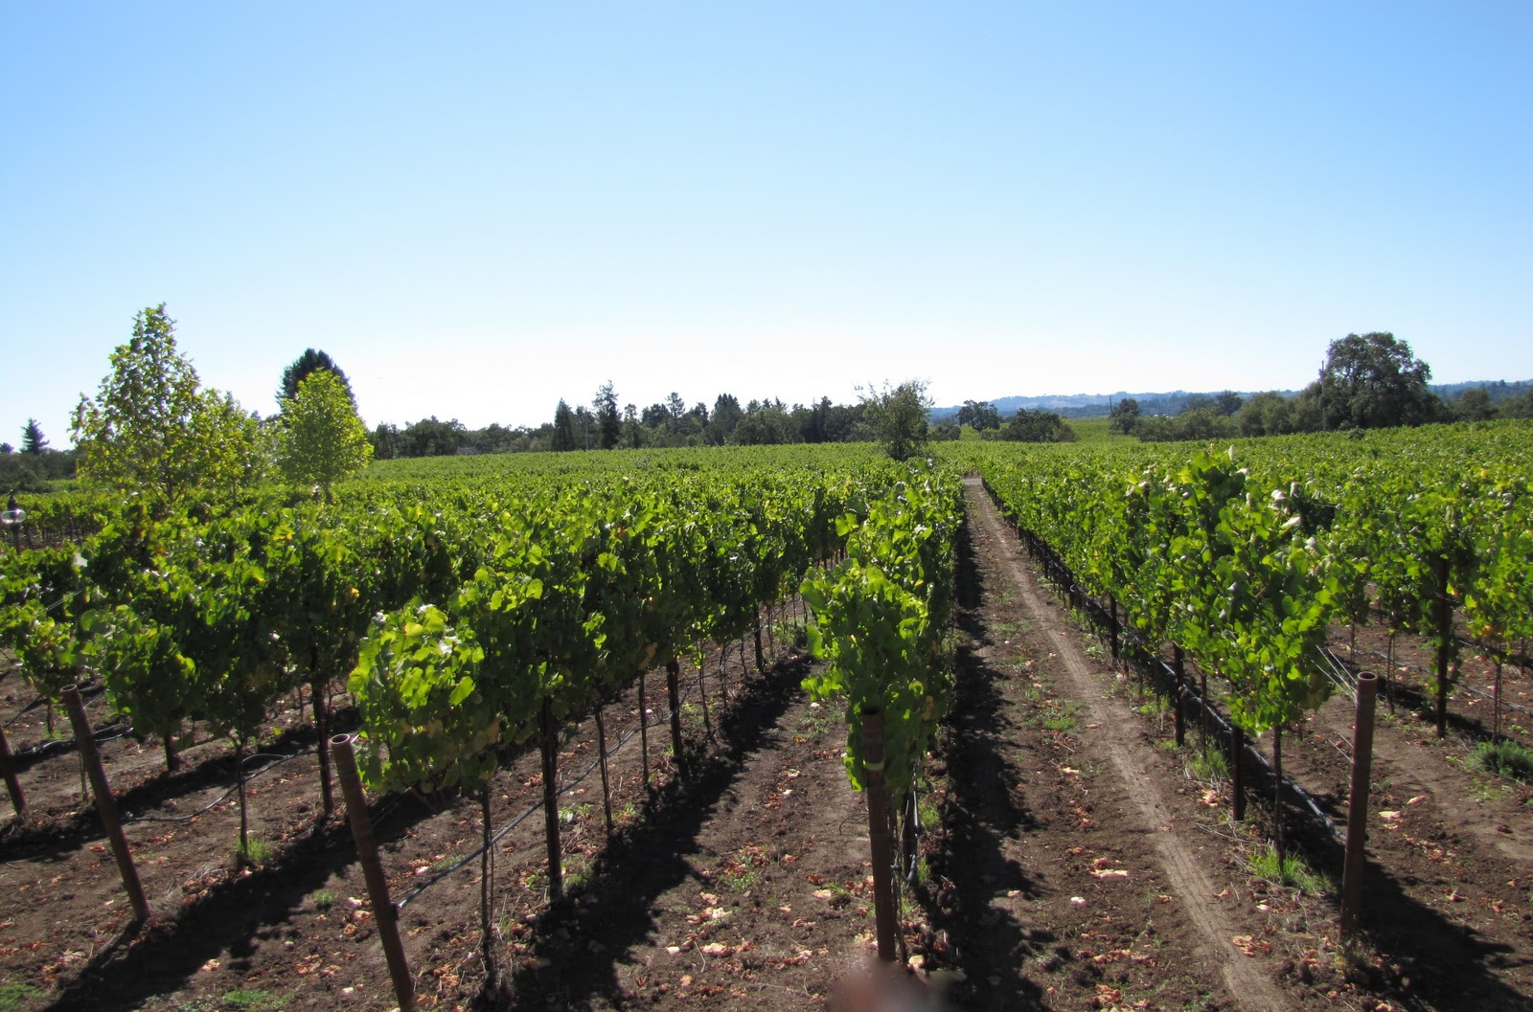
These complications have given the grape a reputation for being difficult to grow. It is a grape that can express terroir.

Slide 9
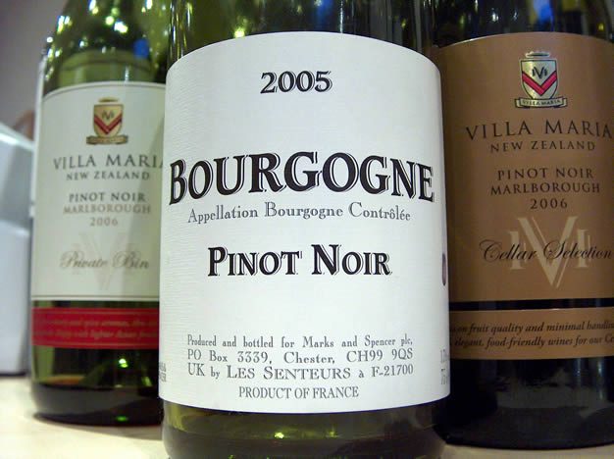
the wine tends to be of light to medium body with an aroma reminiscent of black and / or red cherry, raspberry and to a lesser extent currant and many other fine small red and black berry fruits

Slide 10
The wine's color when young is often compared to that of garnet, frequently being much lighter than that of other red wines.
Cabernet Sauvignon Syrah Merlot Pinot Noir

Slide 11
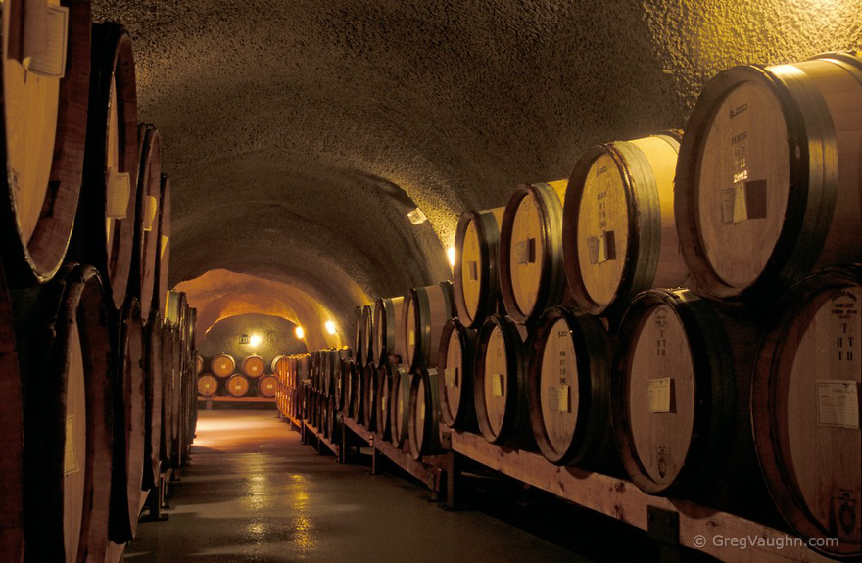
Pinot Noir is aged in oak.

Slide 12
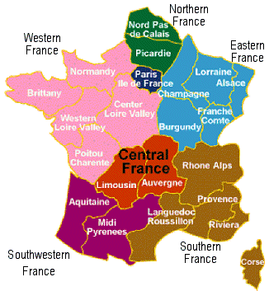
Pinot noir grapes are grown around the world, mostly in the cooler regions, but the grape is chiefly associated with the Burgundy region of France.

Slide 13
Pinot noir has made France's Burgundy appellation famous, and vice-versa.

Slide 14
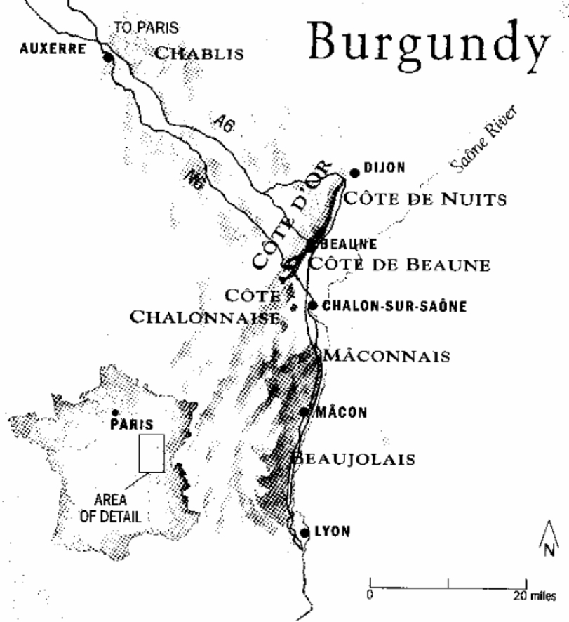
the celebrated Côte d’Or area of Burgundy has about 4,500 hectares (11,000 acres) of Pinot noir. Most of the region's finest wines are produced from this area.

Slide 15
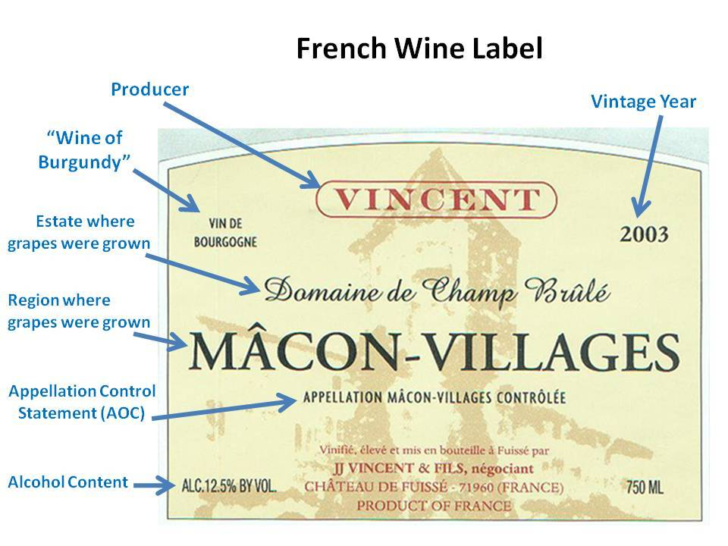
Burgundy's Pinot noir produces great wines which can age very well in good years, developing complex fruit and forest floor flavours as they age, often reaching peak 15 or 20 years after the vintage.

Slide 16
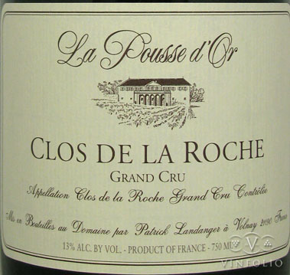
Many of the wines are produced in very small quantities and can be very expensive.

Slide 17
Traditional red Burgundy is famous for its savoury fleshiness and 'farmyard' aromas

Slide 18
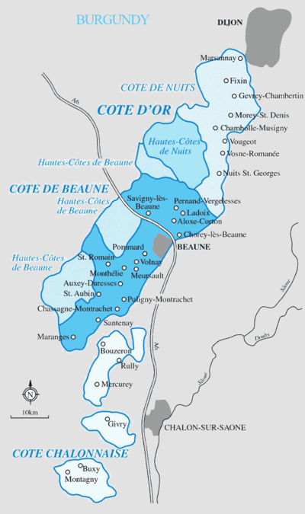
The Côte Chalonnaise and Mâconnais regions in southern Burgundy have another 4,000 hectares (9,900 acres), but their wines are typically very much less fine.

Slide 19
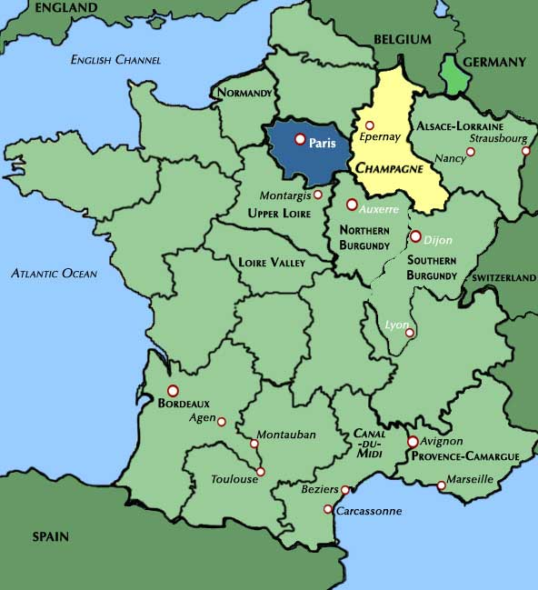
Pinot noir is also used in the production of Champagne (usually along with Chardonnay and Pinot meunier) and is planted in most of the world's wine growing regions for use in both still and sparkling wines.

Slide 20
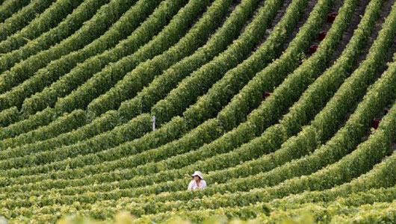
The Champagne appellation has more Pinot planted than any other area of France.

Slide 21
In Sancerre it is used to make red and rosé wines, in Alsace it is generally used to make Pinot-noir d'Alsace (fr), a varietal rosé wine.

Slide 22
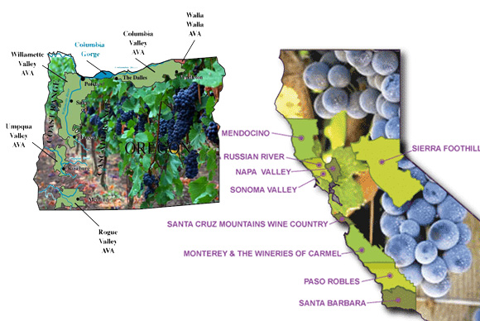
The United States has increasingly become a major Pinot noir producer.

Slide 23
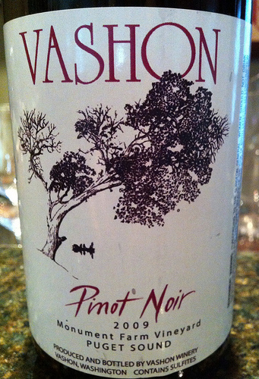
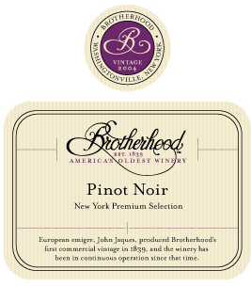
By volume most Pinot noir in America is grown in California with Oregon coming in second. Other regions are the states of Washington, Michigan, and New York.

Slide 24
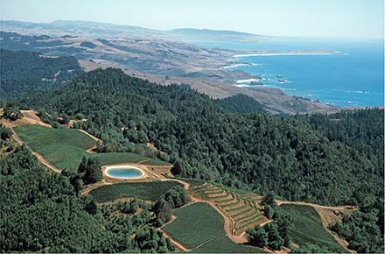
California wine regions known for producing Pinot noir are:
Sonoma Coast

Slide 25
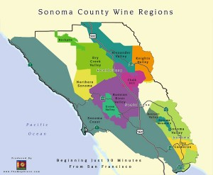
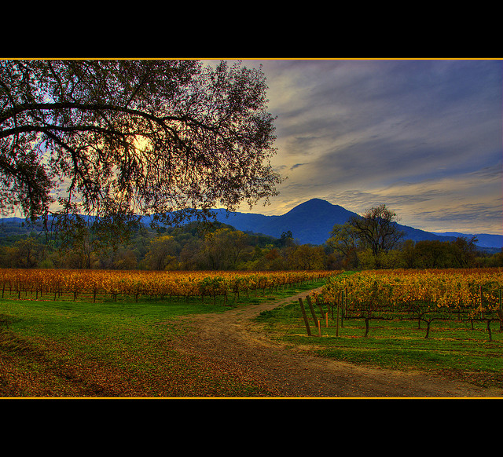
Russian River Valley AVA

Slide 26
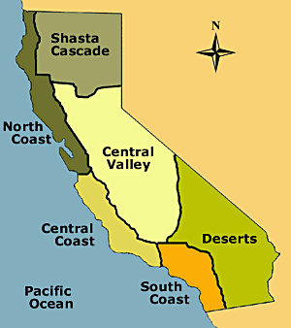
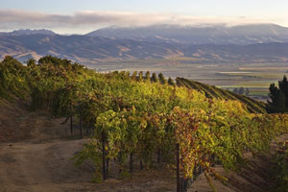
Central Coast AVA

Slide 27
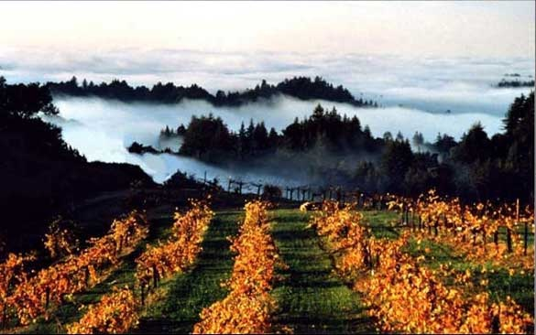
Santa Cruz Mountains AVA

Slide 28
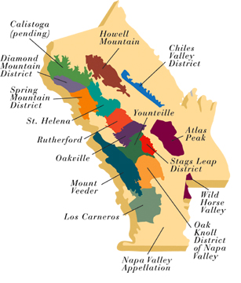
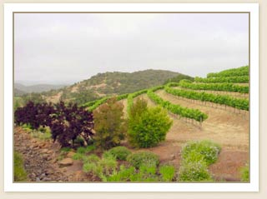
Carneros District

Slide 29
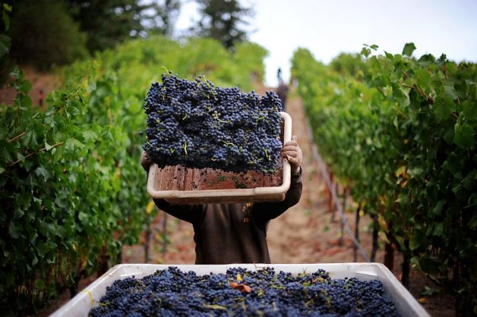
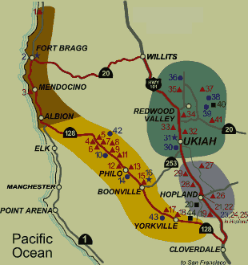
Anderson Valley

Slide 30
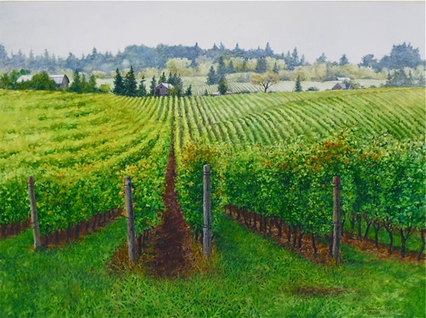
The Willamette Valley of Oregon is at the same latitude as the Burgundy region of France, and has a similar climate in which the finicky Pinot noir grapes thrive.

Slide 31
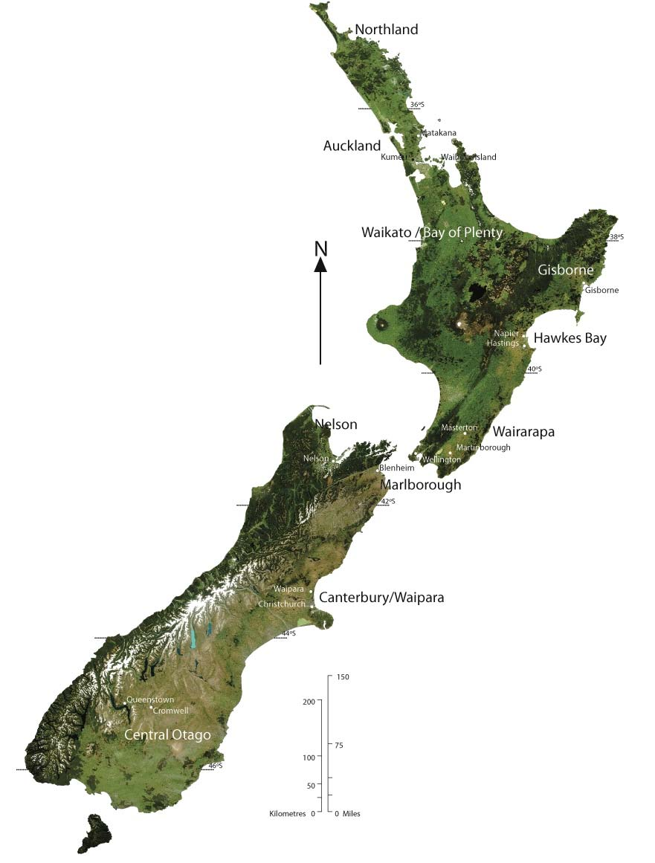
Pinot noir is a grape variety whose importance in New Zealand is extremely high.

Slide 32
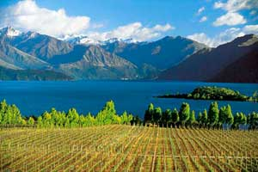
In New Zealand, it is principally grown in Martinborough, Marlborough, Waipara and Central Otago.

Slide 33
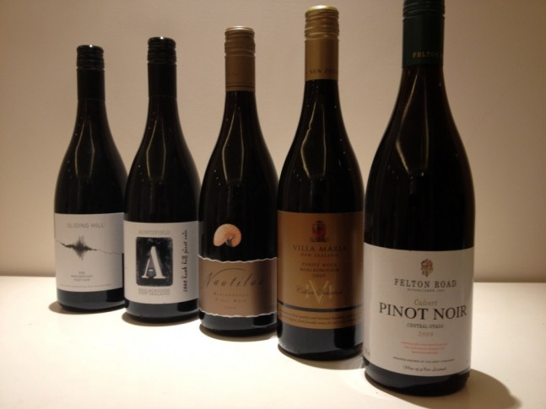
Typically, New Zealand Pinot noir is fruit-driven, forward, and early maturing in the bottle. Alcohol levels are markedly higher than for Burgundies, and natural acidity lower.

Slide 34
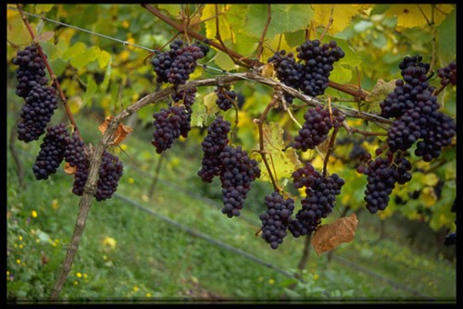
Many New Zealand Pinot noir producers leave their fruit on the vine much longer than is either possible or acceptable in Burgundian vineyards, and plummy flavours, heavier textures, and consequently more Syrah-like wine structure, results.

Slide 35
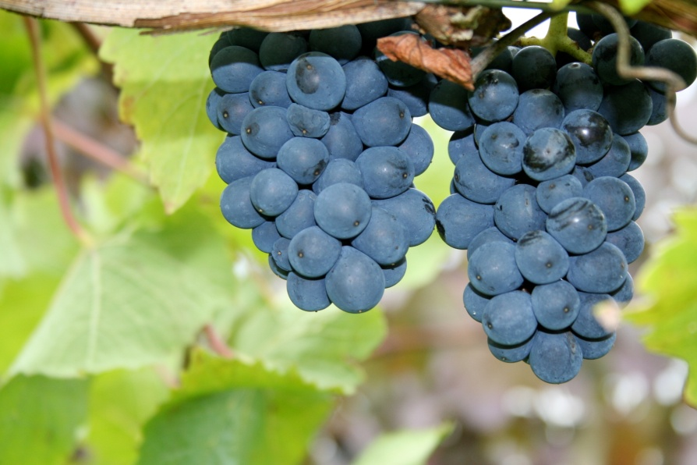
In Germany it is called Spätburgunder (lit. "Late Burgundian"), and is now the most widely planted red grape

Slide 36
In Italy Pinot noir is known as Pinot nero, it has traditionally been cultivated in the Trentino region to produce Burgundy-style red wines.

Slide 37
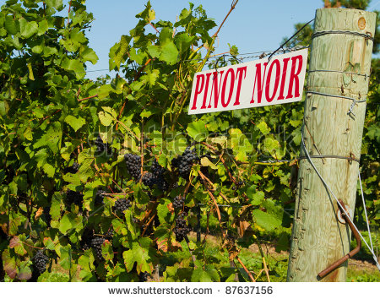
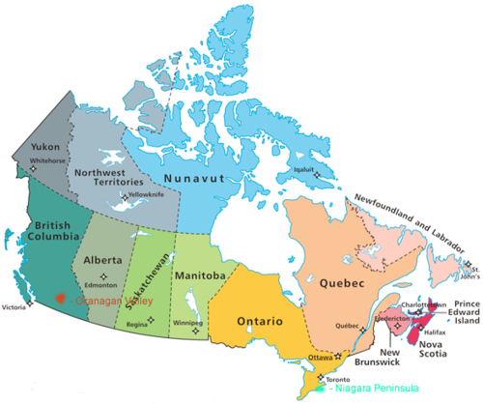
In Canada quality Pinot noir has been grown in Ontario for some time in the Niagara Peninsula and especially the Niagara-on-the-Lake and Short Hills Bench wine regions, as well as in Prince Edward County and on the north shore of Lake Erie.

