Slide 1
Oak/Barrel Making The Influence of oak on Wine

Slide 2
What Happens in the Barrel?
Evaporation
Oxidation
Clarification
Extraction
Evolution
Notes:
Evaporation – barrel tightness, temperature, and humidity – can lose as much as 4 to 10liters during the aging process! Over a case of wine!
Water and alcohol lost thru surface of barrel is not replaced.
Oxidation: mostly during racking process. BBL is quite an airtight vassal as a vacuum develops thru loss of water and alcohol!
Usually winemakers want to avoid oxygen! However, this controlled exposure to oxygen is beneficial to the structure and development of the wine!
Some oxygen passes in thru the wood itself
Majority thru the gaps between the staves.
Color is intensified because of the reaction between the tannins and anthocyanins.
Tannins are softened by polymerization
Clarification_ explain and tie into winemaking lecture
Extraction – flavors from wood ! Oak is an important source of volatile and non- volatile phenolic acids and aldehydes. Phenolics are a large group of chemical compounds which includes anthocyanins, tannins, and flavor compounds.
Evolution – marry of flavors

Slide 3
Factors Influencing Oak Extracts
Barrel Size
Oak Species
Previous Use
Oak Origin
Duration
Barrel Making Techniques
Seasoning Heating Toasting
Notes:
225 liters or 59 gallons = 25 cases of wine!

Slide 4
Oak Species
American Oak
Quercus Alba
French Oak
Quercus Robur
Quercus Sessilis
Notes:
American oak is separate species with quite different characteristics – One of which is that it is much more dense
Portuguese Oak – Quercus Suber from which cork is made

Slide 5
Oak Origins: French Forests
Argonne
Nevers
Vosges
Centre
Bourgogne
Troncais
Limousin
Allier
Notes:
Categories of prestige!

Slide 6
Oak Origins: United States
Notes:
Other countries: Former Yugoslavia, Serbia and Montenegro
Hungary
Bulgaria
Germany
Canada

Slide 7
AROMAS/FLAVORS - OAK

Slide 8
AROMAS/FLAVORS – TOAST

Slide 9
Relative Oak Intensity Ratings By Origin
Vanilla
Raisin
Caramel
Troncais
Limousin
Spicy
Buttery
Vosges
American
Nutty
Coconut
Cedar

Slide 10
Toast Grades
Light
Medium Light
Medium
Medium Heavy
Heavy
Notes:
And custom toast levels!

Slide 11
Oak Origins: French Forests
Argonne
Nevers
Vosges
Centre
Bourgogne
Troncais
Limousin
Allier
Notes:
France owns the forest………

Slide 12
Francois Frères
Notes:
Located in Southern Burgundy, just south of Beaune, in the town of Saint-Romain , population 300!

Slide 13
Notes:
Francois family has been making barrels since 1910
150 barrels each day – 3 bbls per worker! 170,000 each year!
only 5% of worlds wine production is aged in oak barrels
Cost - $1000/barrel!
Family has a domestic affilliate in Napa called Demptos

Slide 14
Notes:
Sourcing by a professional /expert
Grain must be straight and tight without knots and imperfections
They select and tag trees for 150 years out!
Purchased thru auction which takes place 3 times per year.
Most trees are between 150 to 200 years old!
Notice forest code

Slide 15
Notes:
French oak must be split! It is preferred to sawing because it results in a natural separation of wood along planes of vessel elongation.
American oak is much more dense and not so porous and can thererfore be sawn instead.

Slide 18
Seasoning
Notes:
This is seaonsong- the wood is dried for 2 to 3 years depending on the climate. Francois Freres cite is windy…this is no accident.
Fungi and bacteria produce and liberate aromatic aldehydes
Vs kiln dried. = American
produces more aggressive, green chaaracter.

Slide 19
Planing
Notes:
PLANING GIVES THE STAVES SHAPE AND THE CHIPS THAT ARE LEFT OVER ARE USED TO FUEL THE TOASTING FIRES.

Slide 20
Notes:
Central burner to assist in shaping staves

Slide 21
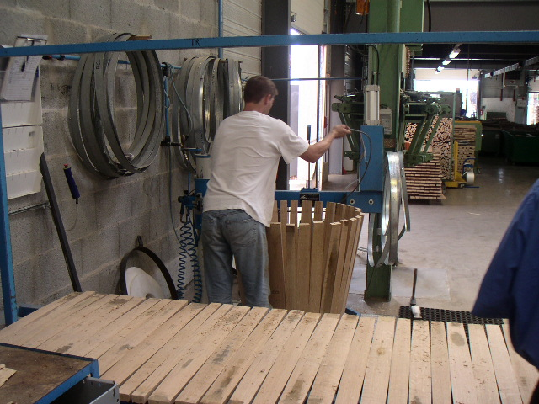

Slide 23
Heating & Toasting

Slide 24
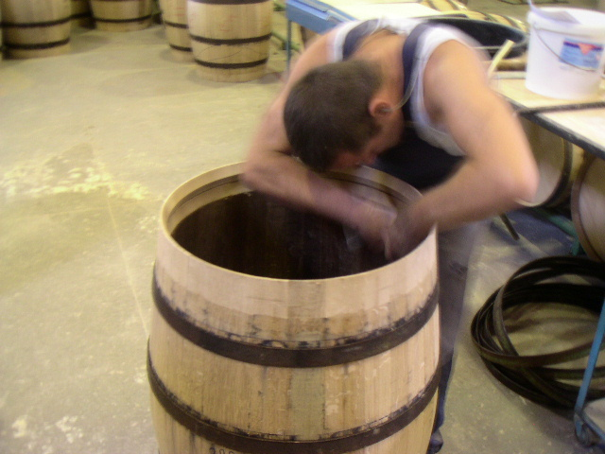
Notes:
Interior inspection
Soft blisters
Char
Reeds
Split staves
Splinters
Paste
Uneven planing
Putting on the head

Slide 26
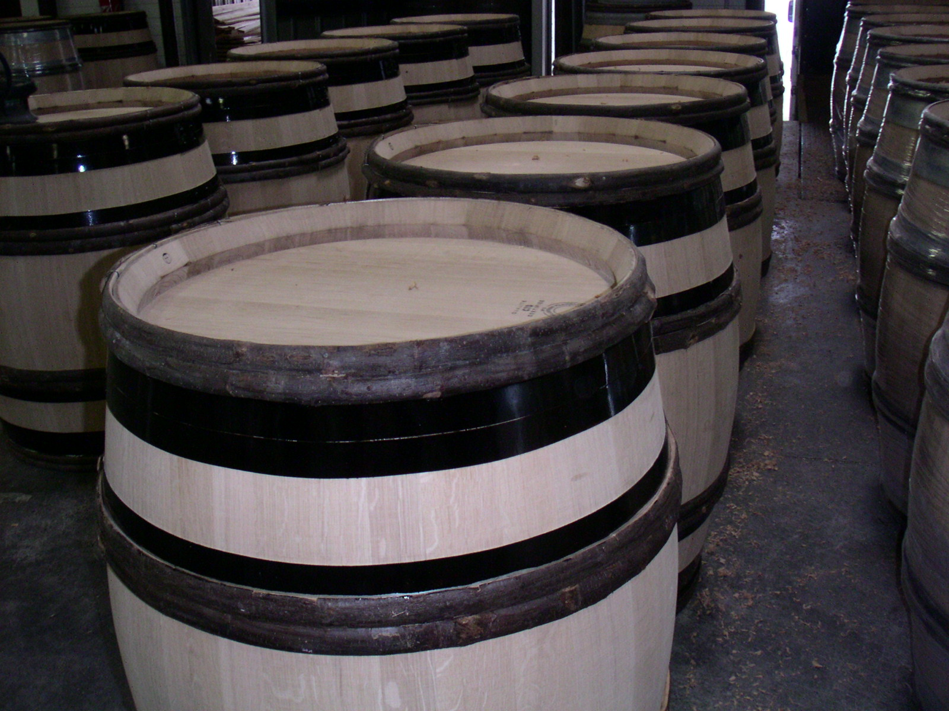
Notes:
Burgundy bbl

