Slide 1
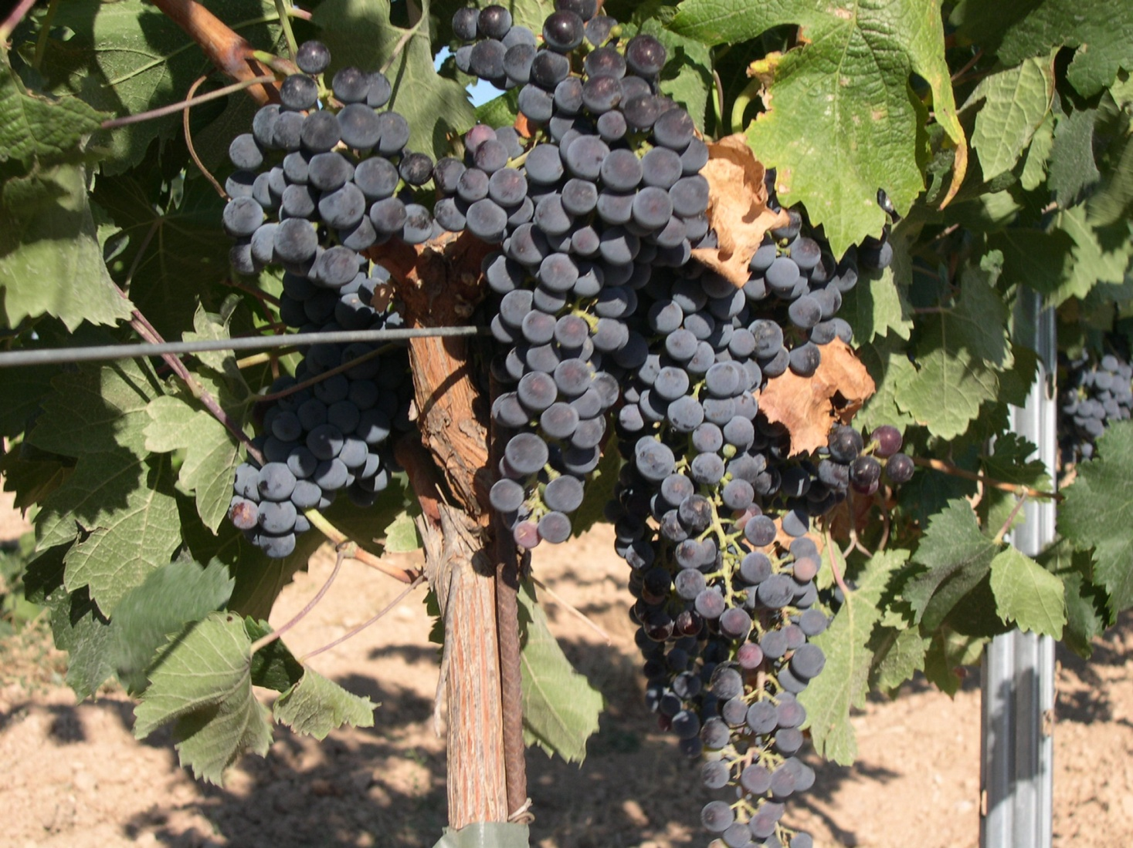
Merlot

Slide 2
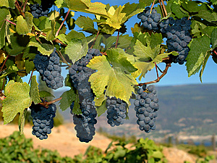
Merlot is a darkly blue-colored wine grape, that is used as both a blending grape and for varietal wines. The name Merlot is thought to derive from the Old French word for young blackbird

Slide 3
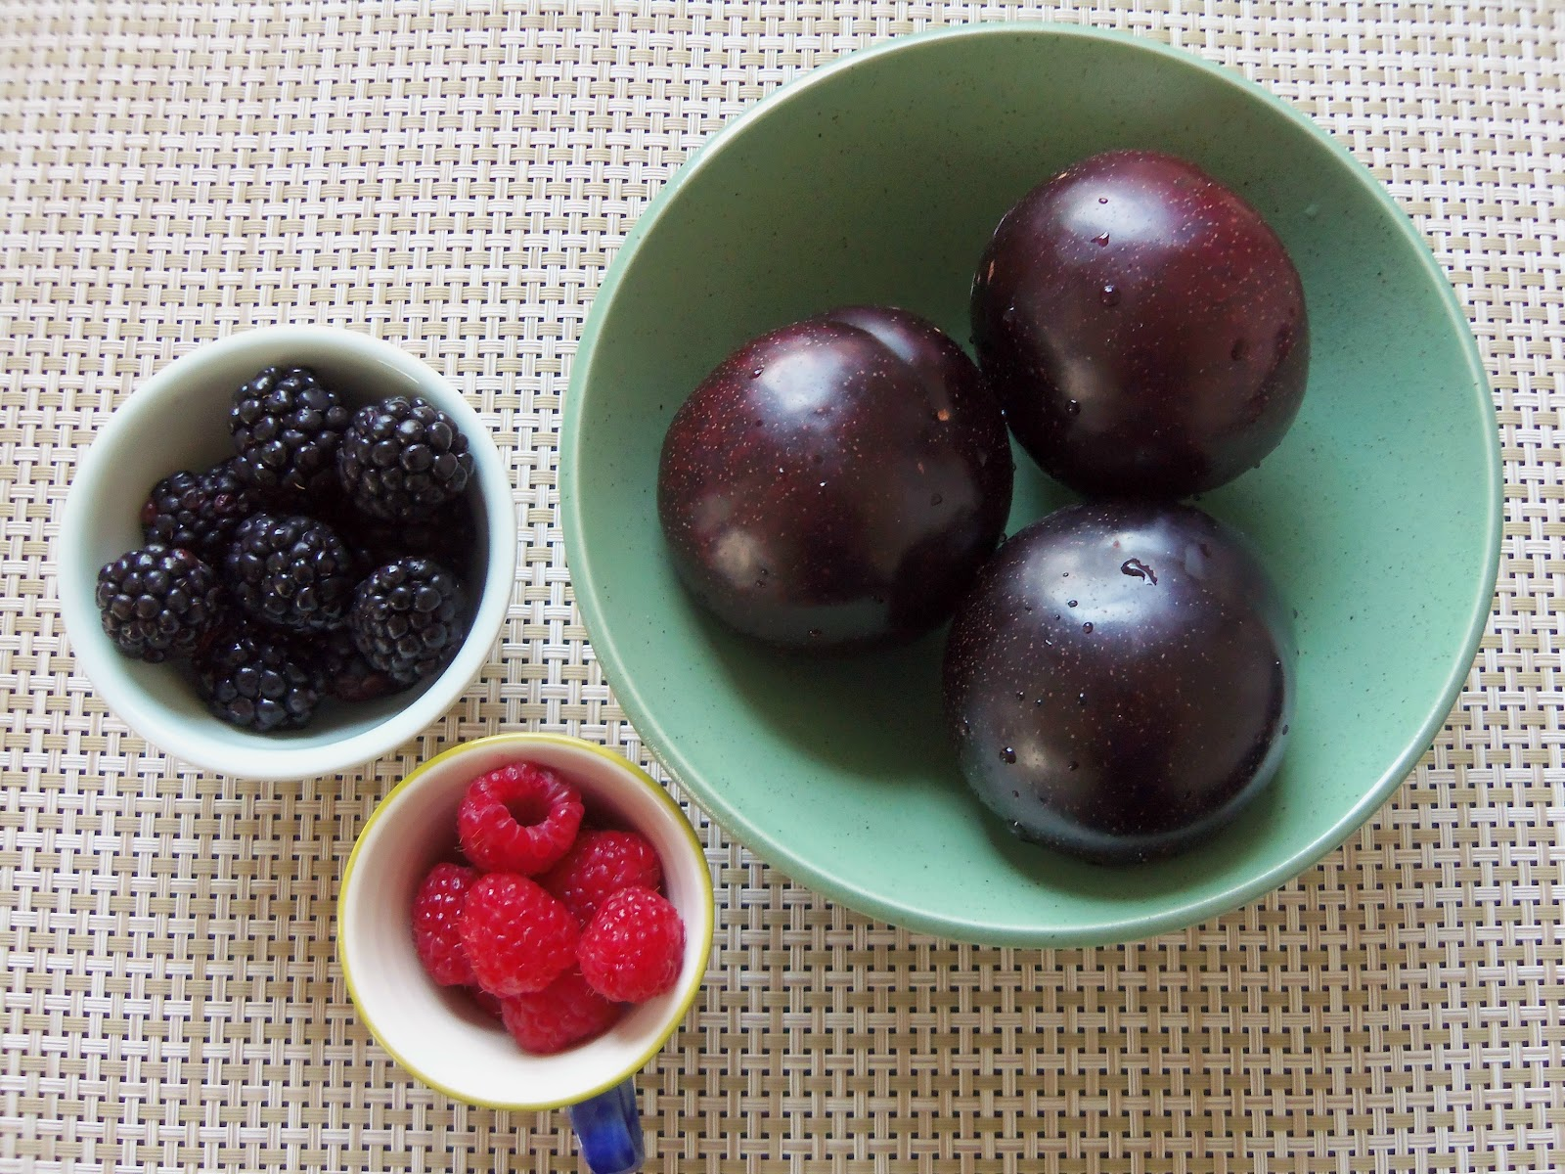
Merlot-based wines usually have medium body with hints of berry, plum, and currant.

Slide 4
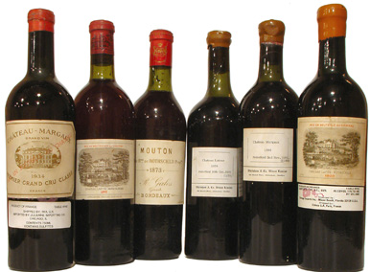
Along with Cabernet Sauvignon, Cabernet Franc, Malbec and Petit Verdot, Merlot is one of the primary grapes in Bordeaux wine where it is the most widely planted grape.

Slide 5
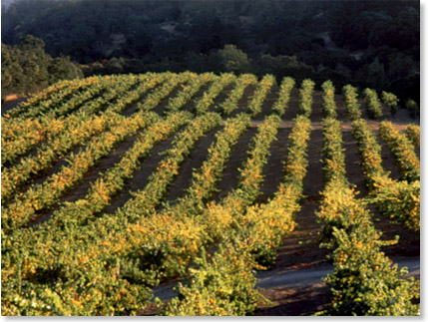
Merlot is estimated to be the third most grown variety at over 640,000 acres globally.

Slide 6
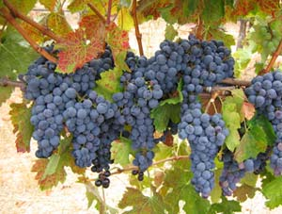
Merlot grapes are identified by their loose bunches of large berries

Slide 7
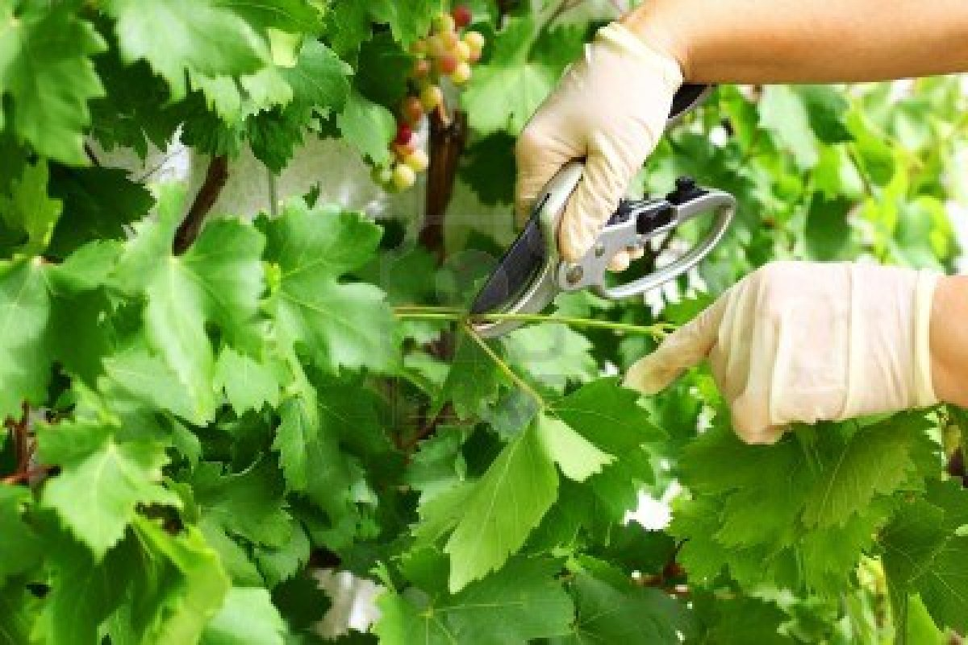
Pruning is a major component to the quality of the wine that is produced

Slide 8
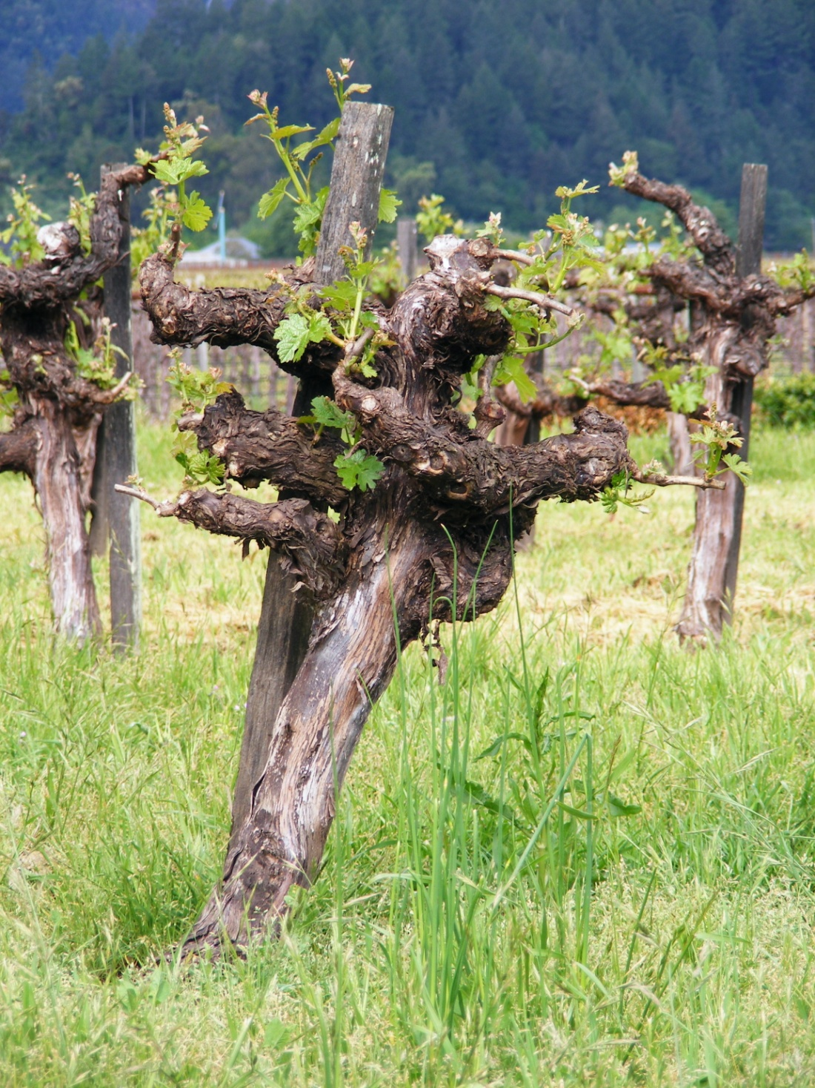
The age of the vine is also important, with older vines contributing character to the resulting wine

Slide 9
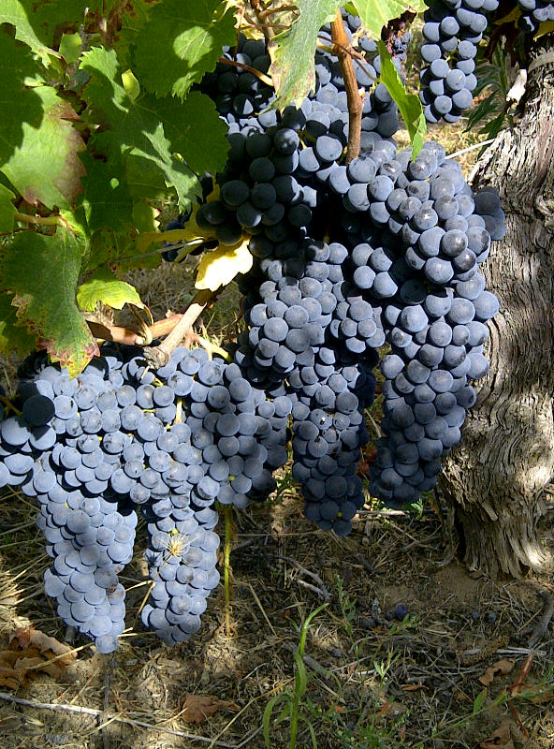
A characteristic of the Merlot grape is the propensity to quickly overripen once it hits its initial ripeness level, sometimes in a matter of a few days. In areas that are too warm, Merlot will ripen too early.

Slide 10
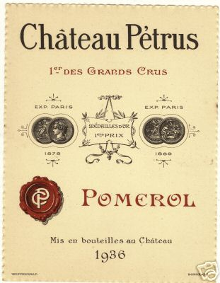
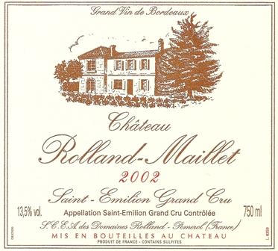
There are two schools of thought on the right time to harvest Merlot. The wine makers of Château Pétrus favor early picking to best maintain the wine's acidity and finesse as well as its potential for aging. Others, such as Rolland, favor late picking and the added fruit body that comes with a little bit of over-ripeness

Slide 11
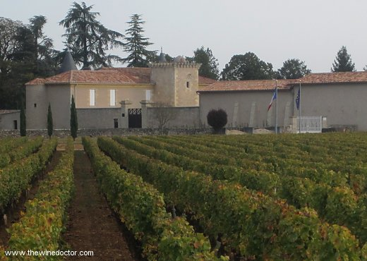
Merlot is the most commonly grown grape variety in France.

Slide 12
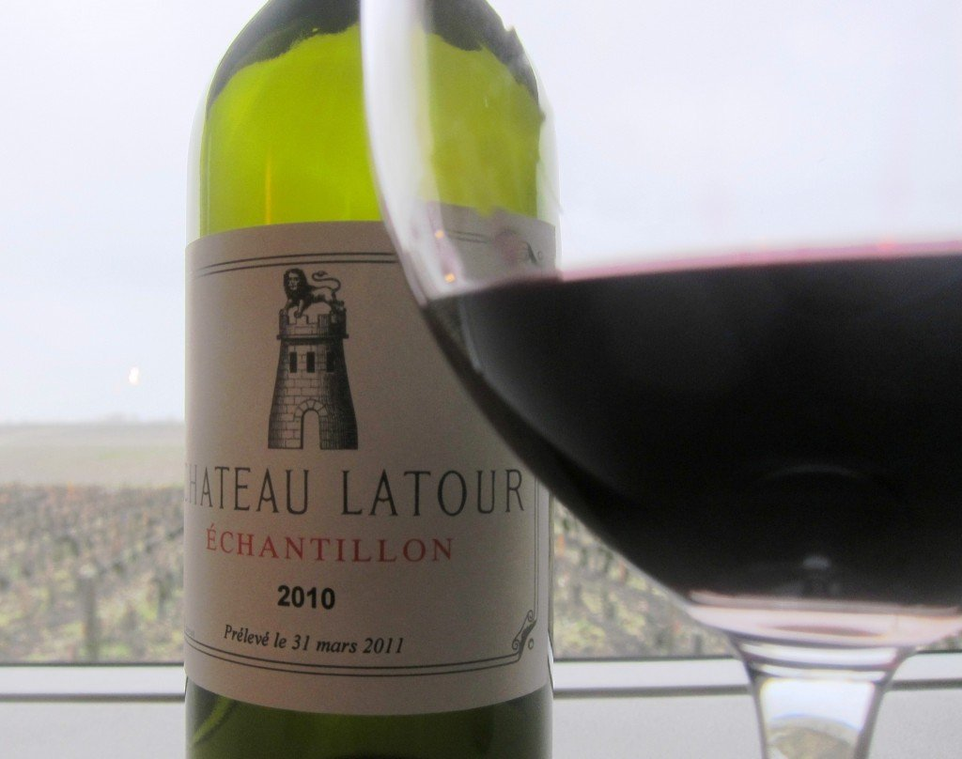
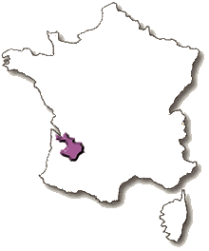
It is most prominent in Bordeaux.
In the traditional Bordeaux blend, Merlot's role is to add body and softness.

Slide 13
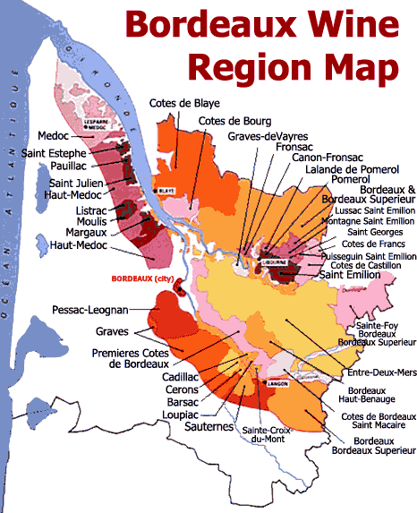
Left Bank & Right Bank

Slide 14
Of these Left Bank regions, the commune of St-Estephe uses the highest percentage of Merlot in the blends. However, Merlot is much more prominent on the Right Bank of the Gironde in the regions of Pomerol and Saint-Émilion, where it will commonly comprise the majority of the blend.

Slide 15
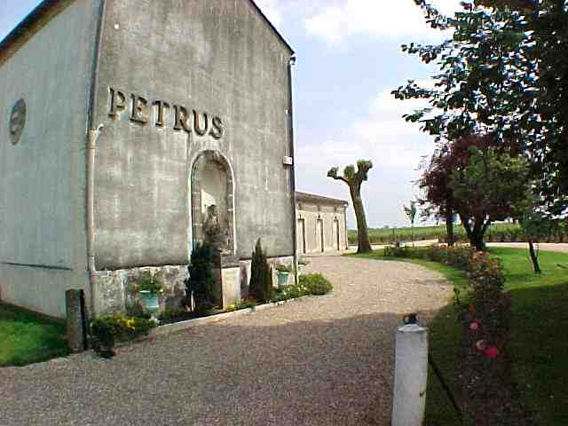
One of the most famous and rare wines in the world, Château Pétrus, is almost all Merlot.

Slide 16
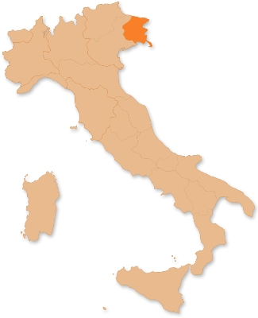
In Italy, a large portion of Merlot is planted in the Friuli wine region where it is made as a varietal or sometimes blended with Cabernet Sauvignon or Cabernet Franc.

Slide 17
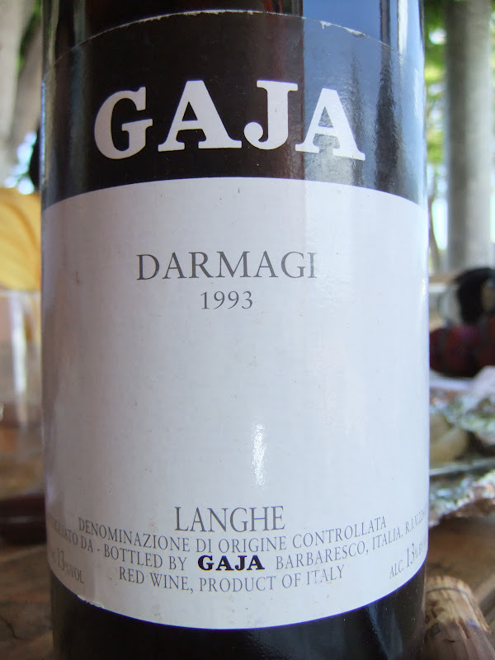
In other parts of Italy, such as Tuscany, it is often blended with Sangiovese to give the wine a similar softening effect as the Bordeaux blends.

Slide 18
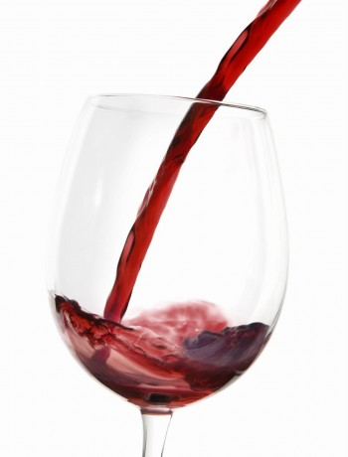
Italian Merlots are often characterized by their light bodies and herbal notes

Slide 19
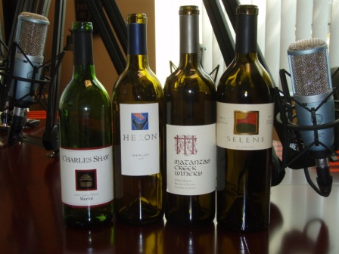
In California, Merlot can range from very fruity simple wines to more serious, barrel aged examples. It can also be used as a primary component in Meritage blends

Slide 20
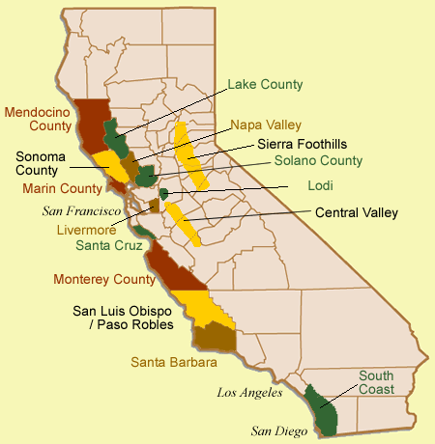
While Merlot is grown throughout the state, it is particularly prominent in Napa, Monterey and Sonoma County.

Slide 21
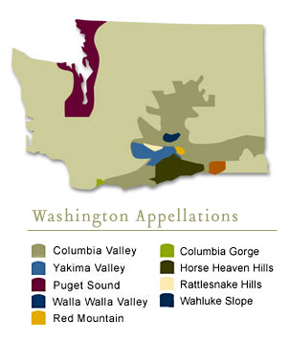
In the 1980s, Merlot helped put the Washington wine industry on the world's wine map. Prior to this period there was a general perception that the climate of Washington State was too cold to produce red wine varietals.

Slide 22
Merlots from Leonetti Cellar, Andrew Will, Columbia Crest and Chateau Ste. Michelle demonstrated that areas of the Eastern Washington were warm enough for red wine production. Today it is the most widely grown red wine grape in the state and accounts for nearly one fifth of the state's entire production.

Slide 23
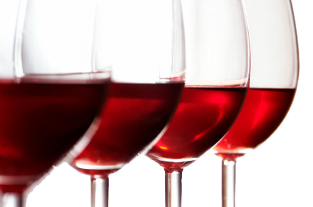
Washington Merlots are noted for their deep color and balanced acidity. The state's climate lends itself towards long days and hours of sunshine with cool nights that contributes to a significant diurnal temperature variation and produces wines with New World fruitiness and Old World structure

Slide 24
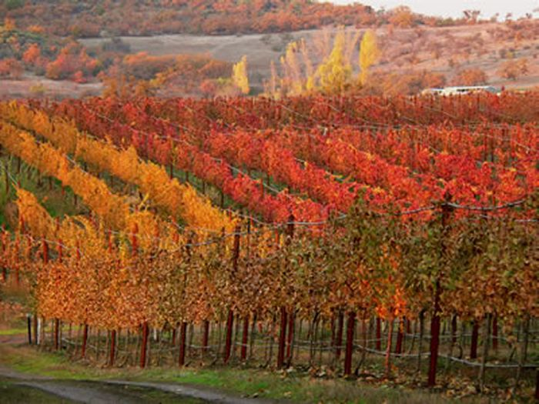
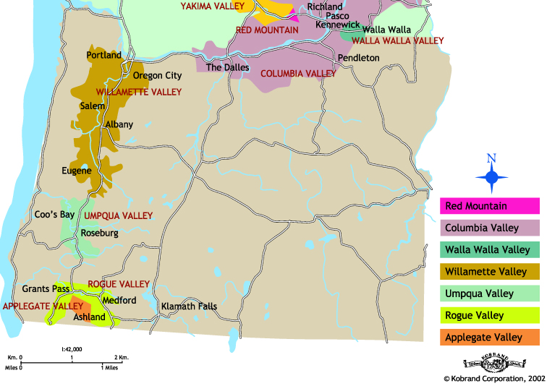
Oregon's Rogue Valley AVA produces significant quantities of Merlot .

Slide 25
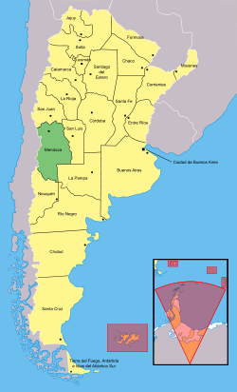
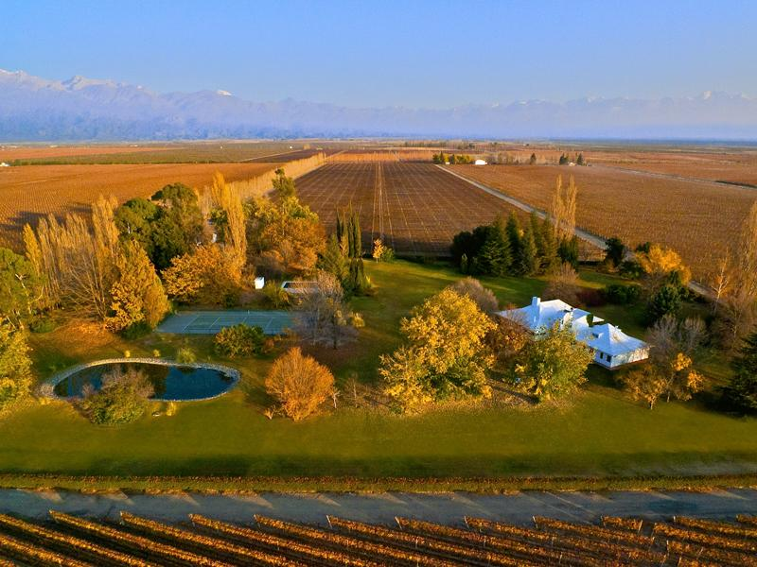
In Argentina, Merlot plantings have been increasing in the Mendoza region with the grape showing an affinity to the Tupungato region of the Uco Valley.

Slide 26
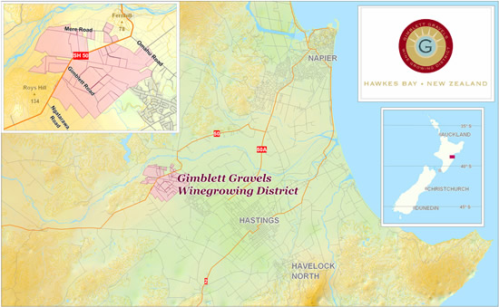
In New Zealand, plantings of Merlot have increased in the Hawke's Bay Region, particularly in Gimblett Gravels where the grape has shown the ability to produce Bordeaux style wine

Slide 27
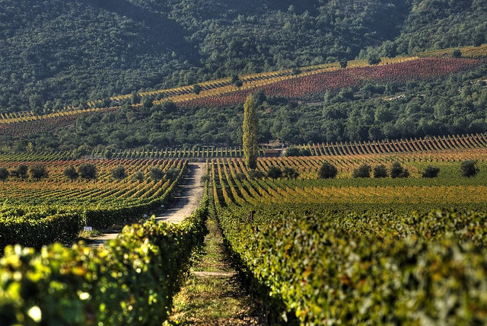
In Chile, Merlot thrives in the Apalta region of Colchagua Province. It is also grown in significant quantities in Curicó, Casablanca and the Maipo Valley.

Slide 28
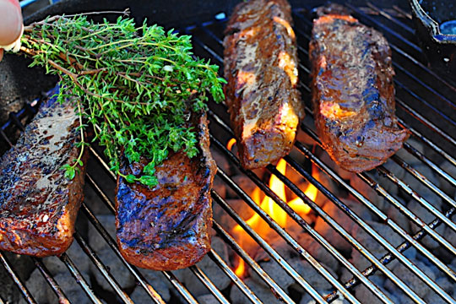
In food and wine pairings, the diversity of Merlot can lend itself to a wide array of matching options. Cabernet-like Merlots pair well with many of the same things that Cabernet Sauvignon would pair well with, such as grilled and charred meats.

Slide 29
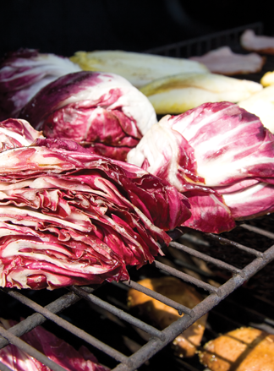
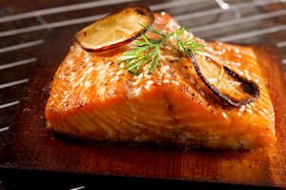
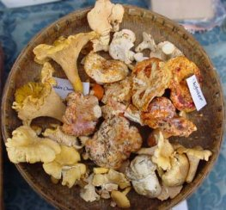
Softer, fruitier Merlots (particularly those with higher acidity from cooler climate regions like Washington State and Northeastern Italy) share many of the same food-pairing affinities with Pinot noir and go well with dishes like salmon, mushroom-based dishes and greens like chard and radicchio.

Slide 30
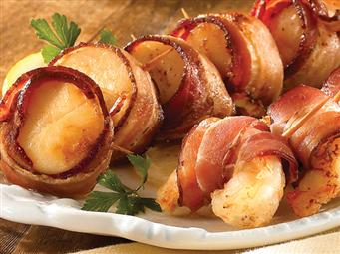
Light-bodied Merlots can go well with shellfish like prawns or scallops, especially if wrapped in a protein-rich food such as bacon or prosciutto.

Slide 31
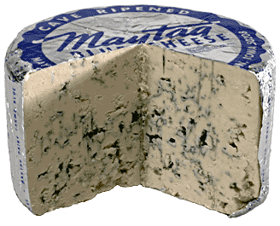
Merlot tends not to go well with strong and blue-veined cheeses that can overwhelm the fruit flavors of the wine.

Slide 32
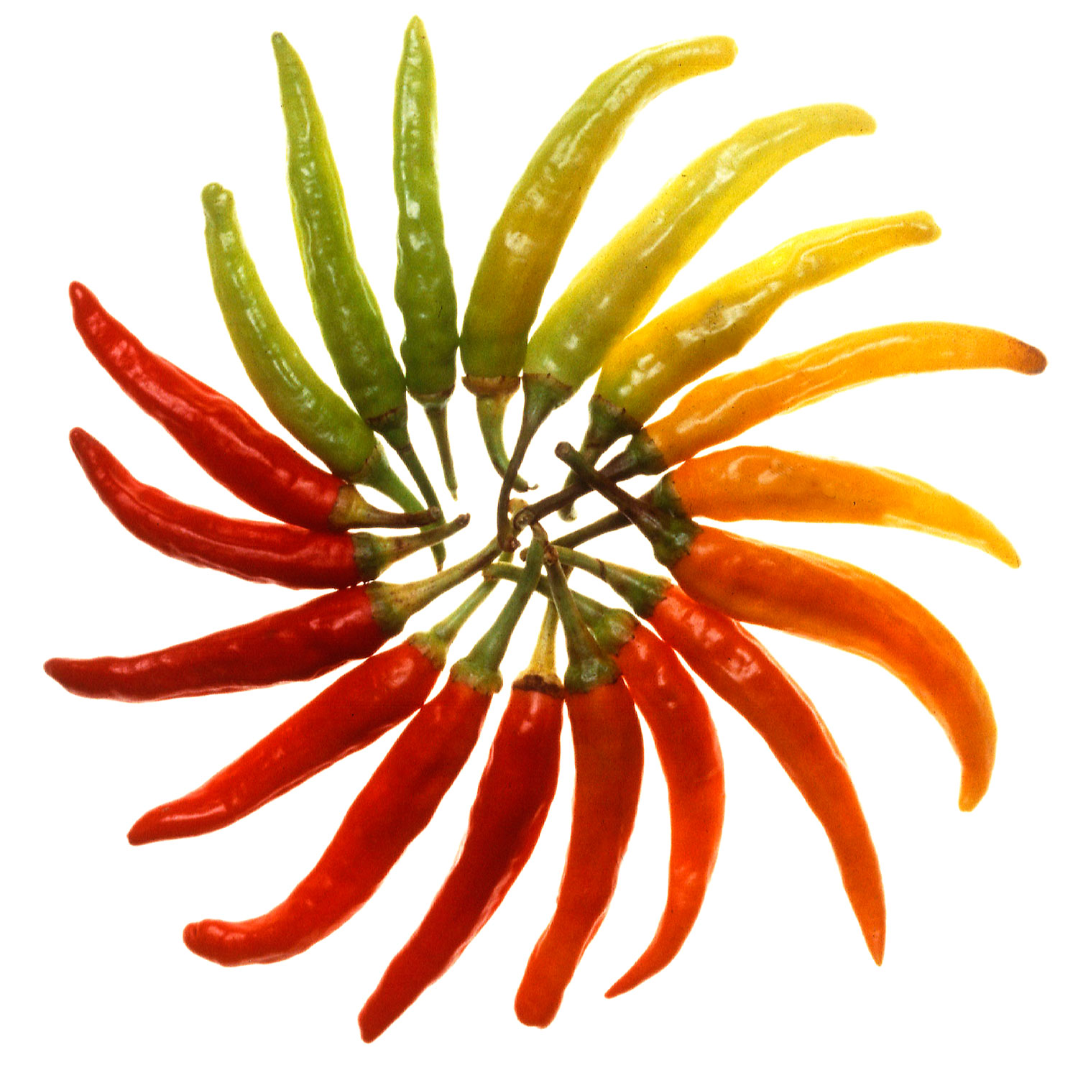
The capsaicins of spicy foods can accentuate the perception of alcohol in Merlot and make it taste more tannic and bitter.

