Slide 1
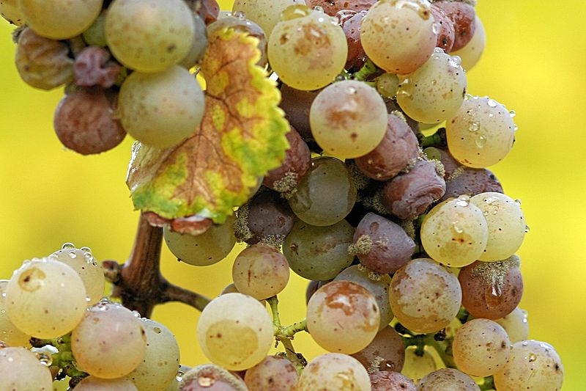
Late Harvest

Slide 2
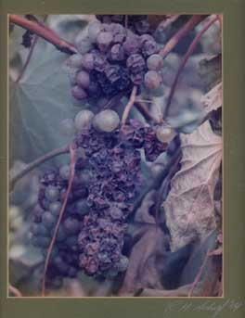
Late harvest is a term applied to wines made from grapes left on the vine longer than usual. Late harvest is usually an indication of a sweet dessert wine.

Slide 3
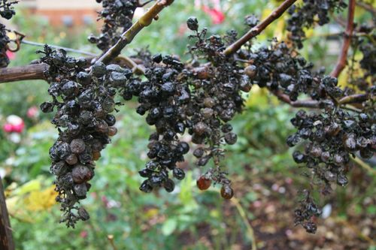
Late harvest grapes are often more similar to raisins, but have been naturally dehydrated while on the vine.

Slide 4
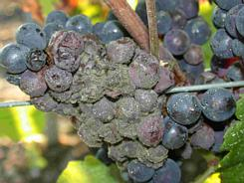
Noble rot
Botrytis cinerea is a fungus that affects many wine grapes and causes them to shrivel into moldy raisins. The fungus responds to the humidity and warmth in the climate and attacks the grapes.

Slide 5
As the mold penetrates the skin its spores begin to germinate, causing the water inside to evaporate and the grape to dehydrate. With the absence of water, the sugar becomes more concentrated and the botrytis begins to alter the acidity within the grape.

Slide 6
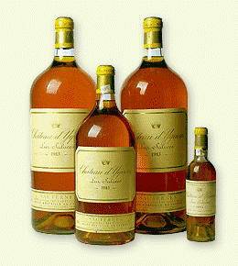
Typically botrytis infection begins to take place in late September and can last till late October. The wine is often said to have an aroma of honeysuckle and a bitter finish on the palate.

Slide 7
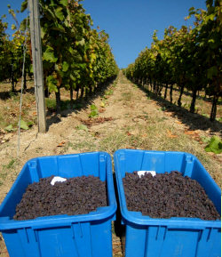
The infection rate of botrytis is sporadic with vines and bunches achieving full rottenness at different times. This requires harvest workers to go through the vineyards several times between October and November to hand-pick the full rotted grapes. In some occasions, the usable grapes from a single vine may only produce enough juice for a single glass.

Slide 8
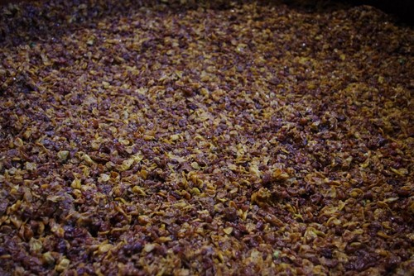
Botrytis complicates winemaking by making fermentation more complex. Botrytis produces an anti-fungal that kills yeast and often results in fermentation stopping before the wine has accumulated sufficient levels of alcohol

Slide 9
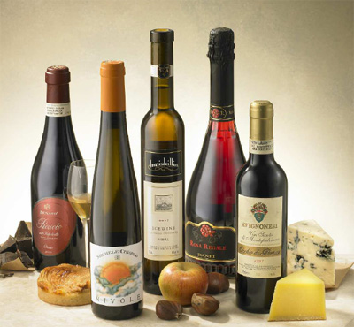
Makers of fine German dessert wines have been known to take fermenting tubs of wine into their homes to nurture the yeast through the night to assure that the alcohol level reaches legal minimums for the product to be called wine

Slide 10
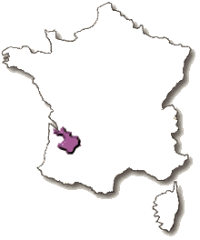
Sauternes
Due to its climate, Sauternes is one of the few wine regions where infection with noble rot is a frequent occurrence, the region has a maritime climate which brings the viticultural hazards of autumn frost, hail and rains that can ruin an entire vintage.

Slide 11
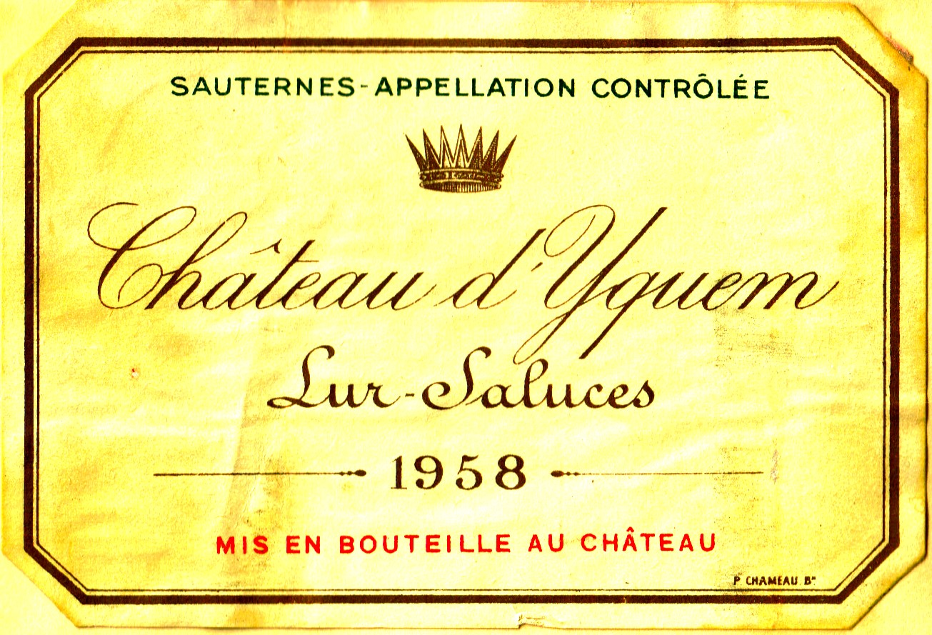
Wines from Sauternes, especially the Premier Cru Supérieur estate Château d'Yquem, can be very expensive, due largely to the very high cost of production

Slide 12
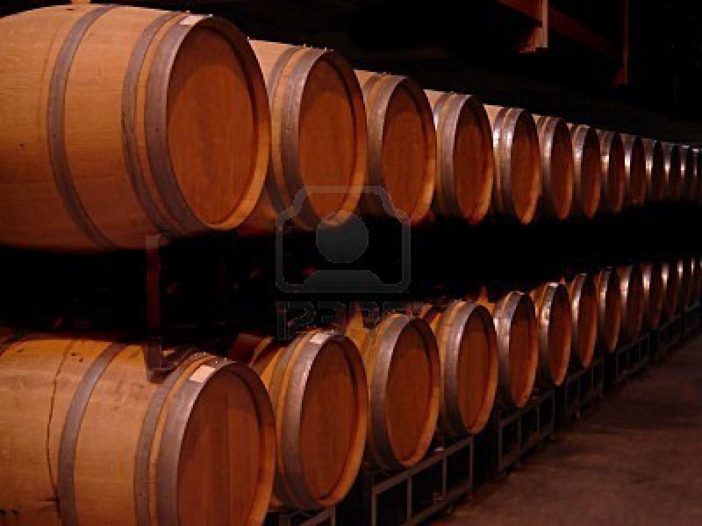
During fermentation, the juice is transferred into oak wine barrels where the high sugar concentration of must prolongs the fermentation time which can last up to a year.

Slide 13
After fermentation, the wine is placed in an aging barrel for two to three years before it is bottled where it will continue aging. A Sauterne from a reputable estate can bottle age for over 30 years though they normally hit their peak 10 years after the vintage date.

Slide 14
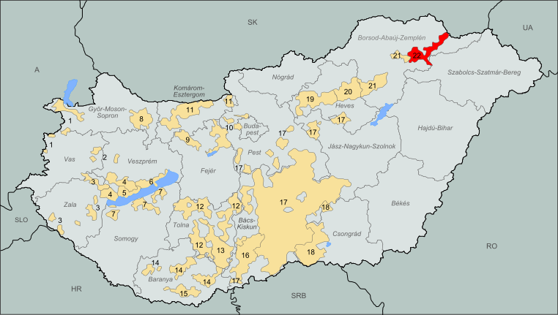
Tokaji
Tokaji (Hungarian: of Tokaj) is the name of the wines from the region of Tokaj-Hegyalja in Hungary and Slovakia.

Slide 15
This region is noted for its sweet wines made from grapes affected by noble rot, a style of wine which has a long history in this region. The "nectar" coming from the grapes of Tokaj is mentioned in the national anthem of Hungary.

Slide 16
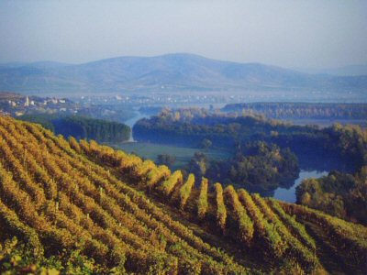
The area where Tokaji wine is traditionally grown is a small plateau, 1500 ft above sea level, near the Carpathian Mountains.

Slide 17
The location of the region has a unique climate, beneficial to this particular viniculture, due to the protection of the nearby mountains. Winters are bitterly cold and windy; spring tends to be cool and dry, and summers are noticeably hot. Usually, autumn brings rain early on, followed by an extended Indian summer, allowing a very long ripening period.

Slide 18
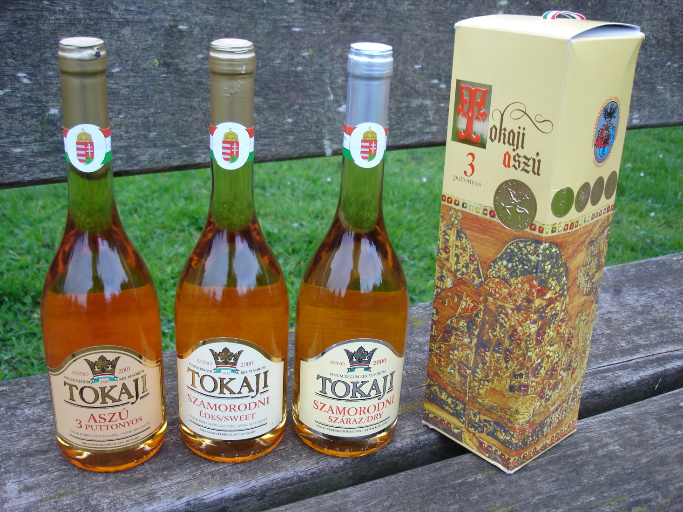
Tokay is the world-famous sweet, topaz-colored wine made with botrytised (i.e. "nobly" rotten) grapes.

Slide 19
German late harvest wines
In Germany, wines are classified according to the ripeness of the grape at time of harvest

Slide 20
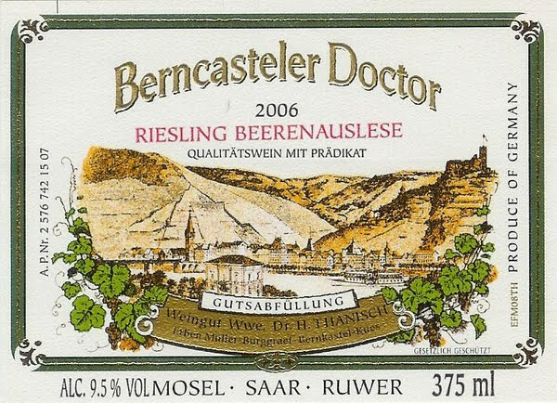
Beerenauslese ("selected berries harvest") and Trockenbeerenauslese ("selected dried-berries harvest") levels are botrytized.

Slide 21
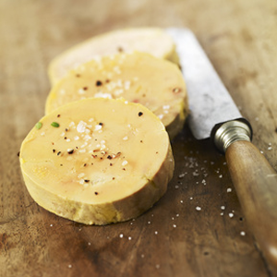
Sweet wines and foie gras is the most classic food and wine combination, but they can be paired with many sweet and savory combinations.

