Slide 1
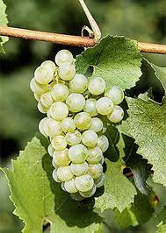
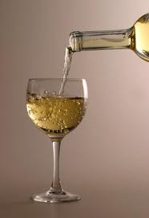
Chardonnay

Slide 2
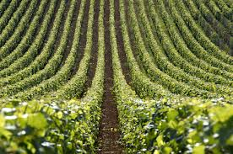
Chardonnay is a green-skinned grape
used to make white wine

Slide 3
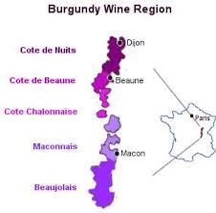
It originated in the Burgundy wine
region of eastern France

Slide 4
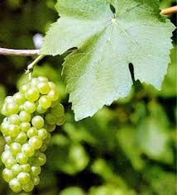
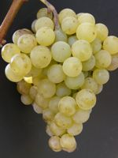
Chardonnay is a cross between the
Pinot Blanc and Gouais Blanc grape varieties

Slide 5
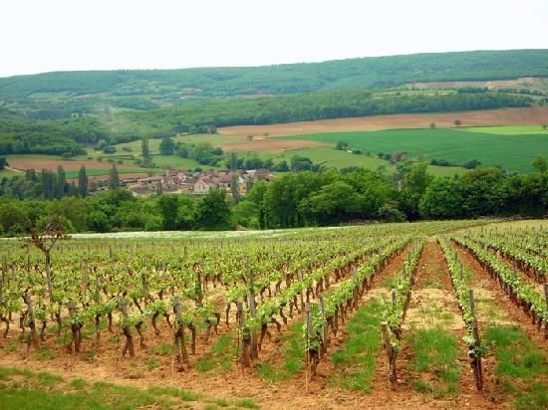
Chardonnay is planted in more
wine regions than any other grape

Slide 6
Chardonnay is easy to cultivate
and is adaptable to different conditions
The grape reflects its terroir and winemaker

Slide 7
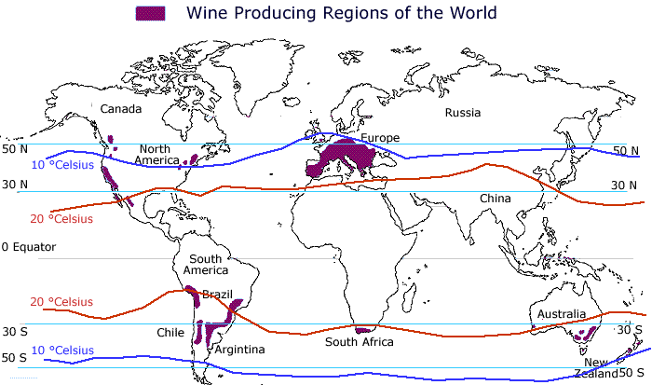
There is not one universal "style"
to Chardonnay made across the globe

Slide 8
It is vinified in many different styles, from the
lean, crisply mineral wines of Chablis, France to
New World wines with oak, and tropical fruit flavors.

Slide 9
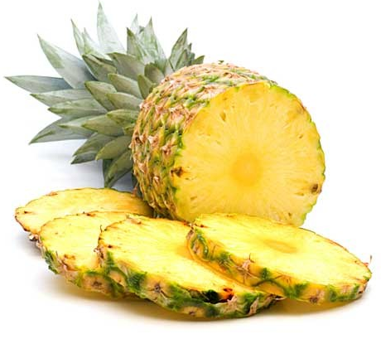
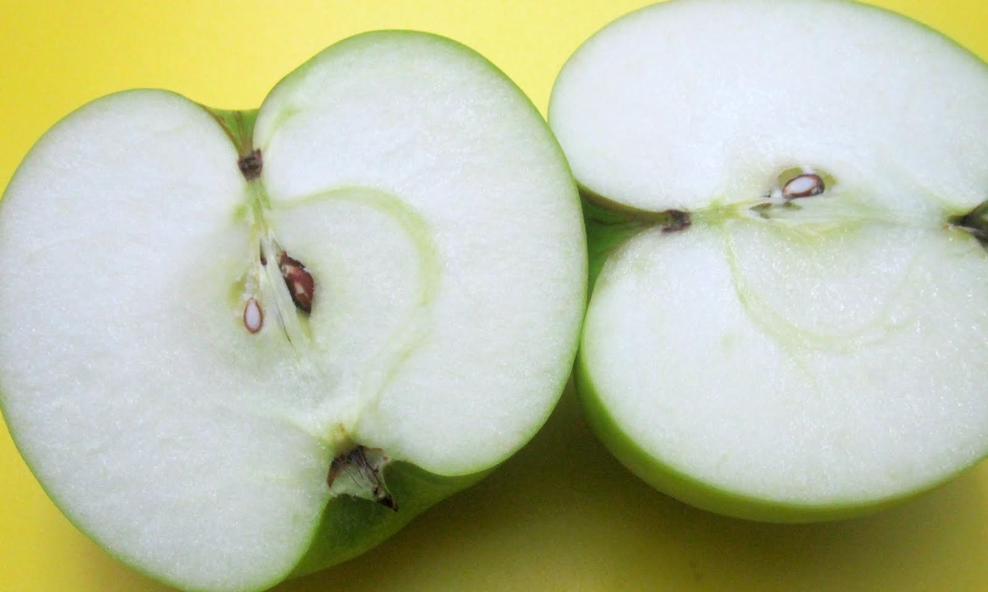
Styles are regionally based:
Pineapple Notes-Napa Valley
Green Apples-Chablis

Slide 10
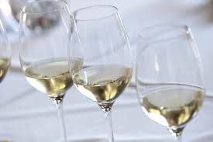
Winemaking
Chardonnay can be used with
any style of wine making
from dry still wines,
to sparkling wines
to sweet late harvest and even
botrytized wines.

Slide 11
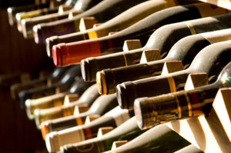
Many examples of Chardonnay can benefit from
a few years of bottle aging, but most Chardonnays
are meant to be consumed in their youth

Slide 12
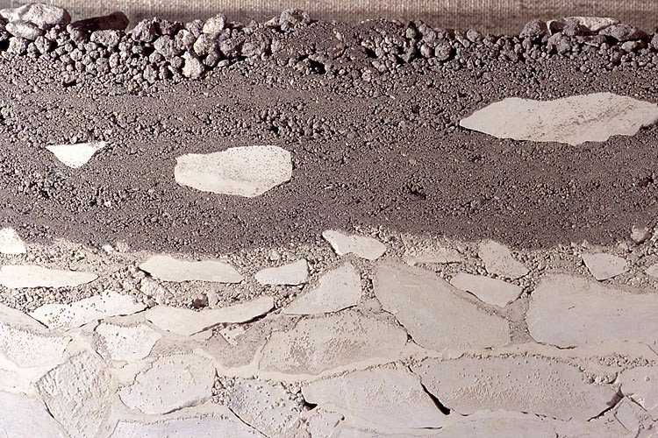
Chardonnay can adapt to almost all vineyard soils,
the types it seems to like most are chalk, clay and limestone

Slide 13
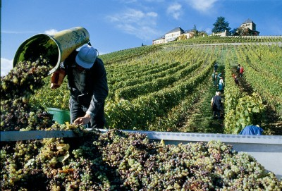
Time of harvest is crucial as the grapes
quickly begin to lose acidity as they ripen

Slide 14
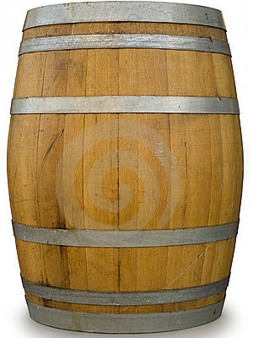
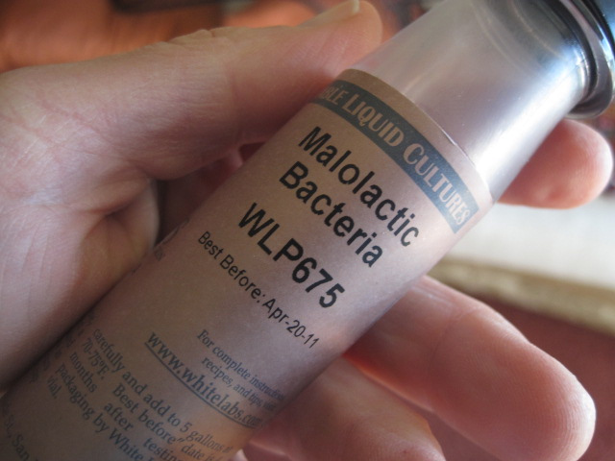
The two winemaking decisions that most widely affect the wine:
Malolactic Fermentation
Degree of Oak Influence

Slide 15
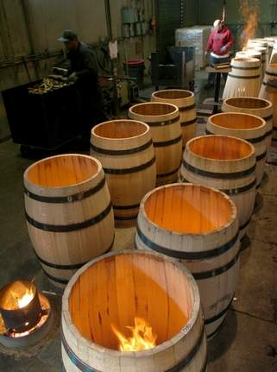
The amount of charring will determine the level of "toastiness”

Slide 16
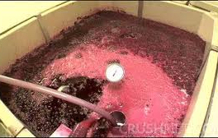
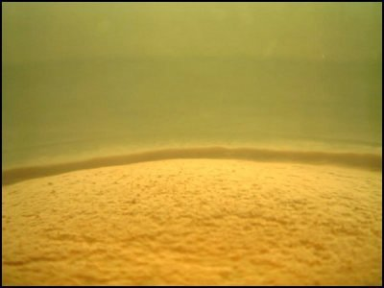
Other winemaking decisions that effects the flavor of the wine:
Temperature of Fermentation
Time, if any, on the lees

Slide 17
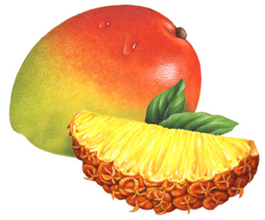
Colder fermentation produces more
"tropical" fruit flavors like mango and pineapple

Slide 18
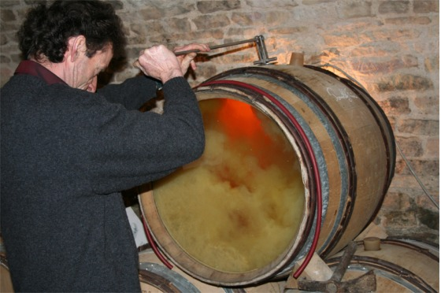
Burgundian winemaking favor extended contact on the lees
bâttonage-"stirring up" the lees

Slide 19
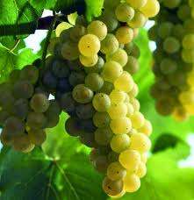
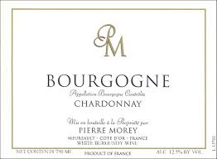
France
In France, Chardonnay is the second most widely
planted white grape variety just behind Ugni blanc

Slide 20
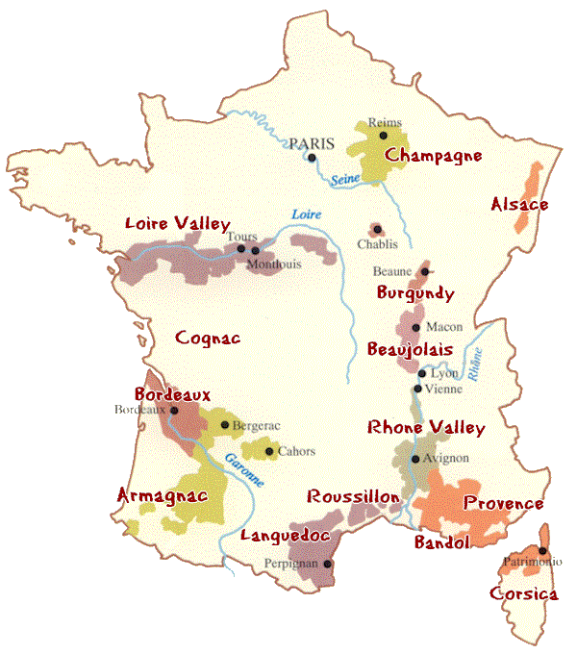
The grape first rose to prominence in the
Chablis and Burgundy regions.

Slide 21
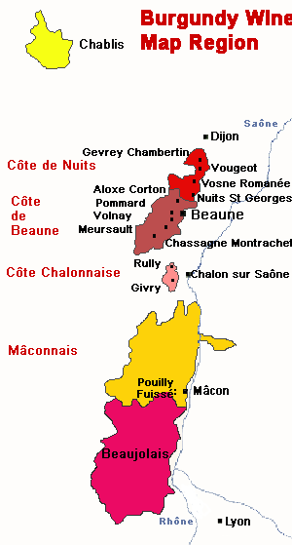
France-Burgundy
Chardonnay is one of the dominant grapes in Burgundy

Slide 22
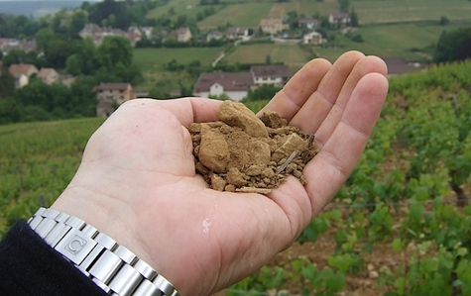
In addition to being the most expensive, the Burgundy
examples of Chardonnay are considered the benchmark
standard of expressing terroir through Chardonnay.

Slide 23
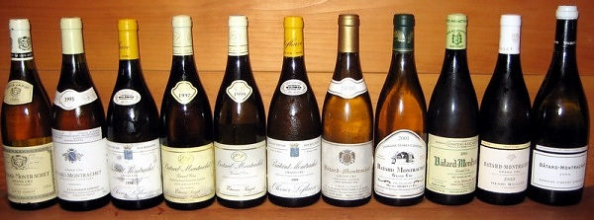
It is grown in 8 Grand Cru Vineyards;
“The Montrachets”
Montrachet, Criots-Bâtard-Montrachet, Bâtard-Montrachet, Chevalier-Montrachet, Bienvenues-Bâtard-Montrachet as well as Charlemagne, Corton-Charlemagne & Le Musigny

Slide 24
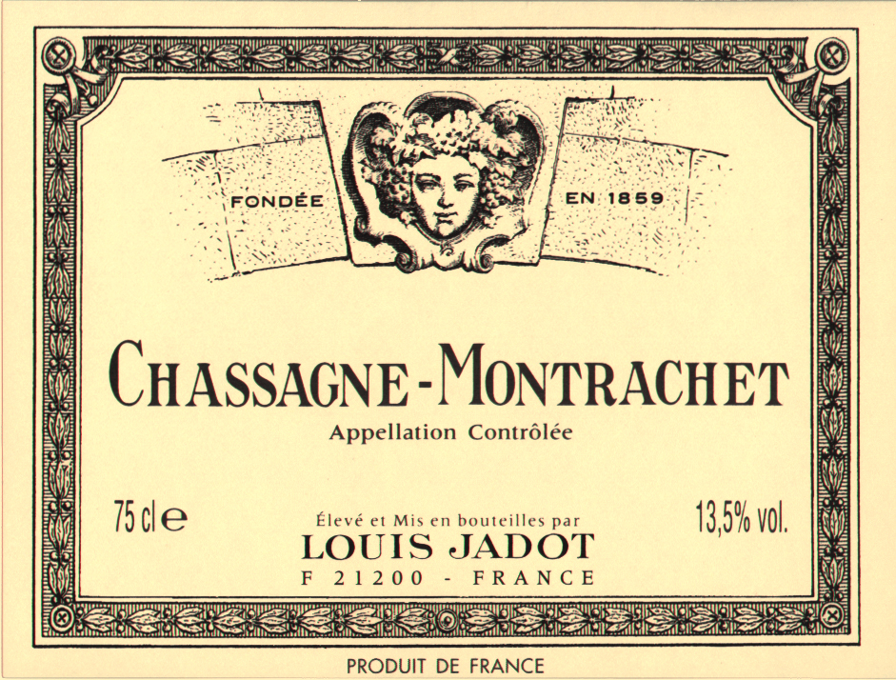
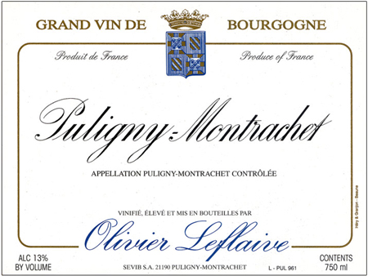
They have high alcohol levels, often above 13%
& deep concentration of flavors
Chassagne-Montrachet-hazelnut aroma
Puligny-Montrachet-steely flavors.

Slide 25
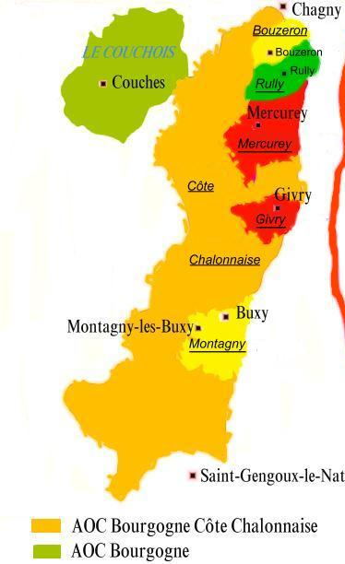
Côte Chalonnaise
Mercurey
Montagny-lès-Buxy
Rully
(The largest producers of Chardonnay in the Côte Chalonnaise)

Slide 26
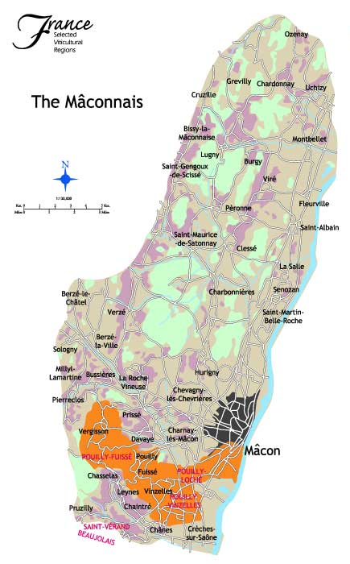
Mâconnais
Production is centered around the town of Mâcon and the Pouilly-Fuissé region.

Slide 27
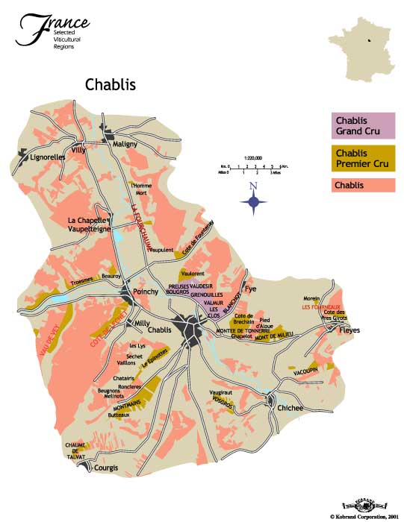
Chablis
Chardonnay is the only permitted AOC grape variety in the region

Slide 28
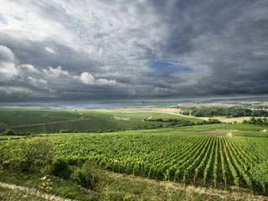
Chardonnay in Chablis is one of the "purest" expressions of the varietal character due to the simplistic style of winemaking

Slide 29
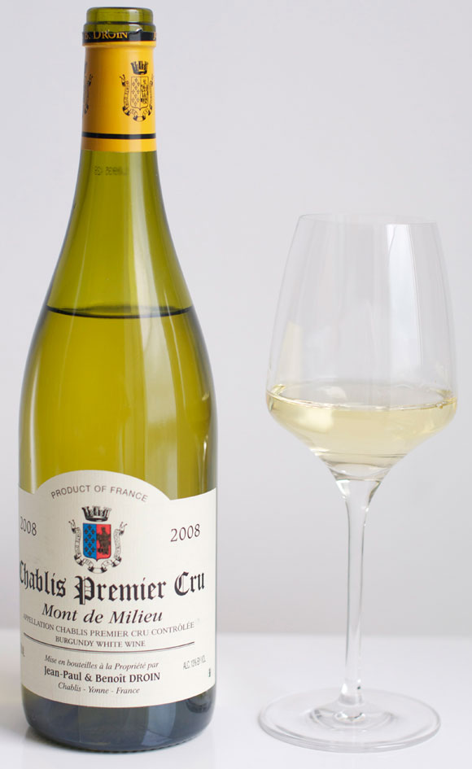
The wines rarely go through malolactic fermentation and are usually not exposed to oak (though its use is increasing)

Slide 30
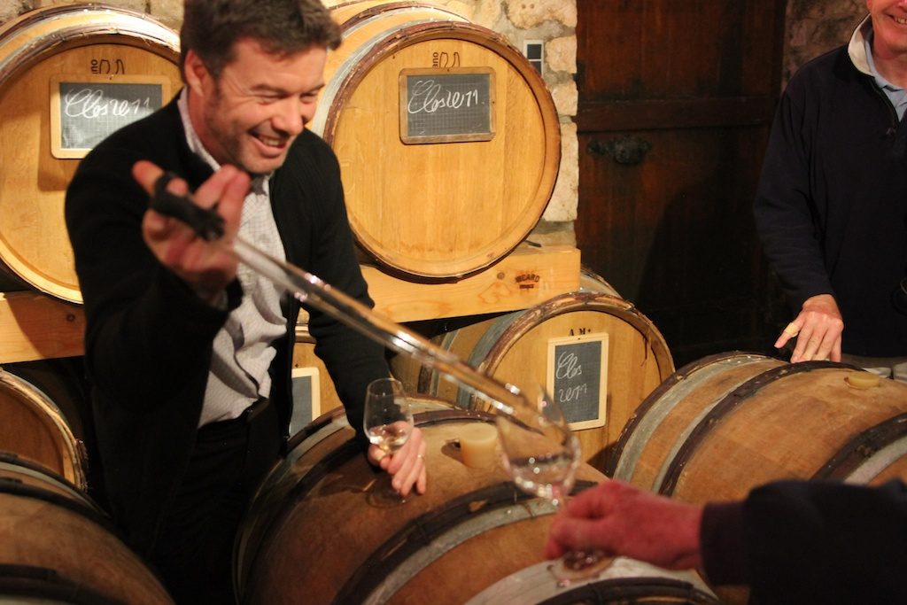
The winemakers that do use oak tend to favor more neutral oak to avoid the vanilla characteristic associated with American oak

Slide 31
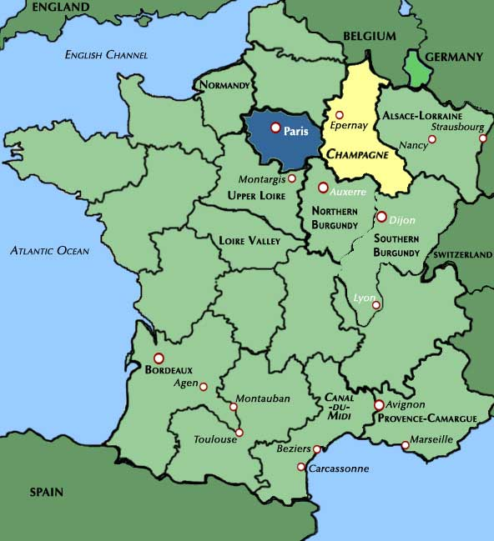
Champagne
Chardonnay is one of three major grape varieties planted in the region
The others- Pinot Noir
& Pinot Meuniere

Slide 32
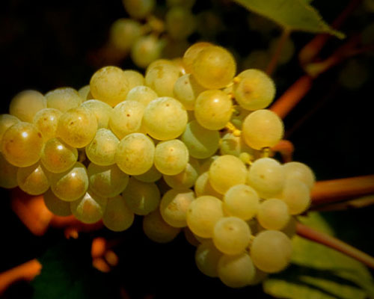
The element that Champagne wine-makers look for is
the finesse and balance of acidity
Flavors that emerge from extended time on its lees:
Creamy, Nutty, Floral

Slide 33
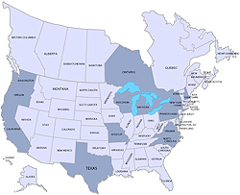
North America
North America, particularly California, produces a style of wine that is noticeably different than that of France
It is the dominant white variety, overtaking Riesling in 1990

Slide 34
In the United States it is found most notably in California, Oregon, Texas, Virginia and Washington but also in Alabama, Arizona, Arkansas, Colorado, Connecticut, Georgia, Idaho, Illinois, Indiana, Iowa, Maryland, Massachusetts, Michigan, Minnesota, Missouri, New Hampshire, New Jersey, New Mexico, New York, North Carolina, Ohio, Oklahoma, South Carolina, Tennessee and Vermont wine.

Slide 35
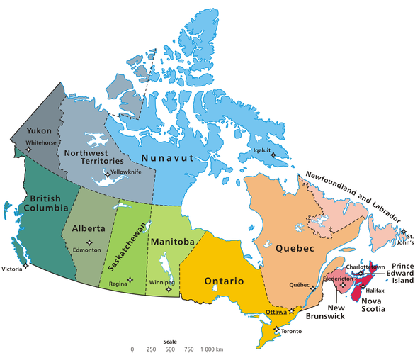
In Canada, Chardonnay is found in
British Columbia, Nova Scotia, Ontario and Quebec

Slide 36
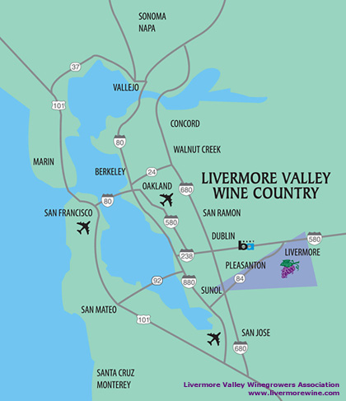
California
The first successful commercial production was in the Livermore Valley AVA
Wente Vineyards developed a clone that was used in many Californian vineyards throughout the 1940s

Slide 37
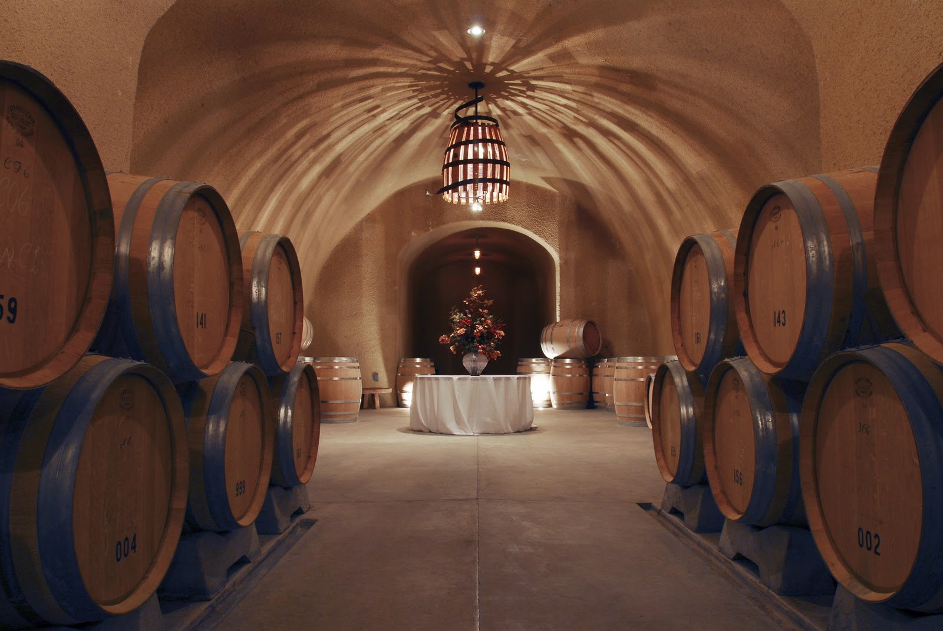
The early trend was to imitate the great Burgundy wines

Slide 38
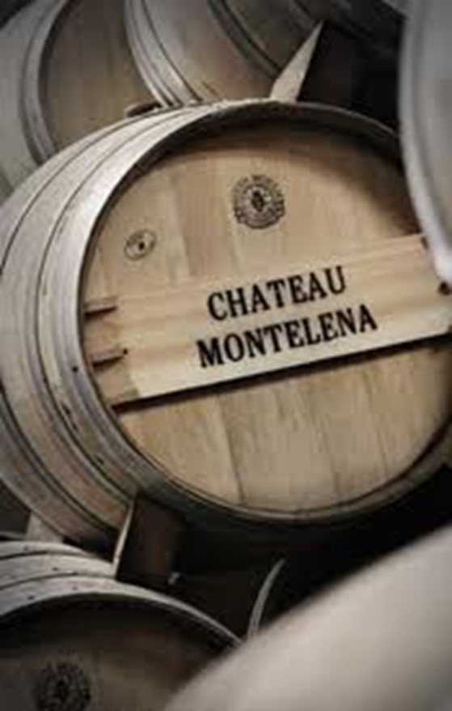
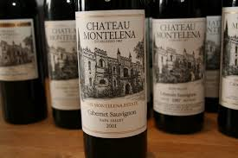
1976- Chateau Montelena's victory over Burgundy
Chardonnay in the blind tasting event conducted by
French judges known as the Judgment of Paris

Slide 39
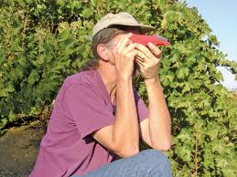
In the 1970s, the focus was on harvesting at higher
degrees of ripeness and at higher Brix levels
New oak barrels were used to produce wines that
were big in body, mouthfeel and alcohol.

Slide 40
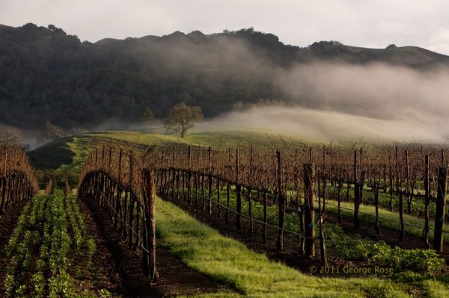
The wine regions with coastal fogs produce premium level wines
The fogs slow the ripening of the grapes and give
them more time to develop their flavors

Slide 41
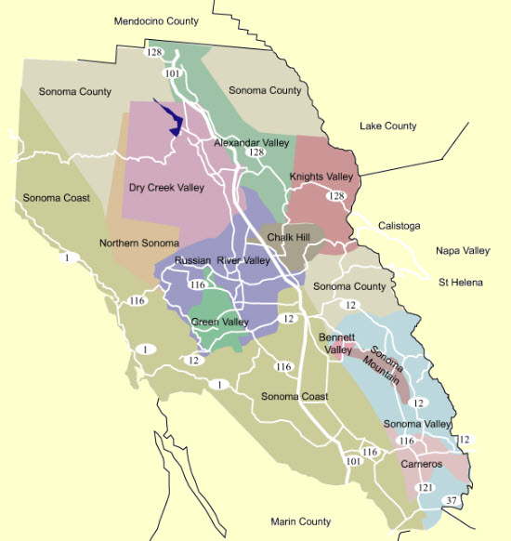
Alexander Valley, Los Carneros, Russian River Valley & Sonoma
Have great success producing wines
that reflect Burgundian styles

Slide 42
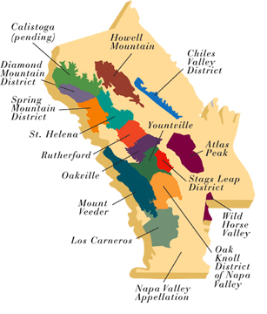
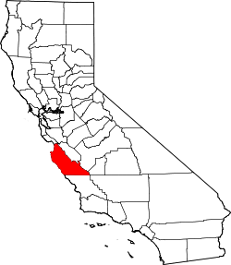
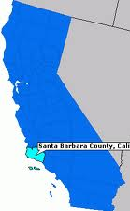
Other regions often associated with Chardonnay include
Napa Valley, Monterey County and Santa Barbara County

Slide 43
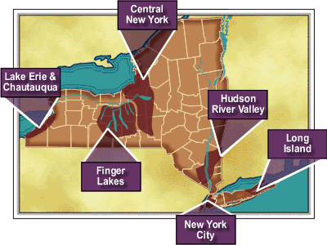
New York
Chardonnay was one of the first European grape varietals
to have been grown commercially east of the Rocky Mountains.
Finger Lakes region of upstate New York

Slide 44
New York’s comparatively cool growing season:
Slower ripening & a Longer hang time
The grapes develop greater complexity at reasonable
sugar levels compared to warmer Chardonnay regions

Slide 45
Washington
Washington Chardonnays can be similar to Californian Chardonnays with more emphasis on fruit than creaminess

Slide 46
Washington vineyards are planted with clones from
The University of California-Davis
Designed to take longer to ripen in our warmer weather.
This allows winemakers to maintain the acidity levels that balance the fruity and earthiness of Washington Chardonnay

Slide 47
Apple notes are common and can range from flavors of
Golden Delicious and Fuji to Gala and Jonathan

Slide 48
Oregon
Oregon Chardonnays can be very similar to
French Chardonnays but with a little more body.

Slide 49
Australia & New Zealand
Best from South Australia, New South Wales and Victoria.
1971- one of the first commercially successful Chardonnays is produced by Murray Tyrrell in the Hunter Valley

Slide 50
Tyrell's vineyard was planted with cuttings that he
"borrowed" from Penfolds' by jumping their
barb-wire fence and pruning their vines

Slide 51
To compensate for the very warm climate, richness is enhanced by the use of oak chips and acid is added during fermentation

Slide 52
Italy
For most of its history in Italian winemaking Chardonnay was and still is a blending grape

Slide 53
In Lombardy, the grape is often used for spumante.

Slide 54
In Spain, Chardonnay is increasingly
used in the sparkling wine Cava.

Slide 55
Portugal
The Portuguese have been mostly influenced by flying winemakers from Australia and the wines produced are very New World in style

Slide 56
Chile/Argentina
In the cool-climate wine regions of Argentina's
Uco Valley and Chile's Casablanca, Chardonnay has developed a presence

Slide 57
With Food
Due to the wide range of styles, Chardonnay has the potential to be paired with a diverse spectrum of food types.

Slide 58
It is most commonly paired with white meats

Slide 59
Heavily Oaked Chardonnays do not pair
well with light seafood dishes
These wines tend to go better with smoked fish,
spicy southeast Asian cuisine and garlic dishes

Slide 60
Chardonnays from Washington, which have more acidity, pair well with tomato-based dishes and items featuring sweet onions

Slide 61
Older, more mellow Chardonnays are often paired with more "earthy" dishes like mushroom soup and aged cheese

Slide 62
"Chardonnay”
Arboisier, Arnaison Blanc, Arnoison, Aubain, Aubaine, Auvergnat Blanc, Auvernas, Auvernas Blanc, Auvernat Blanc, Auxeras, Auxerras Blanc, Auxerrois Blanc, Auxois, Auxois Blanc, Bargeois Blanc, Beaunois, Biela Klevanjika, Blanc de Champagne, Blanc de Cramant, Breisgauer Suessling,

Slide 63
Breisgauer Sussling, Burgundi Feher, Chablis, Chardenai, Chardenay, Chardenet, Chardennet, Chardonay, Chardonnet, Chatenait, Chatey Petit, Chatte, Chaudenay, Chaudenet, Chaudent, Clävner, Clevner Weiss, Cravner, Epinette, Epinette Blanc, Epinette Blanche, Epinette de Champagne, Ericey Blanc, Feher Chardonnay, Feherburgundi, Feinburgunder, Gamay Blanc, Gelber Weissburgunder, Gentil Blanc, Grosse Bourgogne, Klawner, Klevanjka Biela, Klevner,

Slide 64
Luizant, Luzannois, Maconnais, Maurillon Blanc, Melon Blanc, Melon D'Arbois, Meroué, Moreau Blanc, Morillon Blanc, Moulon, Noirien Blanc, Obaideh, Petit Chatey, Petit Sainte-Marie, Petite Sainte Marie, Pineau Blanc, Pino Sardone, Pino Shardone, Pinot Blanc à Cramant, Pinot Blanc Chardonnay, Pinot Chardonnay, Pinot de Bourgogne, Pinot Giallo, Pinot Planc,

Slide 65
Plant de Tonnerre, Romere, Romeret, Rouci Bile, Rousseau, Roussot, Ruländer Weiß, Sainte Marie Petite, Sardone, Shardone, Shardonne, Später Weiß Burgunder, Weiß Burgunder (normally refers to Pinot Blanc), Weiß Clevner, Weiß Edler, Weiß Elder, Weiß Klewner, Weiß Silber, Weißedler, Weißer Clevner, Weißer Ruländer.

Slide 66
Chardonnay is a wine that one can use to
explore the whole world!

