Slide 1
Sparkling Wine
Notes:
Assess wine knowledge of class
Who I am
Why wine as part of curriculum?
Provide understanding for the importance of wine as part of
curriculum and culinary career.
Enhance Image
Enhance Food
Profit center
Start with Grape Growing & Winemaking. Knowledge will
provide the foundation for understanding why wines look, smell and taste
the way they do. So when you ask for a barrel fermented Chardonnay
From Ca, you’re going to be pretty sure …describe taste.

Slide 2
“I drink it when I’m happy and when I am sad. Sometimes I drink it when I’m alone. When I have company, I consider it obligatory. I trifle with it if I’m not hungry and drink it when I am. Otherwise, I never touch it…unless I am thirsty.” Madame Bollinger
Notes:
Assess wine knowledge of class
Who I am
Why wine as part of curriculum?
Provide understanding for the importance of wine as part of
curriculum and culinary career.
Enhance Image
Enhance Food
Profit center
Start with Grape Growing & Winemaking. Knowledge will
provide the foundation for understanding why wines look, smell and taste
the way they do. So when you ask for a barrel fermented Chardonnay
From Ca, you’re going to be pretty sure …describe taste.

Slide 3
Overview
Champagne vs. Sparkling wine
Champagne - The Region
Winemaking - 3 Basic Methods
Coming to Terms
Food & Wine Pairing

Slide 4
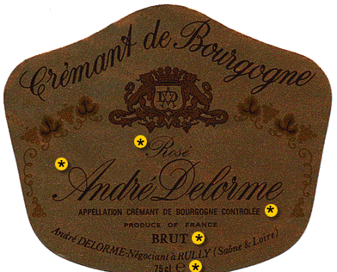
Champagne vs. Sparkling wine
What’s in a name?
Cremant
USA laws must include place
Notes:
It used to be known as the méthode Champenoise but the
Champagne producers have successfully lobbied
the European Union to restrict that term to wines from their region.
Thus wines from elsewhere may not use méthode Champenoise
when sold in the EU, and instead traditional method,
méthode traditionnelle or the local language equivalent can be seen.
Consumers outside the EU may still see méthode Champenoise on
labels, but it is becoming less common.

Slide 5
Champagne vs. Sparkling wine
‘Sparkling wine’
CO₂ from 2nd ferm.
Spain
Germany
Italy
Cava
Sekt
Spumante

Slide 6
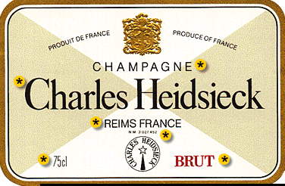
Champagne The Region
84,000 acres
$1.2 mil/acre
25 mil cases

Slide 7
Notes:
located about 100 miles (160 km) east of Paris.

Slide 8
5 Districts:
Aube
Cote des Blancs
Cote de Sezanne
Montagne de Reims
Vallee de la Marne
Notes:
The viticultural boundaries of Champagne are legally defined and
split into five wine producing districts within the administrative
province-the Aube, Côte des Blancs,
Côte de Sézanne, Montagne de Reims, and
Vallée de la Marne. The towns of Reims and Épernay
are the commercial centers of the area.

Slide 9
Champagne The Region
Epernay
Moet & Chandon
Perrier-Jouet
Reims
Krug
Piper-Heidsieck
Roederer
Veuve Cliquot

Slide 10
Champagne Geography
Climate
Latitude 49º
July mean 66º
Rainfall 25 inches
ACID!
Soil
Chalky
Cellars
Drainage / moisture
Vines rich in nitrogen
Notes:
Compare to Wa:
WA: -46 Lat degrees
July mean – 70 degrees
Rainfall: 6 – 8”
Vines rich in nitrogen assists yeast in working effectively

Slide 11
Champagne History
Dom Perignon
“I see stars!”
French ‘perfected’ the process
1500’s
Submerging semi-fermented must…

Slide 12
Winemaking 3 methods
Champagne Method
‘Methode Champenoise’
Labor intensive
Highest quality
All in Champagne region
Notes:
Less than 20% in USA is made this way.

Slide 13
Winemaking 3 methods
Transfer Method
2nd fermentation in bottle
Filtered in tank
Rebottled under pressure

Slide 14
Winemaking 3 methods
‘Charmat’ or bulk method
Inferior grapes
No sur lie aging
2nd fermentation in pressure sealed tank
Filtered in tank
Rebottled under pressure
Notes:
Totts, Cooks, Andre

Slide 15
Winemaking
Methode Champenoise
Notes:
Totts, Cooks, Andre

Slide 16
Harvest
Grapes
Pinot Noir
Pinot Meunier
Chardonnay
Sept/Oct
18 to 20º Brix
Direct to press!
Notes:
Remind that 18 degrees is very low
Why direct to press?
Why best hand harvested?

Slide 17
Primary Fermentation
Tank
Sometimes wood
Lower alc
9 to 11%
High acid!
Sometimes ML
Notes:
Acid level is .7 to .9 g/100ml

Slide 18
Blending
Cuvee or blend
Various base wines
Various vintages
70 different wines!
Goal
‘House style’
Notes:
Usually takes place in last Fall or Spring
Usually takes about 5 to 7 weeks of blending
Goal
Importance of creating same flavor profile year after year

Slide 19
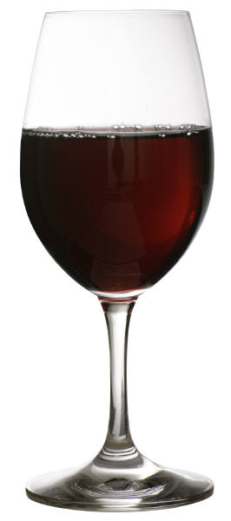
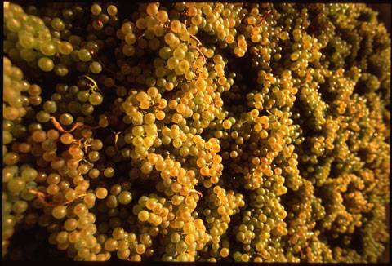
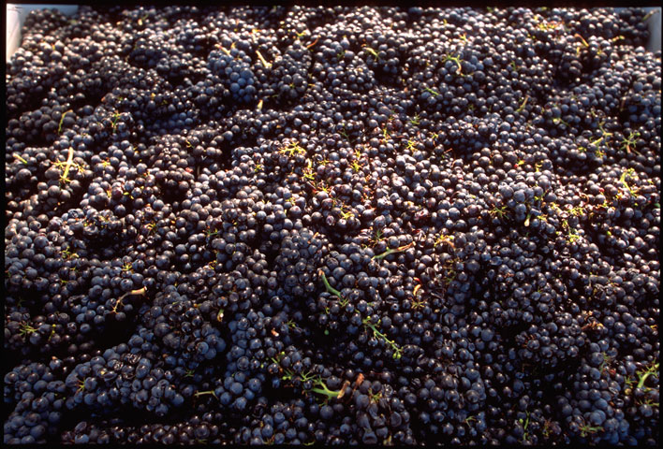
Yeast
+
=
C₆H₁₂O₆ + YEAST 2CH3CH2OH + 2CO2
Notes:
It’s really very simple…grapes, plus yeast (naturally present) and alcohol and
CO2 are produced. All happened by accident as long as 6000 years ago, the
first evidence we have of wine.
But wine can only be its best when it is not left to chance, but rather controlled
every step of the way. Lets have a look at these steps

Slide 20
Second fermentation
Bubbles!
Prise de Mousse!
‘Still wine + ‘Syrup’
Wine, sugar, yeast
Mixed in tank
Temporary closure
Tirage
30 day fermentation
Notes:
French call this liquer de tirage (draw into bottle)
56,000,000!

Slide 21
Aging on the Yeast
Sur lie aging/ entirage
1 to 3 years for finer wines
Autolysis
Adds to bubble longevity
Notes:
Dead yeast cells decompose and release amino acids
creating ‘toastiness’ and creamier texture
Keeps C0₂ dissolved in wine

Slide 22
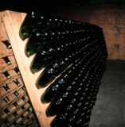
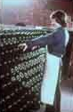
Collecting the Yeast
Riddling
Madame Clicquot-Ponsardin
1 to 12 weeks to complete
20 to 50k bottles per day
Gyro pallet
Notes:
1 quarter of a turn each day

Slide 23
Removing the Yeast
Disgorging
Brine solution
CO₂ push
Notes:
1 quarter of a turn each day

Slide 24
Final Sweetness level
Dosage
‘Syrup’ of sugar, wine, or brandy
Notes:
1 quarter of a turn each day

Slide 25
Aging
Methode Champenoise
2 months minimum
Notes:
1 quarter of a turn each day

Slide 26
Coming to Terms
Type vs Style
Rating System
Taxation

Slide 27
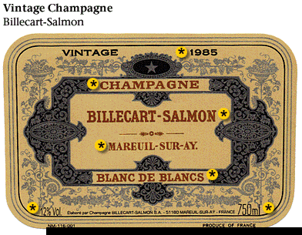
Type vs Style
Type – blend
Vintage
Non Vintage
Blanc de Blancs
‘white of white’
Notes:
Bl

Slide 28
Type vs Style
Type – blend
Blanc de Noirs
‘white of black’
Reserve
Tete Cuvee
Notes:
Bl

Slide 29
Type vs Style
Style - sweetness
Brut
Extra Dry
Notes:
Bl

Slide 30
Type vs Style
Extra Brut
Brut
Extra Dry
Sec
Demi-Sec
Doux
Dry
Dry
Slightly sweet
Sweet
Very sweet
V V sweet
Notes:
Extra Brut < 6g/l
Brut < 15g/l
Extra Dry 12 - 20
Sec 17 - 35
Demi Sec 33 - 50
Doux > 50

Slide 31
Rating System
Based on potential quality
321 communes
Rating between 80 to 100%
Grand Cru = 100%
Premier Cru = 90 – 99%
Deuxieme Cru = 80 – 89%

Slide 32
Taxation
Higher than still wine
Prohibition & morality

Slide 33
Food & Sparkling wine
The Classics:
Caviar
Oysters on the half shell
Smoked salmon
Souffle

Slide 34
Food & Sparkling wine
Contemporary:
Fried Calamari
French fries
Popcorn

Slide 35
Food & Sparkling wine
Extra Dry:
Sushi
Blanc de Noirs/Roses
Lamb, pork
Demi-Sec/Doux
Fruit, cheesecake, chocolate
http://www.moet.com/site.php?lg=us

