Slide 1
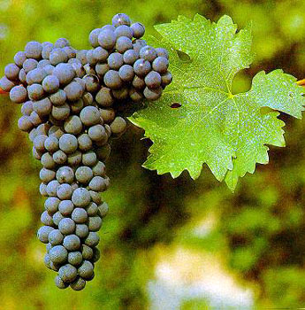
Cabernet Sauvignon

Slide 2
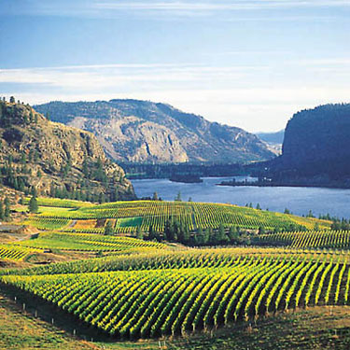
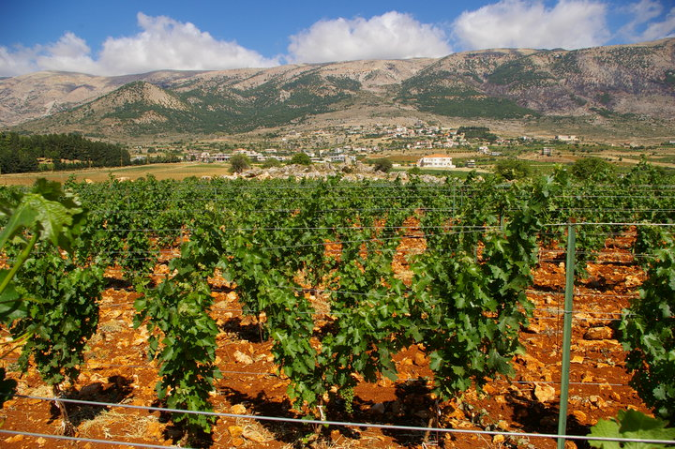
Cabernet Sauvignon is one of the world's most widely recognized red wine grape varieties. It is grown in nearly every major wine producing country among a diverse spectrum of climates from Canada's Okanagan Valley to Lebanon's Beqaa Valley.

Slide 3
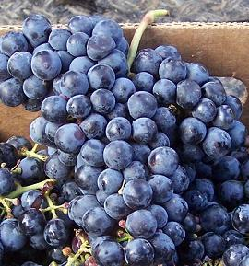
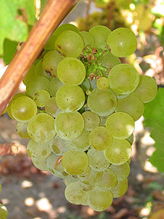
Despite its prominence in the industry, the grape is a relatively new variety, the product of a chance crossing between Cabernet franc and Sauvignon blanc during the 17th century in southwestern France.

Slide 4
Its popularity is often attributed to its ease of cultivation—the grapes have thick skins and the vines are hardy and resistant to rot and frost and to its consistent presentation of structure and flavours which express the typical character ("typicity") of the variety.

Slide 5
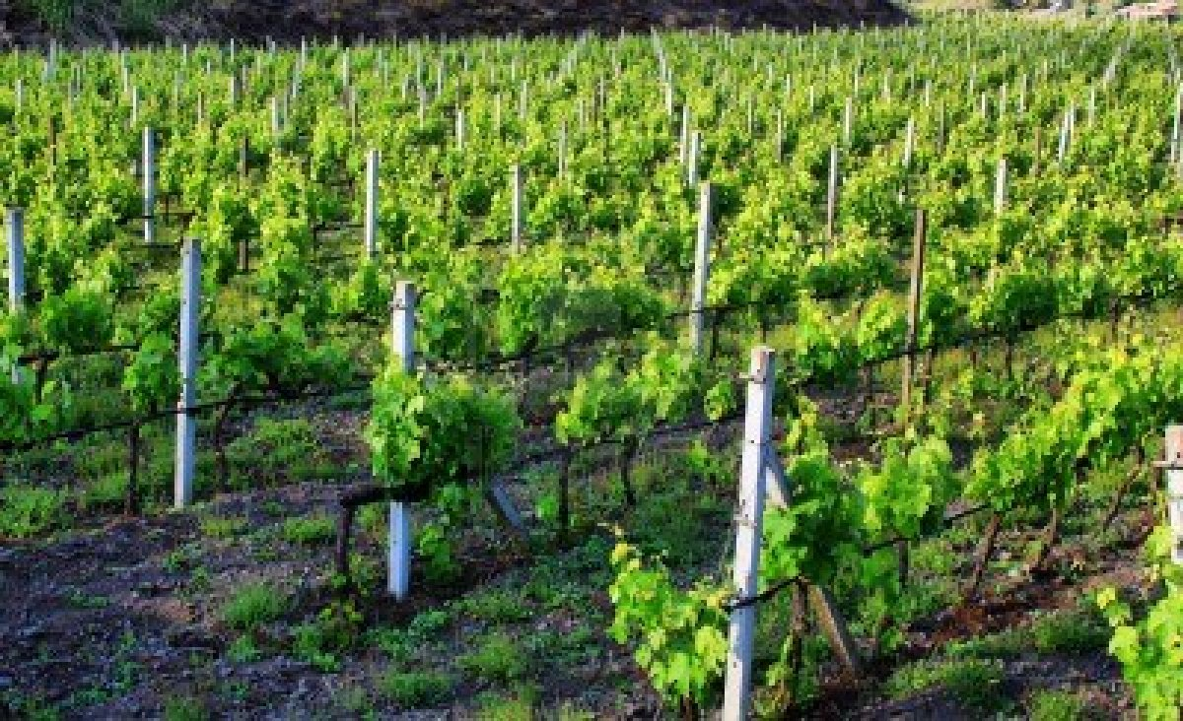
While Cabernet Sauvignon can grow in a variety of climates, its suitability as a varietal wine or as a blend component is strongly influenced by the warmth of the climate.

Slide 6
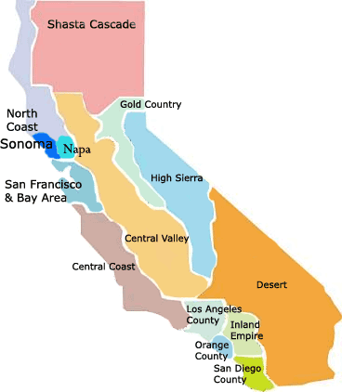
Many wine regions in California give the vine an abundance of sunshine with few problems in ripening fully, which increases the likelihood of producing varietal Cabernet wines.

Slide 7
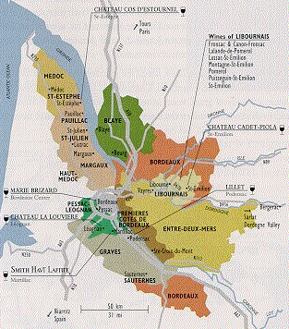
In regions like Bordeaux, under the threat of inclement harvest season weather, Cabernet Sauvignon is often harvested a little earlier than ideal and is then blended with other grapes to fill in the gaps

Slide 8
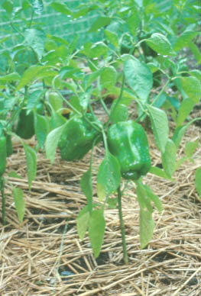
In some regions, climate will be more important than soil. In regions that are too cool, there is a potential for more herbaceous and green bell pepper flavors from less than ideally ripened grapes

Slide 9
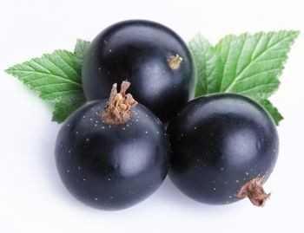
In regions where the grape is exposed to excess warmth and over-ripening, there is a propensity for the wine to develop flavors of cooked or stewed blackcurrants.

Slide 10
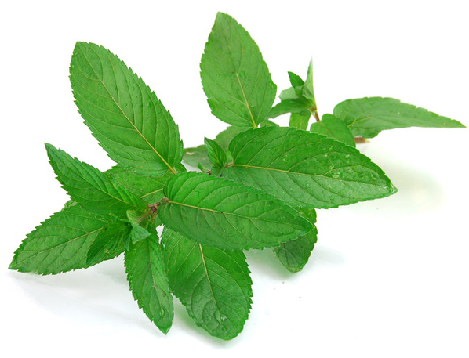
Two other well known Cabernet Sauvignon flavors are mint and eucalyptus. Mint flavors are often associated with wine regions that are warm but are still generally cool, such as Australia's Coonawarra region and some areas of Washington State.

Slide 11
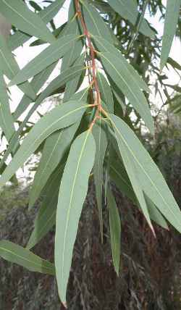
Resinous Eucalyptus flavors tend to appear in regions that are habitats for the eucalyptus tree, such as California's Napa and Sonoma valleys

Slide 12
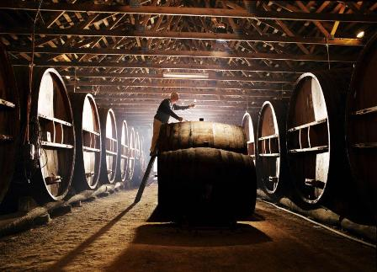
In many aspects, Cabernet Sauvignon can reflect the desires and personality of the winemaker while still presenting familiar flavors that express the typical character of the variety

Slide 13
Typically the first winemaking decision is whether or not to produce a varietal or blended wine.

Slide 14
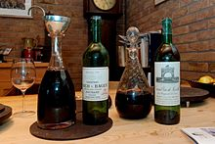
The "Bordeaux blend" of Cabernet Sauvignon, Merlot and Cabernet franc, with potentially some Malbec, Petit Verdot or Carménère, is the classic example of blended Cabernet Sauvignon

Slide 15
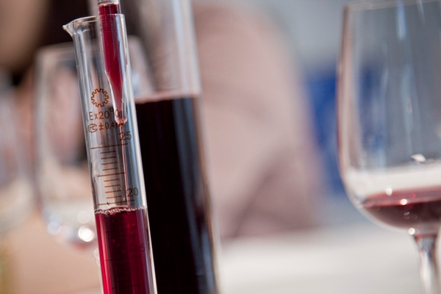
But Cabernet Sauvignon can be blended with a variety of grapes such as Shiraz, Tempranillo and Sangiovese

Slide 16
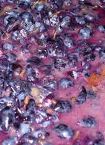
The tannic nature of Cabernet Sauvignon is an important winemaking consideration. As the must is exposed to prolonged periods of maceration, more tannins are extracted from the skin and will be present in the resulting wine.

Slide 17
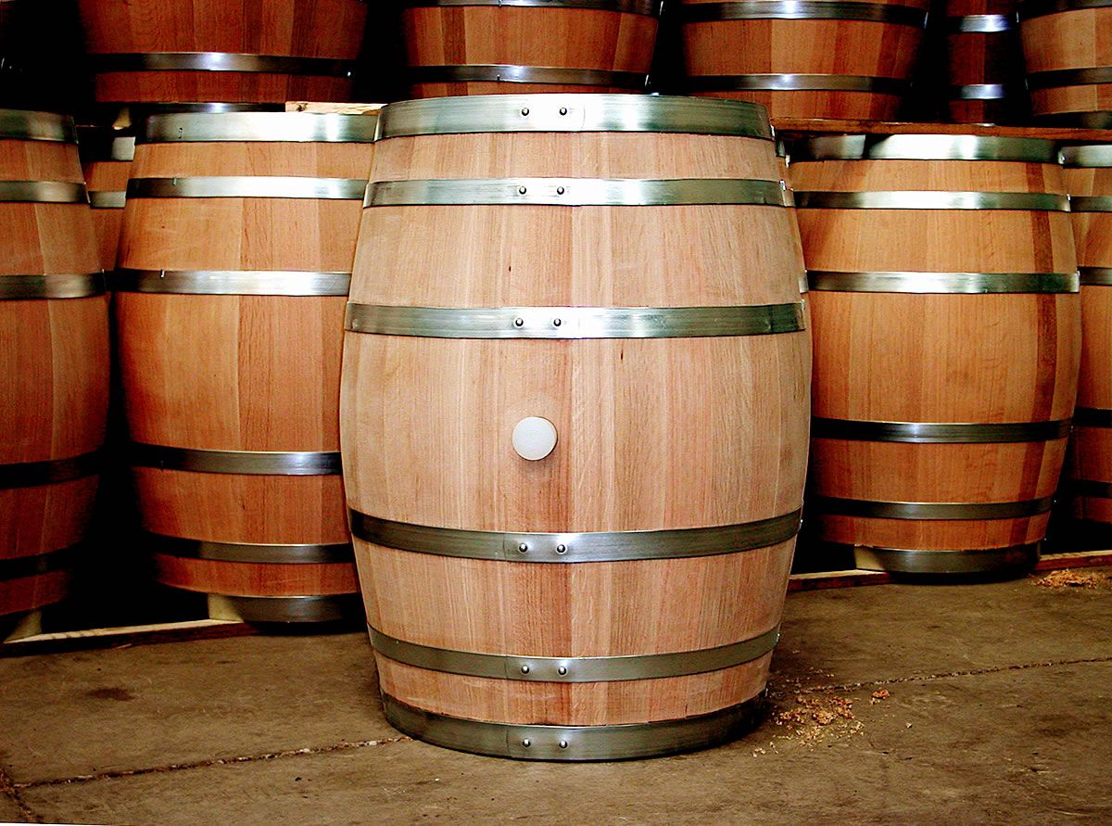
One of the most noted traits of Cabernet Sauvignon is its affinity for oak, either during fermentation or in barrel aging.

Slide 18
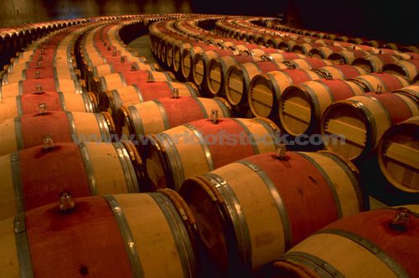
In addition to having a softening effect on the grape's naturally high tannins, the unique wood flavors of vanilla and spice complement the natural grape flavors of black currant and tobacco.

Slide 19
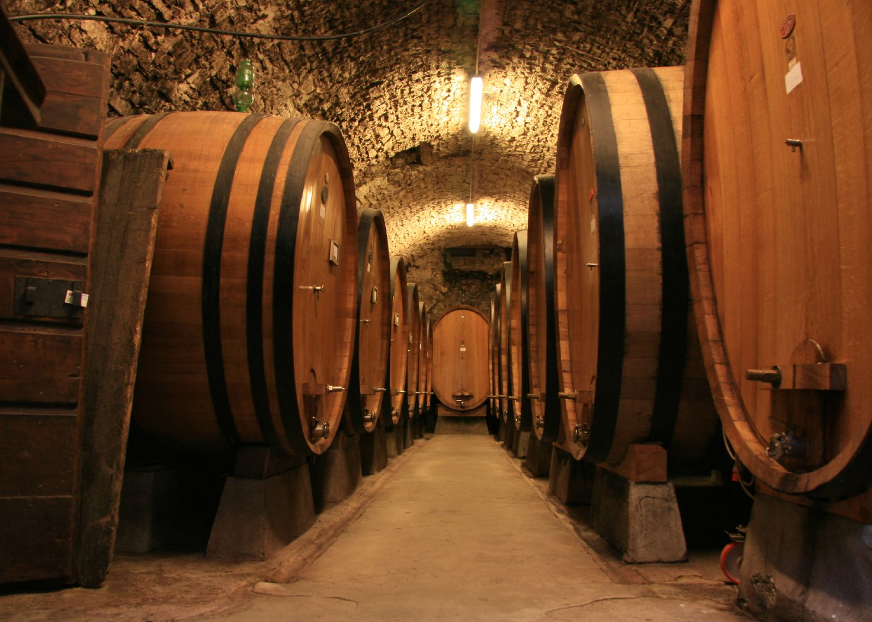
American oak, particularly from new barrels, imparts stronger oak flavors that are less subtle than those imparted by French oak

Slide 20
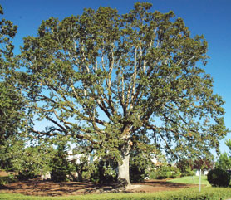
Even within the American oak family, the location of the oak source also plays a role with oak from the state of Oregon having more pronounced influence on Cabernet Sauvignon than oak from Missouri, Pennsylvania and Virginia.

Slide 21
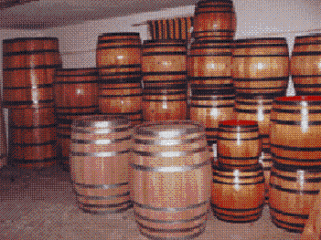
Winemakers often use a variety of oak barrels from different locations and of different ages and blend the wine as if they are blending different grape varieties

Slide 22
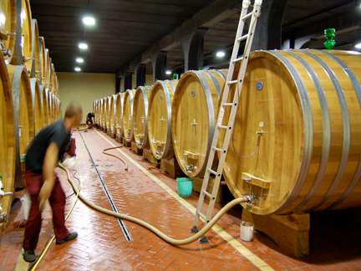
Winemakers can also control the influence of oak by using alternatives to the standard barrique barrels. Larger barrels have a smaller wood-to-wine ratio and therefore less pronounced oak flavors.

Slide 23
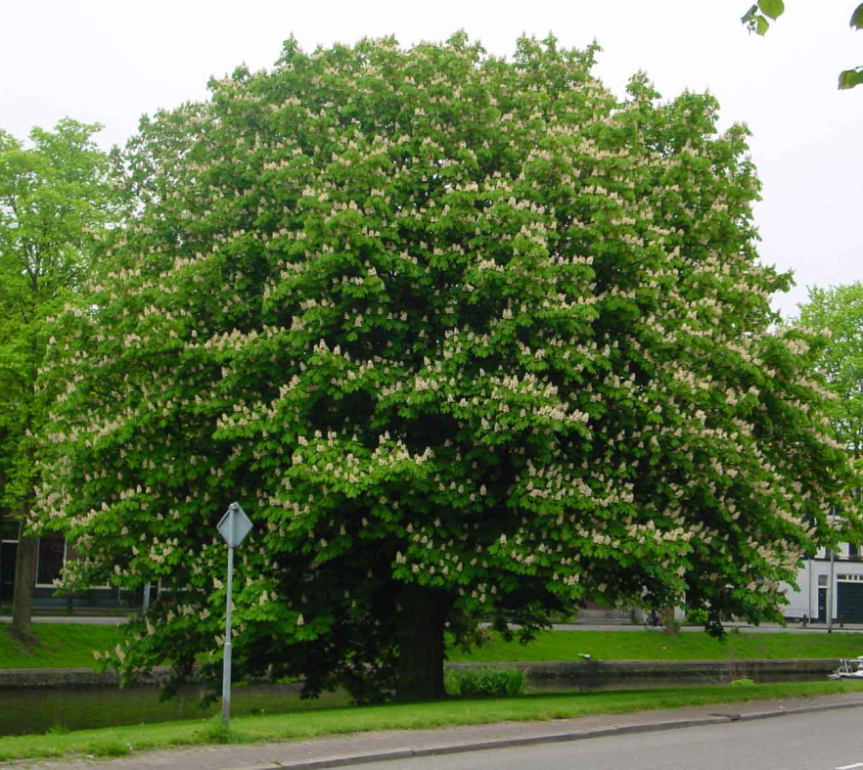
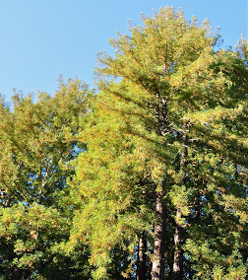
Winemakers in Italy and Portugal sometimes use barrels made from other wood types such as chestnut and redwood.

Slide 24
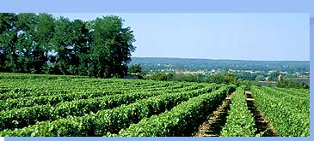
Wine Regions
Bordeaux
It is the likely "birthplace" of the vine, and producers across the globe have invested heavily in trying to reproduce the structure and complexity of Bordeaux wines

Slide 25
The decision to first start blending Cabernet Sauvignon was partly derived from financial necessity. The sometime temperamental and unpredictable climate of Bordeaux did not guarantee a successful harvest every year; producers had to insure themselves against the risk of losing an entire vintage by planting a variety of grapes

Slide 26
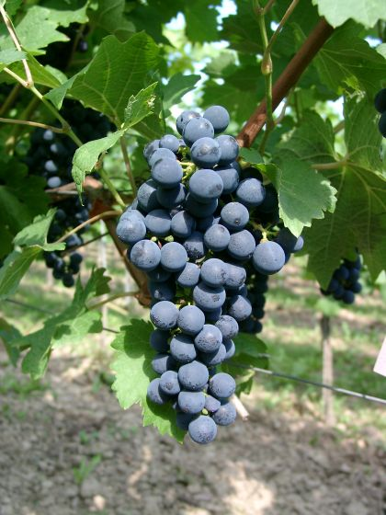
Over time it was discovered that the unique characteristics of each grape variety can complement each other and enhance the overall quality of wine

Slide 27
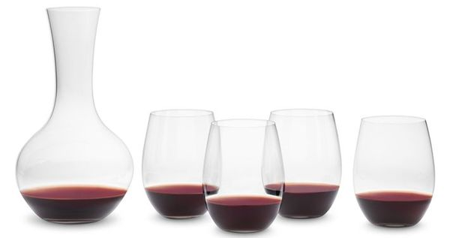
As a base, or backbone of the wine, Cabernet Sauvignon adds structure, acidity, tannins and aging potential.

Slide 28
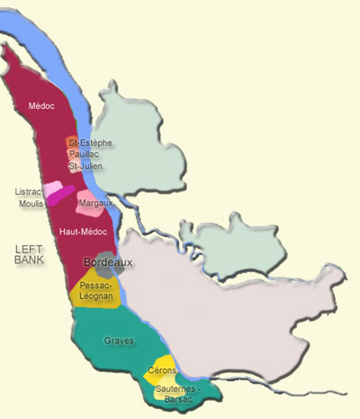
In the wine regions of the Left Bank, the Cabernet influence of the wine has shown unique characteristics in the different regions. In Saint- Estèphe and Pessac- Léognan, the grape develops more mineral flavors

Slide 29
Aromas of violets are a characteristic of Margaux.

Slide 30
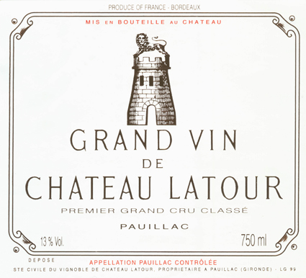
Pauillac is noted by a strong lead pencil scent and Saint- Julien by cedar and cigar boxes.

Slide 31
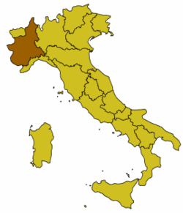
Italy
Cabernet Sauvignon has a long history in Italian wines, being first introduced to the Piedmont region in 1820. In the mid-1970s, the grape earned notoriety and controversy as a component in the so-called "Super Tuscan" wines of Tuscany.

Slide 32
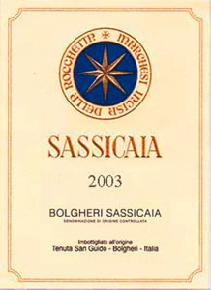
The origin of Super Tuscans is rooted in the restrictive DOC practices of the Chianti zone prior to the 1990s. During this time Chianti could be composed of no more than 70% Sangiovese and had to include at least 10% of one of the local white wine grapes

Slide 33
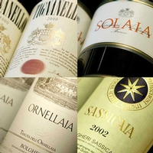
Many Tuscan wine producers thought they could produce a better quality wine if they were not hindered by the DOC regulations, particularly if they had the freedom to use Cabernet Sauvignon in the blend and not require to use white grape varieties

Slide 34
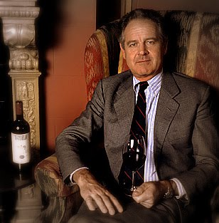
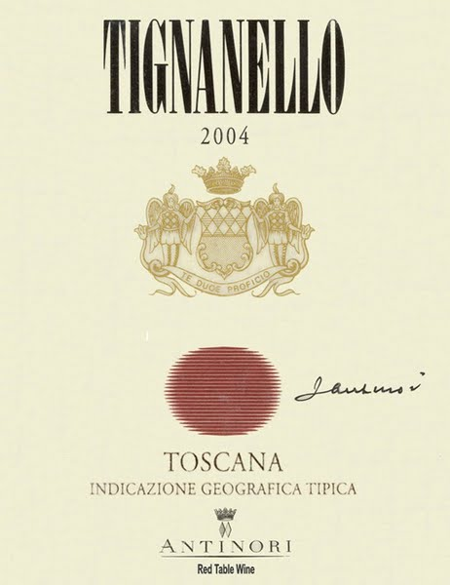
Piero Antinori was one of the first to create a "Chianti-style" wine that ignored the DOC regulations, releasing a 1971 Sangiovese-Cabernet Sauvignon blend known as Tignanello in 1978.

Slide 35
California
In California, the main stylistic difference in Cabernet Sauvignon is between hillside/mountain vineyards and those on flatter terrain like valley floors or some areas of the Central Valley.

Slide 36
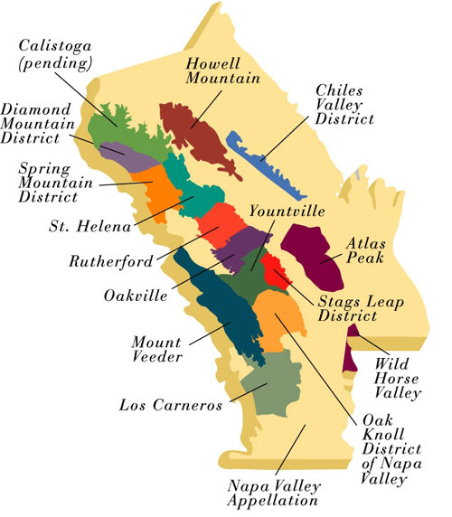
In Napa, the hillside vineyards of Diamond Mountain District, Howell Mountain, Mt. Veeder, Spring Mountain District have thinner, less fertile soils which produces smaller berries with more intense flavors, reminiscent of Bordeaux wines that require years of aging to mature.

Slide 37
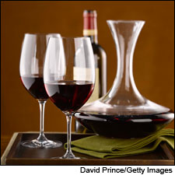
Wines produced from mountainside vineyards tend to be characterized by deep inky colors and strong berry aromas

Slide 38
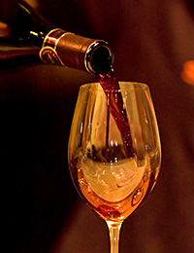
Flat terrain produces higher yields and rounder less complex wines, although many are considered of high quality.

Slide 39
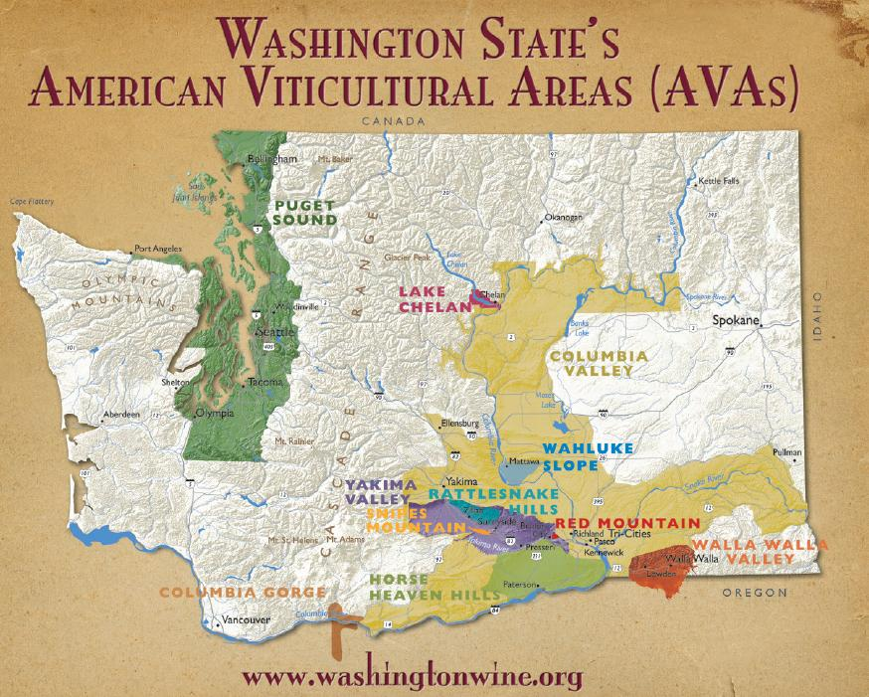
Washington State
After Merlot, Cabernet Sauvignon is the second most widely planted grape variety in Washington State. It is generally found in the warmer sites of the Columbia Valley.

Slide 40
Recent Washington American Viticultural Areas (AVAs) that have seen some success with their Cabernet Sauvignons include Red Mountain, Walla Walla Valley and parts of the Yakima Valley AVA

Slide 41
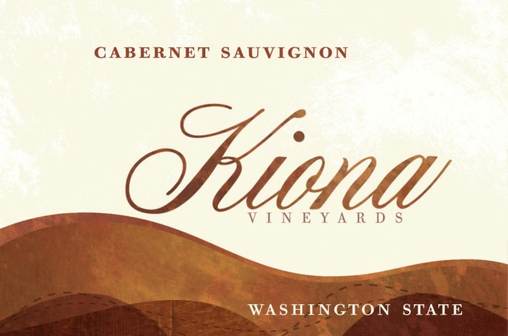
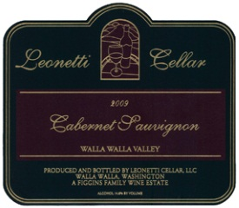
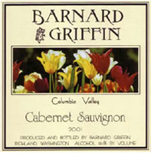
Washington Cabernet Sauvignon is characterized by its fruitiness and easy drinking styles that are not overly tannic

Slide 42
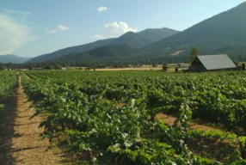
Oregon
In Oregon there are small quantities of Cabernet Sauvignon planted in the warmer southern regions of the Umpqua and Rogue Valleys

Slide 43
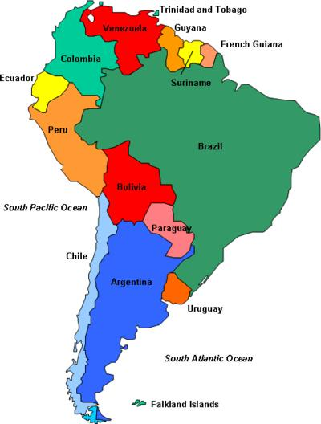
South America
Cabernet Sauvignon is grown in nearly every South American country including Chile, Argentina, Bolivia, Brazil, Peru and Uruguay

Slide 44
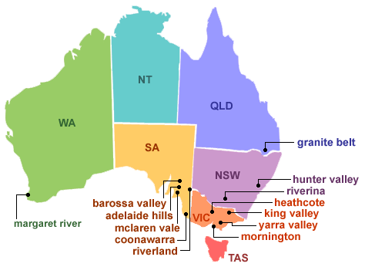
Australia
Today Cabernet Sauvignon is the second most widely planted red wine grape in Australia, following Shiraz with which it is often blended

Slide 45
the Coonawarra region first brought international attention to Australian Cabernet Sauvignons with intense fruit flavors and subtle minty notes
The Margaret River region wines are tightly structured with pronounced black fruit notes
the Barossa Valley produces big, full bodied wines
wines of the Yarra Valley are noted for their balance in acidity, tannins and fruit flavors.

Slide 46
Ability to Age
In the 19th and 20th centuries, a large part of Cabernet Sauvignon's reputation was built on its ability to age and develop in the bottle. In addition to softening some of their austere tannins, as Cabernet wines age new flavors and aromas can emerge and add to the wines' complexity.

Slide 47
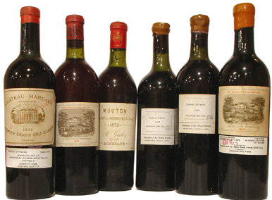
In Bordeaux, the tannins of the wines tend to soften after ten years and can typically last for at least another decade-sometimes longer depending on the producer and vintage. Some premium examples in favorable vintages have the potential to last for over a century

Slide 48
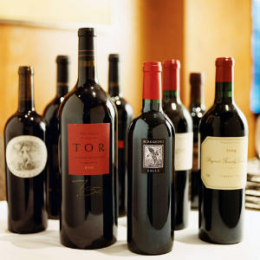
Overall, the majority of Californian Cabernets are meant to be approachable after only a couple of years in the bottle but can still have the potential to improve further over time.

Slide 49
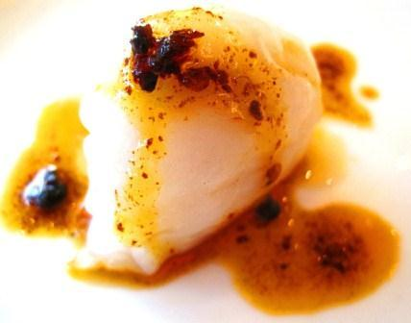
Pairing with Food
Cabernet Sauvignon is a very bold and assertive wine that has potential to overwhelm light and delicate dishes.

Slide 50
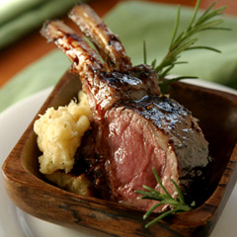
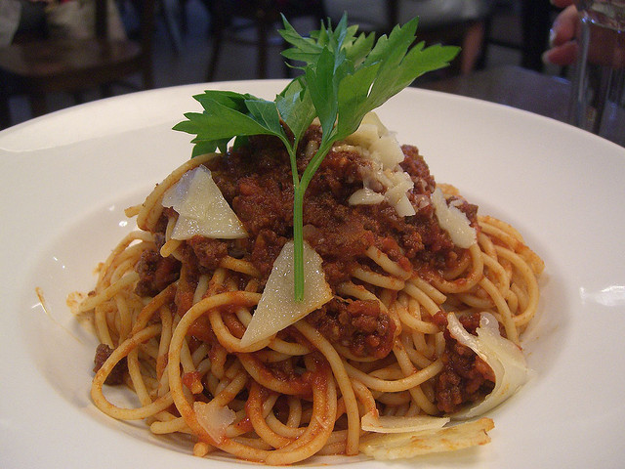
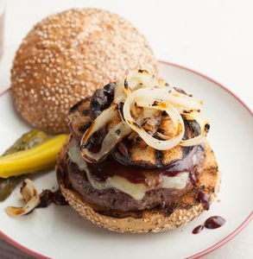
The wine's high tannin content as well as the oak influences and high alcohol levels associated with many regional styles play important roles in influencing how well the wine matches with different foods

Slide 51
Milder spice, such as black pepper, pair well due to their ability to minimize the perception of tannins—such as in the classic pairings of Cabernet Sauvignon with steak au poivre and pepper-crusted ahi tuna

Slide 52
Old World wines, such as Bordeaux, have earthier influences and will pair better with mushrooms.

Slide 53
Cabernet Sauvignon has the potential to pair well with bitter dark chocolate, it will not pair well with sweeter styles such as milk chocolate

Slide 54
The wine can typically pair well with a variety of cheeses, such as Cheddar, mozzarella and Brie, but full flavored or blue cheeses will typically compete too much with the flavors of Cabernet Sauvignon to be a complementary pairing

