Slide 1
February 2021 Town Hall Meeting
February 12, 2021

Slide 2
Overview
Kudos
Return to Work Planning
Budget & Legislative Priorities
ctc-Link February Conversion
Safety concerns
Q&A

Slide 3
Kudos!!
Black Solidarity Think Tank Framework and Take 6
Black Solidarity Think Tank partnership with Professional Development Day
College Success Course
Course and Program Data Dashboard
English Directed Self-Placement
Expanded funding for Student Services

Slide 4
Return to Work Planning
Governor has changed the phases and the State Board just issued a new brief on how those phases relate to higher education Higher education reopening plan (sbctc.edu)
K-12 districts slowly returning to in person instruction with youngest students, given March 1 deadline
We are planning for turning the dial a little in Spring with in person study tables, computer lab and limited F2F student services
Summer/Fall planning depends on vaccine rollout
March survey about work preferences as we turn the dial
Notes:
Reminder about visiting campus - Submit return to work plans if new personnel will be returning to campus
Technology distribution continuing to happen through library with online sign-up
State Agencies clarifying when their essential personnel and personnel serving the public qualify for vaccine distribution in the state distribution plan

Slide 5
Budget & Legislative Priorities
Legislative session under way. As expected much debate over proposed investments/reductions as well as introduction of new taxes/revenue proposals. Still proposing reductions this fiscal year
Authority to offer computer science bachelors degree
International, Running Start and general enrollment are all down so projected revenue loss is even worse than expected
We are working with student services team to provide enrollment and financial aid support to help enrollment
One time funding (stimulus) are keeping us from having to make additional cuts this year.
Resource allocation committee is finalizing budget principles for 2021-22 budget
Notes:
Governor’s budget released in December includes new investments to advance equity ($23M), job skills training ($10M) and expand high demand degree production ($4M). It also includes a number of compensation-related reductions including cancellation of 2020 wage increases ($40M), furloughs ($66M), health insurance rate increases ($3.8M) and suspension of I-732 COLAS ($25M)

Slide 6
ctcLink is Here!
CTC go-live February 22nd
Many of us are involved in training and user testing, so remember patience and grace for colleagues
Reminder about non-service dates
Jan 15–March 8 E-forms disabled and no new requisitions in NeoGov
Feb 8–March 1 No financial aid, scholarship or emergency funding disbursements
Feb 10–March 1 Cashiering closed
Feb 12 TLR for 2/1-16 must be entered
Feb 12-22 Admissions portal will close
Feb 22-26 Payroll, Accounting, College Business Offices, Enrollment & Registration, Admissions, and Financial Aid Offices closed on all campuses

Slide 7
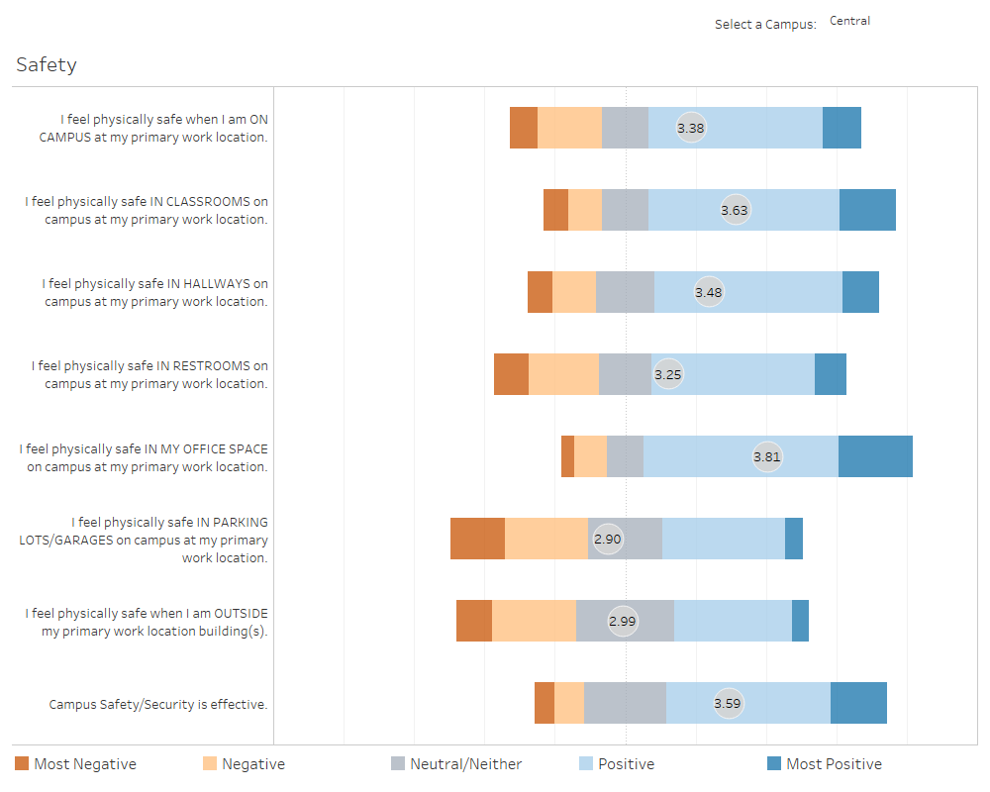

Slide 8
Campus Safety – Action Being Taken
New and upgraded cameras, especially on Nagle
Brighter lighting around perimeter of campus & at garage, also improved lighting in stairwells
Overnight security patrols to discourage graffiti
Offering escorts after dark to garage or transit stop
Security & Info Central staff shirts and jackets standardized – encourage all staff to wear nametags
Public information including personal safety courses, helpful tips and tactics
Implementation of RS2 card system

Slide 9
Announcements
Virtual Campus-Wide Lunch with the President on Feb 23 at noon
Scholarship applications open on February 15
March 25 launch of Equity Can’t Wait Campaign
Seattle Promise application closed 2/1 with 2100 applications

Slide 10
Thank You
Q & A
This is being recorded and will be available on our website

