Slide 1
2021-2022 Town Hall Meeting for Faculty & Staff
May 19, 2022

Slide 2
Land Acknowledgment
On behalf of Seattle Central College, I acknowledge the land on which we stand today as the traditional home of the Coast Salish people, the traditional home of all tribes and bands within the Duwamish, Suquamish, Tulalip and Muckleshoot nations. Without them, we would not have access to this gathering and to this dialogue. I ask that we take this opportunity to thank the original caretakers of this land who are still here.
Notes:
Kao will read

Slide 3
Labor Acknowledgement
Today in this Present Moment, we honor the survival, the adaptations, the forced assimilation, and the resilience and creativity of Native peoples – past, present, and future.
We encourage participants to consider their responsibilities to the people and land, both here and elsewhere, and to stand in solidarity with Native, Indigenous, and First Nations People, and their sovereignty, cultural heritage, and lives.
We recognize that enslaved and indentured peoples were forced into unpaid and underpaid labor in the construction of this country, state and city.
To the people who contributed this immeasurable work and their descendants, we acknowledge our/their indelible mark on the space in which we gather today.
It is our collective responsibility to critically interrogate these histories, to repair harm, and to honor, protect, and sustain this land.
Notes:
Dr. Wendy will read

Slide 4
Overview
Kudos
Updates
Q&A

Slide 5
Kudos
Congratulations to the Phi Theta Kappa Society 2022 All-Washington Academic Team
Shane Taylor
Helene Liobard
Alice-Marie Van Norman

Slide 6
Campus Events
Faculty Forum on Remote Teaching and Learning Survey – May 25 from 2:00-3:00pm
District Tenure Reception – May 25 from 4:30pm-6pm
Location: Georgetown campus
Employee Service Awards – May 26 from 3pm-4:30pm
Commencement – June 21 from 5pm-7:15pm
T-Mobile Park

Slide 7
New Hires
Eustace Mazila - Springboard8
Christy Trimble – Facilities
Reno Zeta – Student Support Services
Notes:
-Oo-kuh-ng-ee Chew-wuh-l
-Susan Joo
-Nathaniel Meskel (Meh-skl)

Slide 8
Interim President Search Update
By May 20: a) Applications due; b) Search Committee formed
By June 10: a) Complete review of applications; b) Semi-finalists selected and interviewed; c) 1-3 finalist(s) identified and announced.
By 6/24: a) finalist(s) interviewed by the Search Committee, Chancellor’s Executive Cabinet, and 1-2 trustees and chancellor b) Finalist(s) Open Forums held, and feedback collected.
By June 30: a) The top candidate’s reference checked; and) Interim President announced.
By August 1: Interim President takes office (the length of the Interim President is dependent on negotiation, between 1-2 years).

Slide 9
Update on status of programs
Working with different groups to find long term, sustainable funding
Seattle Colleges Foundation
Legislators
Local and Regional Leaders – Industry and Government
State Board for Community and Technical Colleges: convening a work group
Seattle City Council $1M investment for SMA
Notes:
Dr. Harden:
Here are my notes
Foundation is doing drives to find funds to support these programs
Chancellor and others are working with Legislators = colleges do not do college/college asks, we do is as part of the SBCTC system
Working with industry and local leaders

Slide 10
Budget Update
Operating Budget Summary | 21-22 Budget | 22-23 Budget | Change | %
Revenue | 53,532,732 | 56,415,277 | 2,882,545 | 5.4%
Expense | 66,222,587 | 60,581,548 | (5,641,039) | -8.5%
Net Revenue (Loss) | (12,689,855) | (4,166,271) | 8,523,584 | -67.2%
Notes:
The budget that was approved by the Board of Directors for FY21-22 was with a 12M overspend. We would have 3 years to balance and this is with a 2.5% cut from FY20-21, 5% for FY 22-23 and 2.5% for FY23-24. We were able to meet that by reducing our expense by 5.6M. Due to our enrollment going up and expenses going down, we are showing a total change of 8.5M change from FY21-22. Eventually, we will need to balance to our total revenue and start building our Fund Reserve.

Slide 11
Budget Update
 | Central | North | South | District
20-21 Enrollment Revenue Change | -17% | -7% | -16% | N/A
20-21 Employee Headcount Change | -7% | -16% | -11% | -14%
20-21 S/F Ratio | 15.16 | 17.72 | 20.66 | N/A
21-22 Projected Net Revenue (Loss) | (9,227,697) | (3,935,559) | 230,023 | N/A
Notes:
Another point of good news is that even though the board approved an overspend of 12M, we are projecting our overspend to be closer to 9.2M. It’s still significant, but it’s almost 3M in savings that we’re seeing at the end of this coming year. I want to take a moment and thank the Budget Managers, Dr. Rockhill, VP Lezheo and Dr. Harden for the incredible work to bring us to this place. We are moving in the right direction. With the money that we are saving, why are we closing programs? Because we are still not in a place of sustainability. Those high cost programs are going to take away the efforts done to continually and effectively support our school. As our school opens up more (post covid world) and resources are needed to support on campus activities, we won’t have the funds to continually support these high cost programs unless we change the way we approach budgets. One way in which we’re doing that is by having a 80% minimum for classes, another way is reducing our Goods & Services expenditures. Ways big and small are being approached and implemented. Much of that is thanks to you.

Slide 12
Summer 2022 Student Services Hours of Operation
Student Services will be open to the public for in-person services from 8:00am-5:30pm, Monday - Thursday.
On Fridays, all services will be offered virtually from 8am-12pm with the exception of Financial Aid, Testing, and Accessibility Resource Services.
Certain departments may have limited staffing, so please check department websites for specific in-person and virtual services. Note: due to staffing shortage, Counseling Center will be fully virtual until further notice.

Slide 13
Instruction Update: Enrollment Trends Summer and Fall Student Enrollment starts May 16

Slide 14
Enrollment (FTEs)
Students | Spring 2022 | Winter 2022 | Spring 2021
Total FTEs: | 4,009 | 3,954 (+1%) | 4,229 (-5%)
State funded: | 3,026 | 3,018 (+0%) | 3,208 (-6%)
International: | 344 | 331(+4%) | 410 (-16%)
Running Start: | 375 | 423 (-11%) | 463 (-19%)
*Updated 17 May 2022

Slide 15
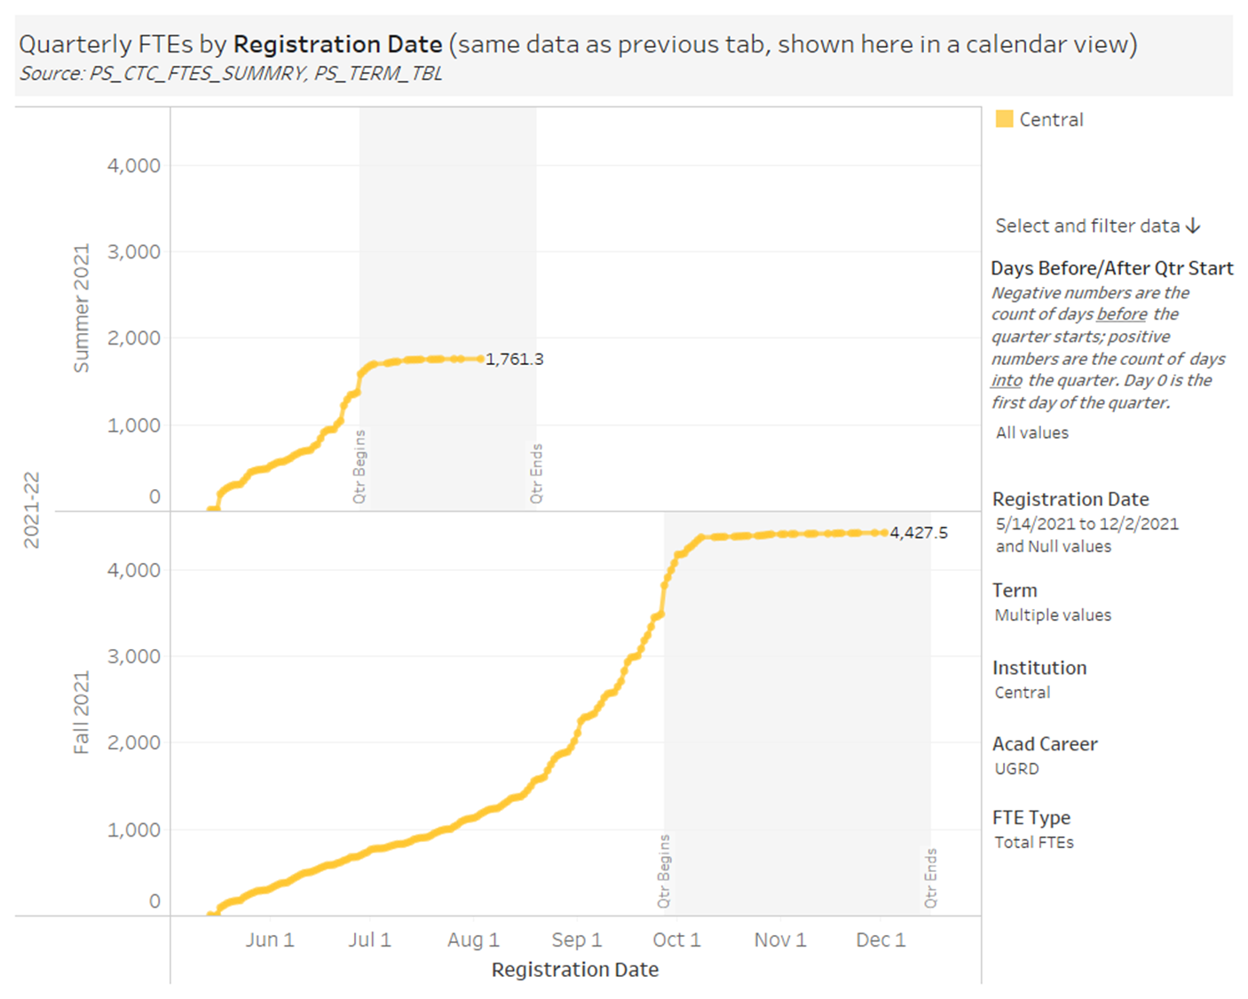
1,761
4,427

Slide 16
Thank You
Q & A
This is being recorded and will be available on our website within 4 business days

